Slide 1
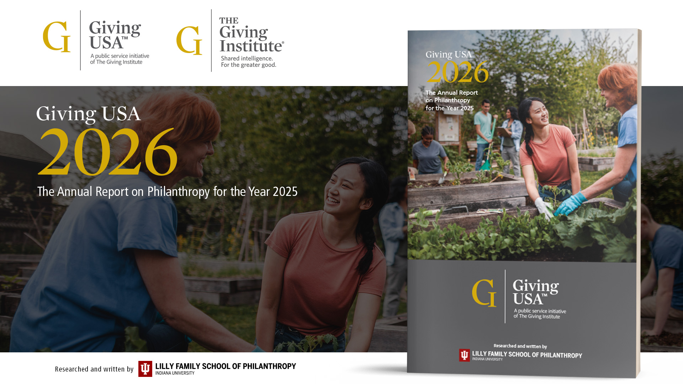
akoyaGO Webinar
The State of Philanthropy
October 29, 2026

Slide 2
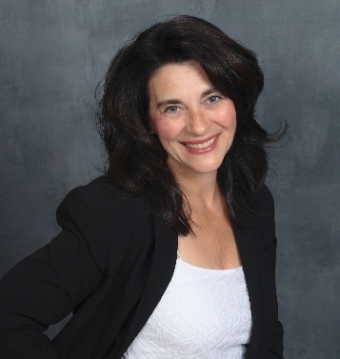

Giving USA 2026: Charitable giving in 2025
Christina Daniken
Editor-in-Chief of Giving USA
Indiana University Lilly Family School of Philanthropy
Giving USA is researched and written by the Indiana University Lilly Family School of Philanthropy and published by the Giving USA Foundation

Slide 3


Total charitable giving reached $617.20 billion in 2025
  Total giving surpassed $600 billion for the first time
  Showed 5.7% growth in current dollars from 2024 (3.0% in inflation-adjusted dollars)
  New high in current dollars
  BUT 2021 remains the highest year on record for charitable giving in inflation-adjusted dollars
  Strong financial markets and other economic factors associated with charitable behavior drove giving

Slide 4
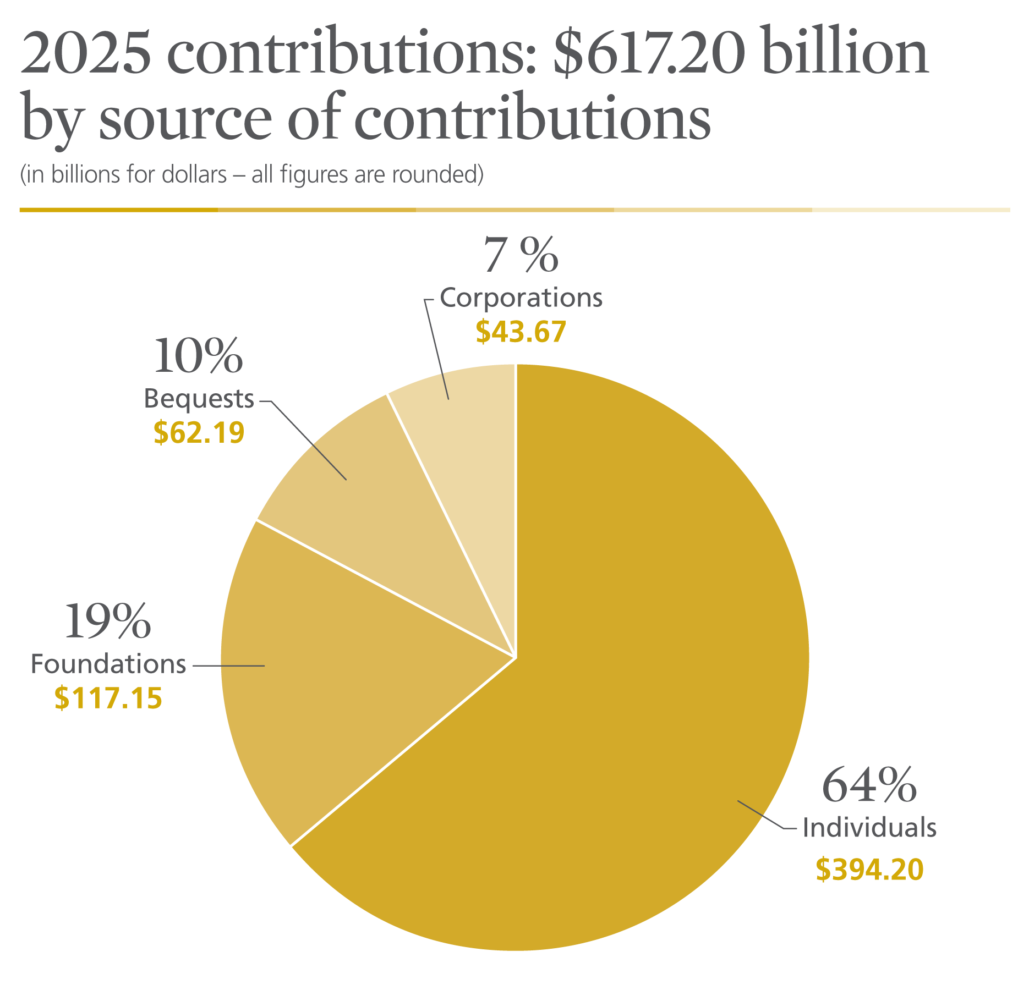
Notes:
Giving by individuals comprised 64 percent of total giving in 2025.¹
Giving by foundations—which includes grants made by independent, community, and operating foundations—amounted to 19 percent of all gifts made in 2025.²
Giving by bequest accounted for 10 percent of all gifts made in 2025.
Giving by corporations comprised 7 percent of total giving in 2025.

Slide 5
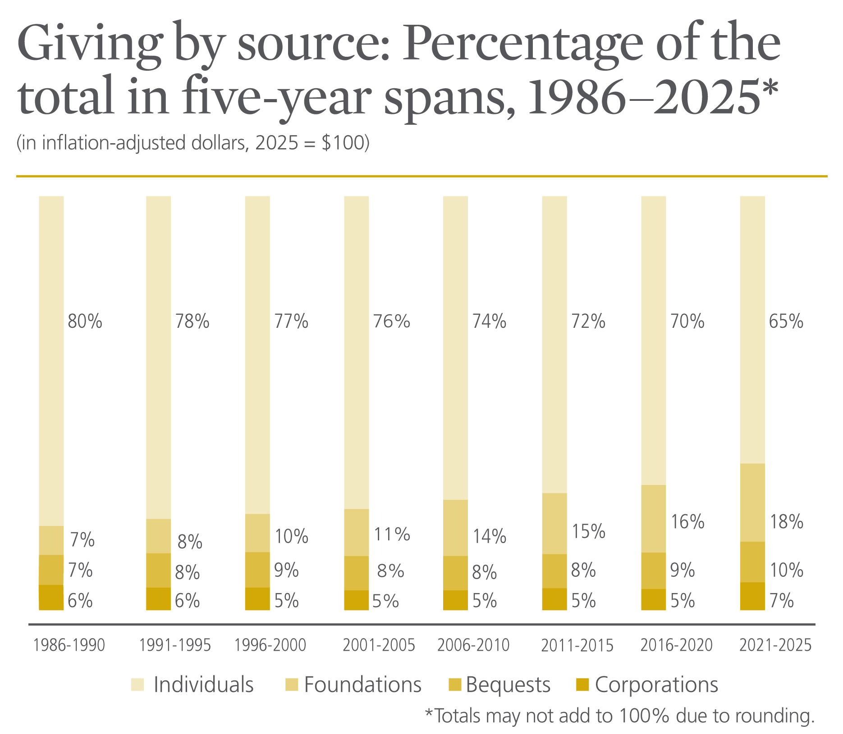
Notes:
Giving by individuals has declined considerably as a percentage of total giving over the last 40 years, from 80 percent in the first five-year period beginning in 1986 to 65 percent in the last five-year period beginning in 2021.²³
Giving by foundations has grown substantially as a percentage of total giving over the last 40 years, from 7 percent in the first five-year period to 18 percent in the most recent five-year period.
Giving by bequest has captured between 7 percent and 10 percent of total giving over the last 40 years, with its highest point in the five-year period beginning in 2021.
Giving by corporations has reached a high in the most recent five-year period beginning in 2021 at 7 percent. Prior to this, giving by corporations had been at 5 or 6 percent of total giving for every five-year period from 1986 to 2016.

Slide 6

Giving by all 4 sources grew in current dollars

Slide 7
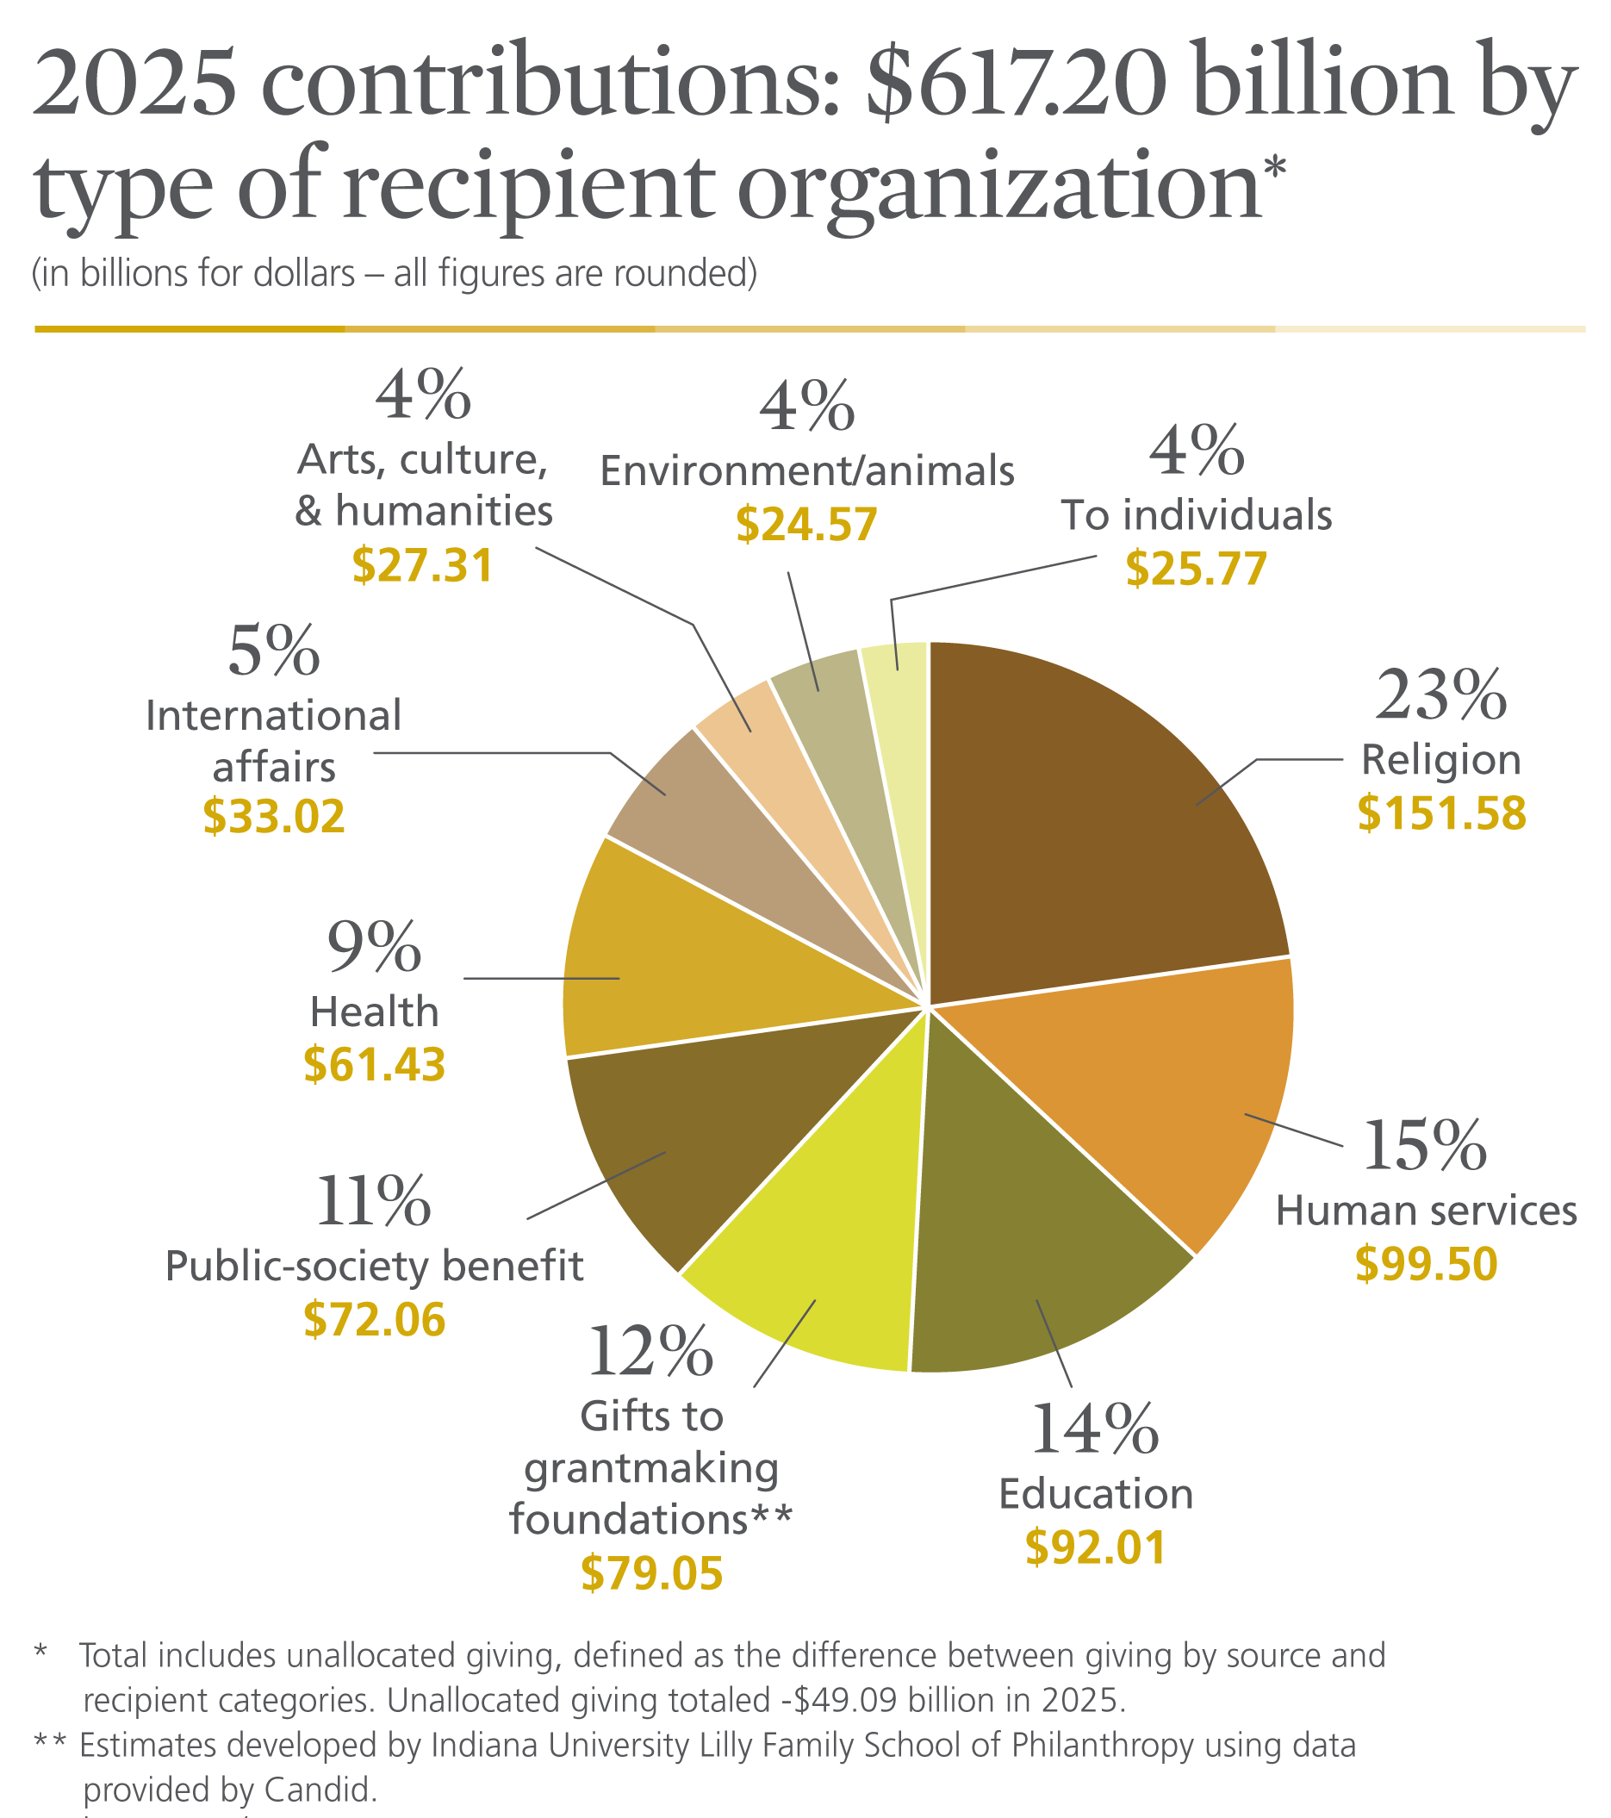
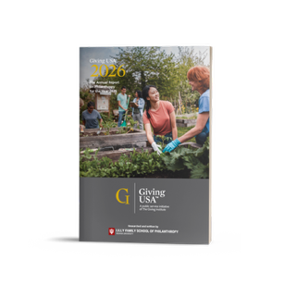
Notes:
Religious organizations received the largest share of charitable dollars in 2025, at 23 percent of total giving.³
Human services organizations comprised the second-largest portion in total gifts received, at 15 percent of the total in 2025.
The education subsector ranked third in total gifts received, at 14 percent of charitable dollars in 2025.
Gifts to grantmaking foundations—including independent, community, and operating foundations—comprised the fourth-largest share of charitable dollars in 2025, amounting to 12 percent of total giving.
The public-society benefit organizations subsector ranked fifth in total gifts received, at 11 percent of charitable dollars in 2025.
Comprising the sixth-largest portion of charitable dollars in 2025, the health subsector received 9 percent of total giving.
The international affairs subsector ranked seventh in total gifts received, amounting to 5 percent of charitable dollars in 2025.
Arts, culture, and humanities organizations received the eighth-largest portion of charitable dollars in 2025, at 4 percent of total giving.
Comprising the ninth-largest share of charitable dollars in 2025, the environment and animals subsector received 4 percent of total gifts.
Additionally, gifts made directly to individuals amounted to 4 percent of total giving in 2025.

Slide 8
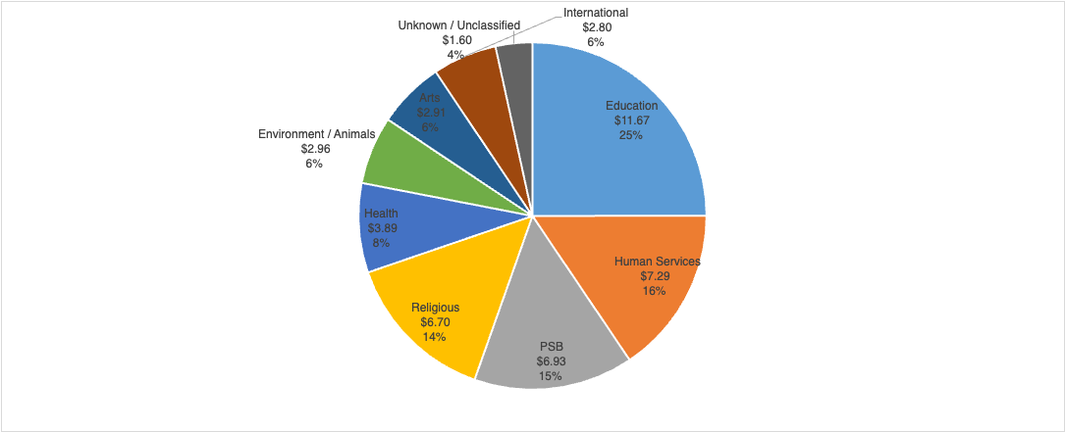
Gift distributions from donor-advised funds differs from that of overall giving
Grant dollar distributions from donor-advised funds by subsector (in billions of dollars):
Data: Indiana University Lilly Family School of Philanthropy original research using IRS Form 990 Schedule I data and granting data received from DAF-sponsoring organizations. All figures are rounded and may not sum to 100.

Slide 9
Giving to foundations declined from the all-time high in 2024,
BUT 2025 is still third highest year on record
Giving to foundations declined by 16.2% in 2025 in current dollars
BUT giving to foundations increased 36.5% from 2023–2024 in current dollars
So, despite the decline in 2025, cumulative growth in giving to foundations from 2023 to 2025 was 14.4% in current dollars

Slide 10

Issues & trends impacting foundations in 2025 and beyond…
    Roughly 1/3 of all US-based nonprofits reported disruptions in government funding in 2025*, in response:
      Private foundations began:
        Increasing annual payouts, launching emergency grants, providing loans and loan guarantees
      Community foundations are also:
        Providing emergency grants (mostly to support local health, basic needs & immigration services)
    Growing use of donor-advised funds (DAFs)
      Private foundations transferred an estimated $3 billion into DAFs in 2025**
      COF CF Insights report shows that in 2024 (most current data available):***
        60% of all Gift Dollars to Community Foundations went to DAFs
        DAFs accounted for 67% of all Community Fdn. Grant Dollars
    Foundations are increasingly collaborating across communities, issues, sectors
    Ongoing interest and concern related to:
        Bringing in the next generation
          Foundation leadership, funding causes important to Next Gen donors, new approaches to grantmaking & fundraising
        AI advancements: grant applications/application review/fundraising
*Urban Institute, How Government Funding Disruptions Affected Nonprofits in Early 2025 (October 2025)
**Institute for Policy Studies, Charity Reform Initiative, Independent Report on Donor-Advised Funds (April 2025)
***Council on Foundations, CF Insights Survey Results for FY2024 (2026)

Slide 11

Thank you!
Questions?
Full report available at:
www.givingusa.org

