Slide 1


Imagining The Future of Philanthropy
Presented by
John Long
Chairman of akoyaGO
CEO of Emergency Activation Network

Slide 2
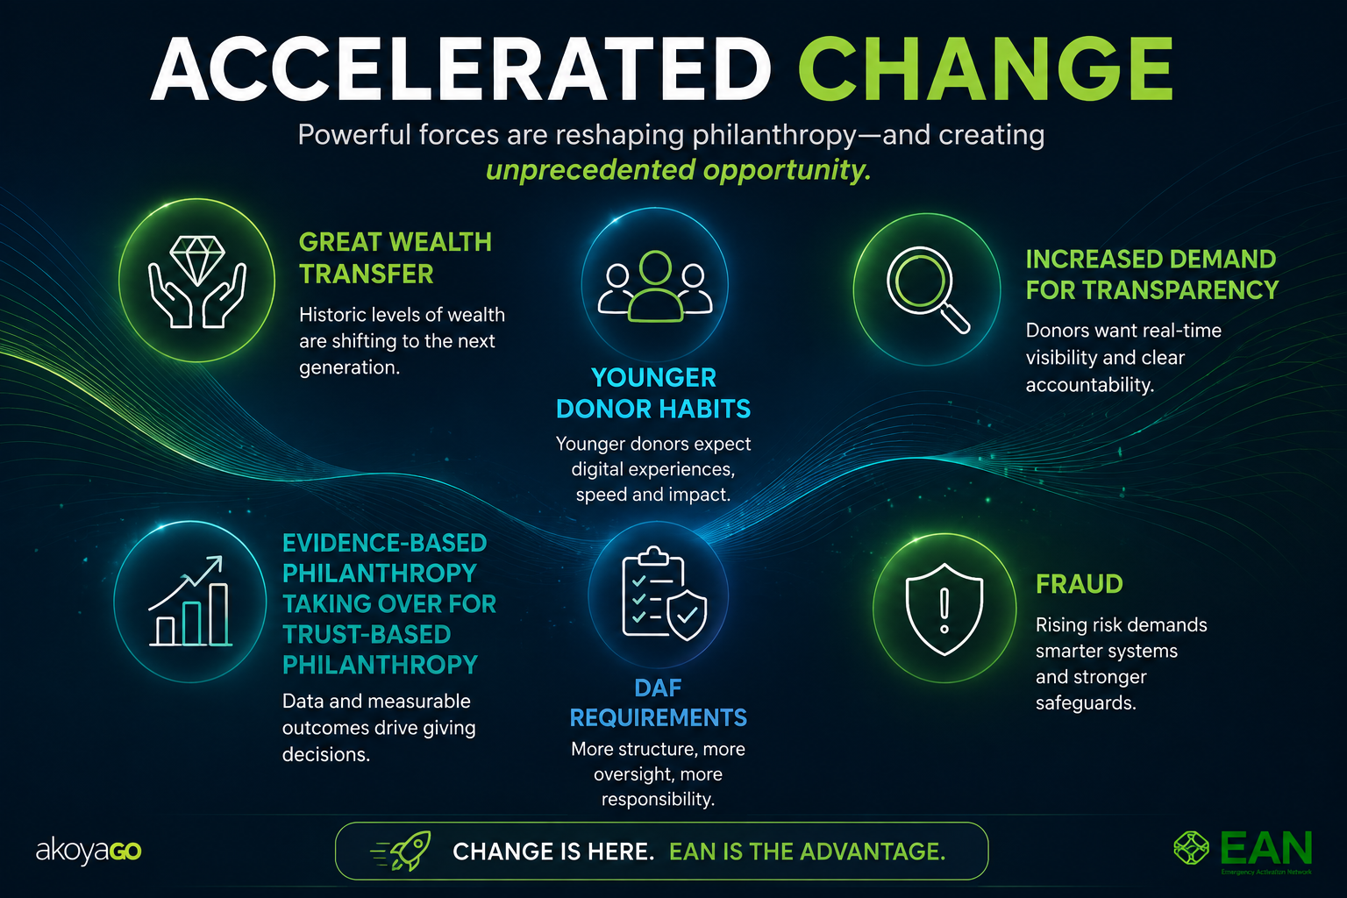

Slide 3
The Great Wealth Transfer
$124T
$18T
$40T
$617B
Generational wealth transfer projected by 2048
Expected to flow to charity over the next ~24 years
In “horizontal” transfers to surviving spouses
Record U.S. giving in 2025; bequests up 17%
What it means — from gift to impact
The largest philanthropic opportunity in history is already underway — bequests are surging, and donors increasingly expect to see the impact of what they give.
Capturing it takes more than the gift: it takes a giving chain that moves every dollar directly, transparently, and fast — all the way to the people it's meant for.
Sources: Cerulli Associates (June 2025); Giving USA 2026; Chronicle of Philanthropy
Notes:
Takeaway for the audience (community foundations): the opportunity is beginning now — three of the past four years have shown big growth in bequests, which may indicate the great wealth transfer has begun Chronicle of Philanthropy
— and it's won through long-term donor relationships and planned-giving readiness.
One note for your delivery: the projections are contested — some experts argue the financial projections are long on hype, and that most of the transfer will occur among the uber-rich www.philanthropy.com
. If you'd like, I can add a small "the skeptic's view" callout, swap in a chart (e.g., bequest growth by year), or tailor the stats toward a specific angle like women donors or DAFs.

Slide 4
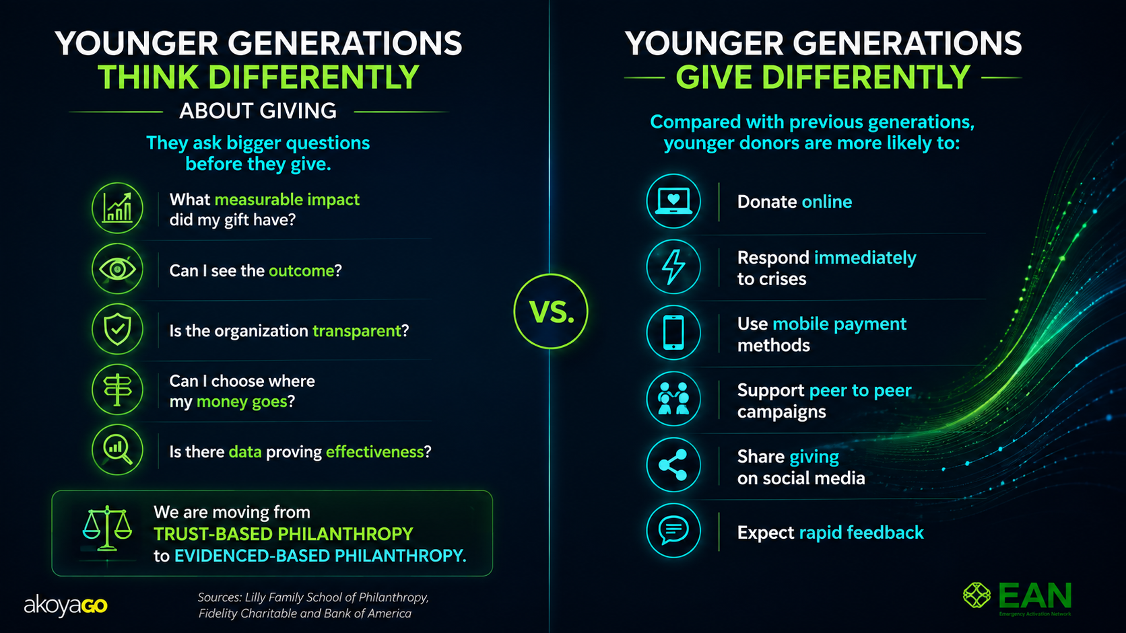

Slide 5

SURVEY INSIGHTS FROM EMPOWERED 2026
5 Trends Shaping What Comes Next
1
Instant, mobile-first giving is now the expectation.
Apple Pay, Venmo, ACH, and direct giving come up in conversation as donors look to what’s next.
2
Paper-based process is the top thing leaders want retired.
Physical checks, printed applications, and manual data entry were named more than any other outdated practice.
3
Boards are recruiting the next generation.
Leaders want younger board members, more community advisory input, and greater trust placed in staff judgment.
4
Transparency is becoming the new accountability.
Trust-based giving and strong oversight are seen as compatible, built through visibility and relationship rather than paperwork.
5
Appetite for change is strong across the sector.
Leaders rate themselves highly likely to adopt new tools and adjust processes in the year ahead.

Slide 6
SURVEY INSIGHTS
By the Numbers: A Sector Ready to Move
Paperless
90%
The most common response to “what current practice should be retired” were paper processes, including writing and sending checks.
Of respondents say they're likely to embrace new tools and adjust how they work
18 of 20 respondents rated 4 or higher on a 5-point scale
Results from foundation respondents at EMPOWERED 2026

Slide 7
LIVE POLL
What long-standing grantmaking practice do you think is overdue for retirement?
Respond in the Teams poll on your screen — results shared live.

Slide 8
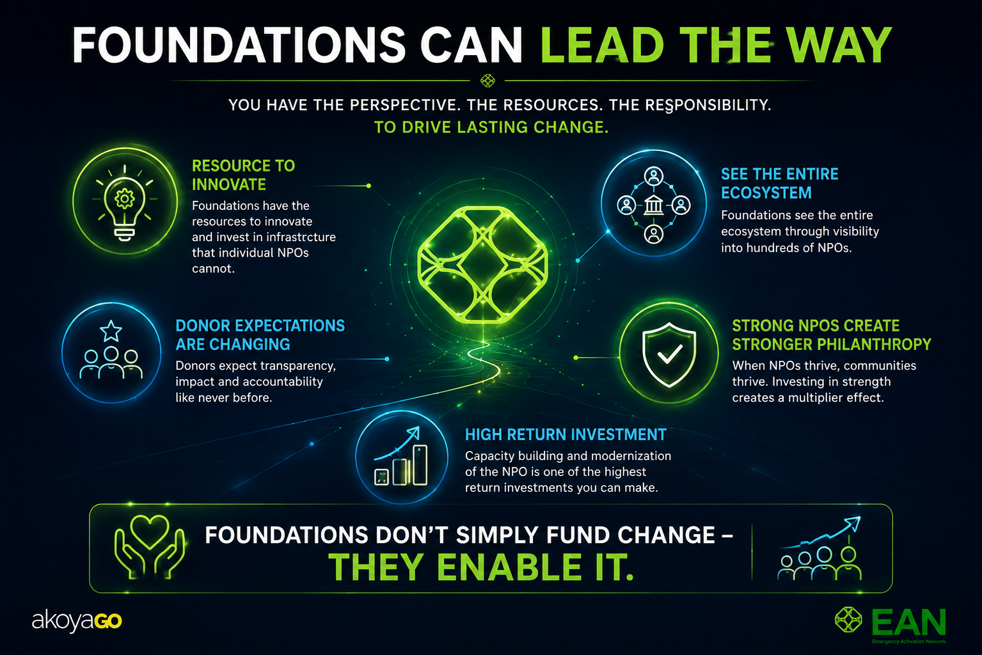

Slide 9
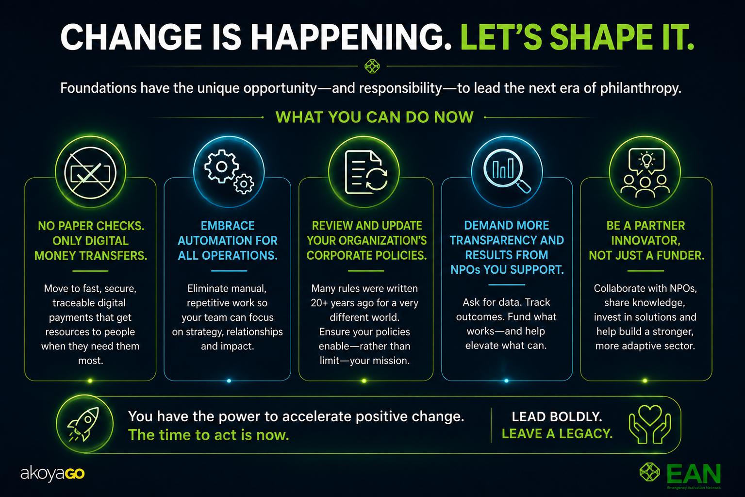

Slide 10
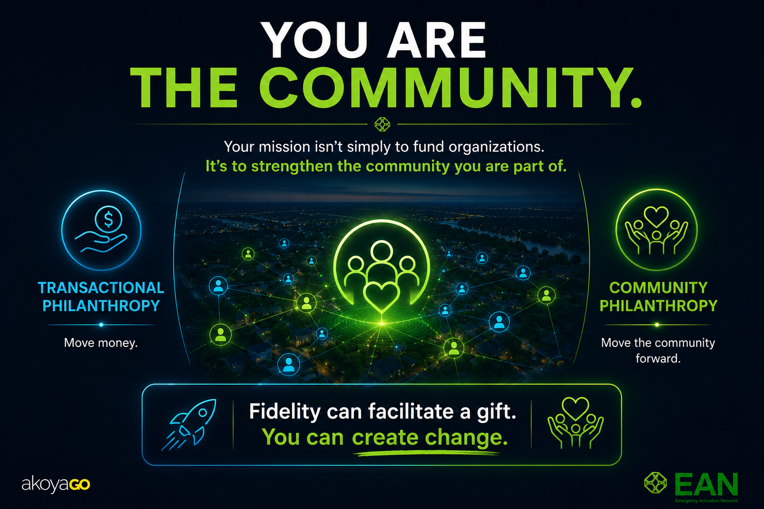

Slide 11
LIVE POLL
How likely are you to embrace new tools and adjust processes as the industry continues to change?
Respond in the Teams poll on your screen — results shared live.

Slide 12
Donor
Trusted Philanthropy.
Fully Linked.
Foundation
Non-Profit
Recipient
John Long, CEO, Emergency Activation Network

Slide 13
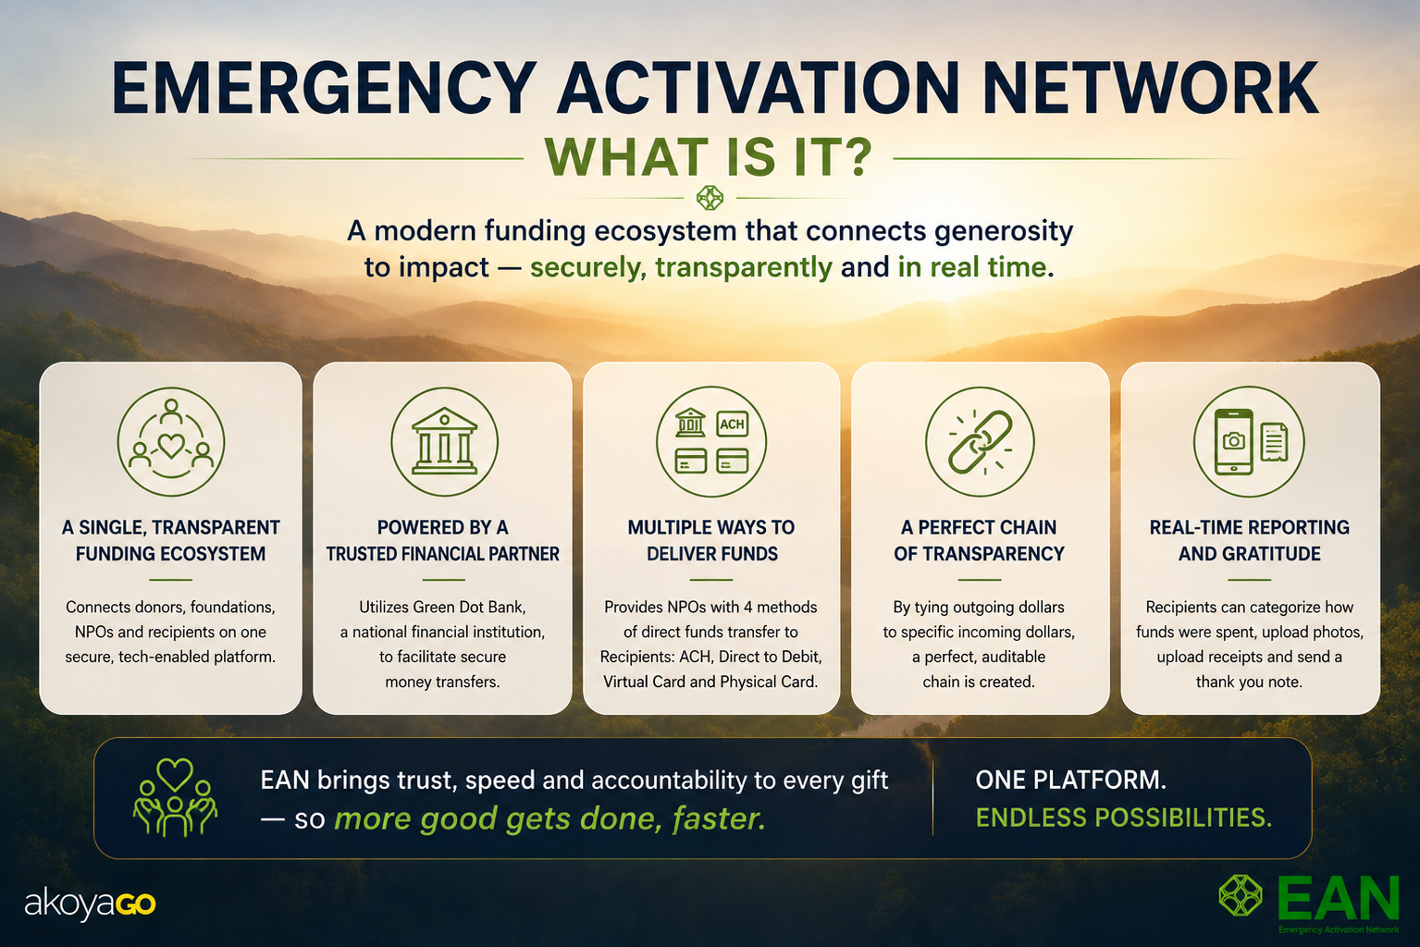

Slide 14
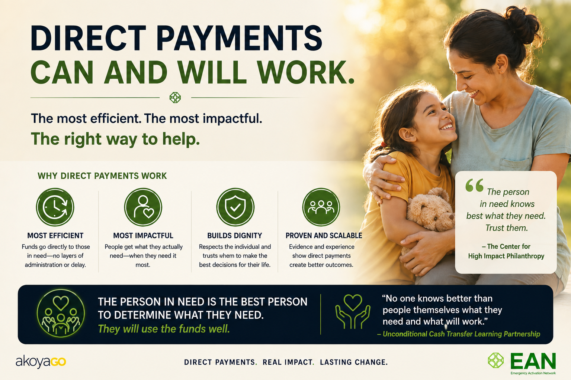

Slide 15
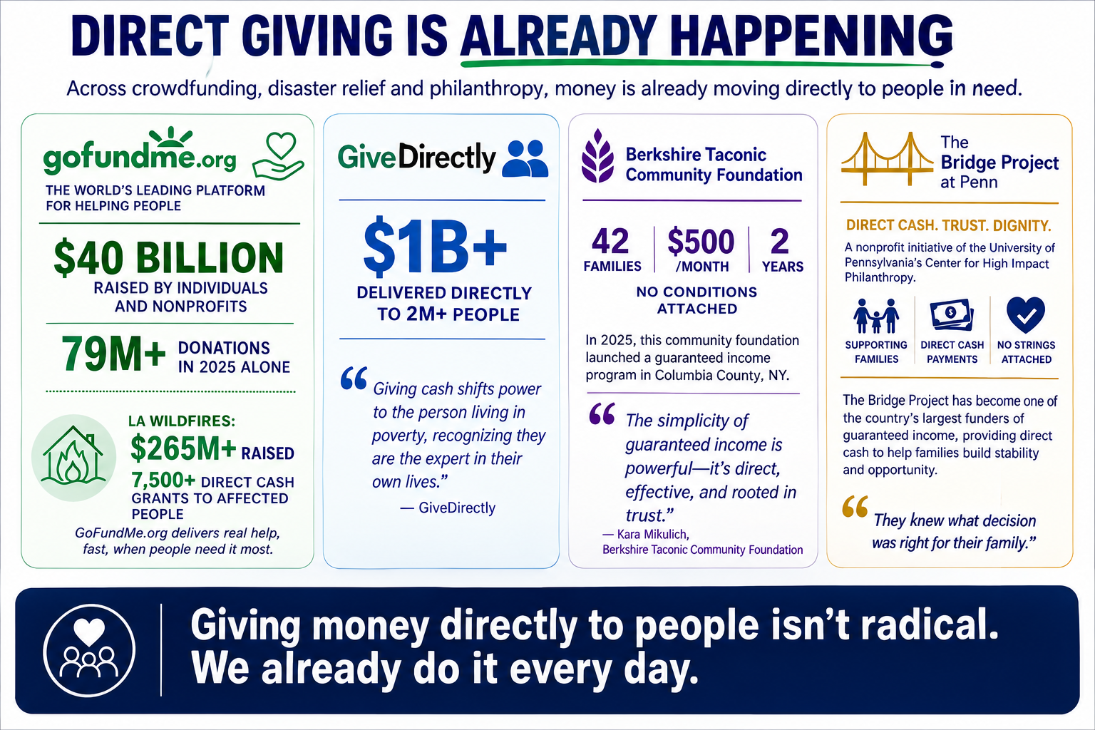

Slide 16
LIVE POLL
When you think about direct giving, what barriers do foundations or nonprofits face right now?
Respond in the Teams poll on your screen — results shared live.

Slide 17
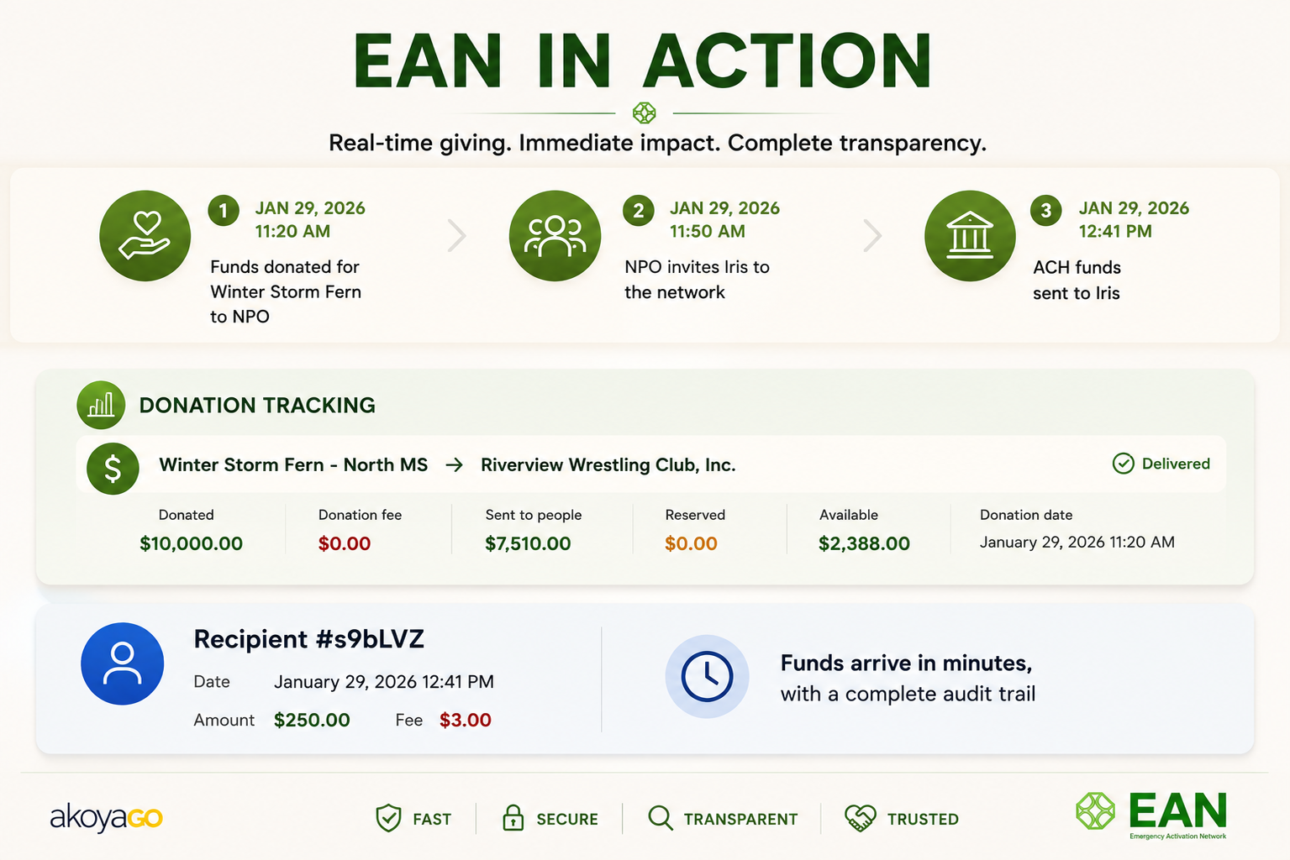

Slide 18
VERIFIED FEEDBACK
The person at the end of the chain.
“The money came in about 12 hours, by the next morning. I was able to replace the groceries we lost.”
— Brian G., Mississippi
“I received my money within 24 hours. We were able to buy groceries that we lost when the power went out.”
— Robbie J., Mississippi
“In the past, we relied on paper checks and cash, which made it difficult to track when funds arrived. EAN changes that.”
— Keith Fulcher, President, CFNM

Slide 19
ONE SOLUTION
EAN is not just for disasters.
The network that activates in an emergency runs every day.
Emergency response
Economic hardship relief
Natural disasters, storms, flooding. Funds move in hours.
Job loss, housing instability, utility crises. Verified and dignified.
Domestic violence support
Community health programs
Fast, private, and traceable. Dignity at every step.
Nutrition, medical, wellness. Every dollar documented.
Homelessness response
Direct Assistance Programs
Immediate assistance. Full compliance reporting built in.
Recurring distributions, back to school programs, winter holiday programs, utility assistance, and more.

Slide 20
Donor
EAN LIVE
Live demo.
Foundation
We're going to run the full giving chain in real time.
Non-Profit
Donor → Foundation → Non-Profit → Recipient
Watch the timestamps. Watch the Tracking Report build.
Recipient

Slide 21
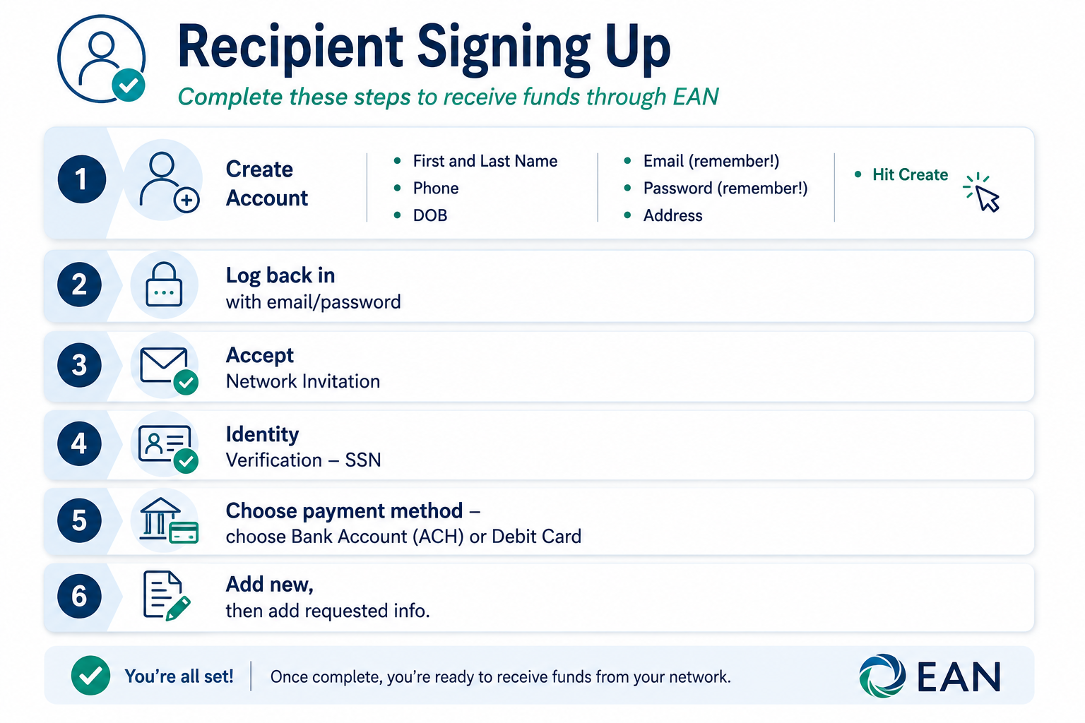

Slide 22
That just happened.
Donor → Foundation → Non-Profit → Recipient
From intent to impact. In real time. In this room.
Timestamped
Fast delivery
Audit trail complete
Impact in real time

Slide 23
LIVE POLL
What should philanthropy look like in 5 to 10 years?
Respond in the Teams poll on your screen — results shared live.

Slide 24
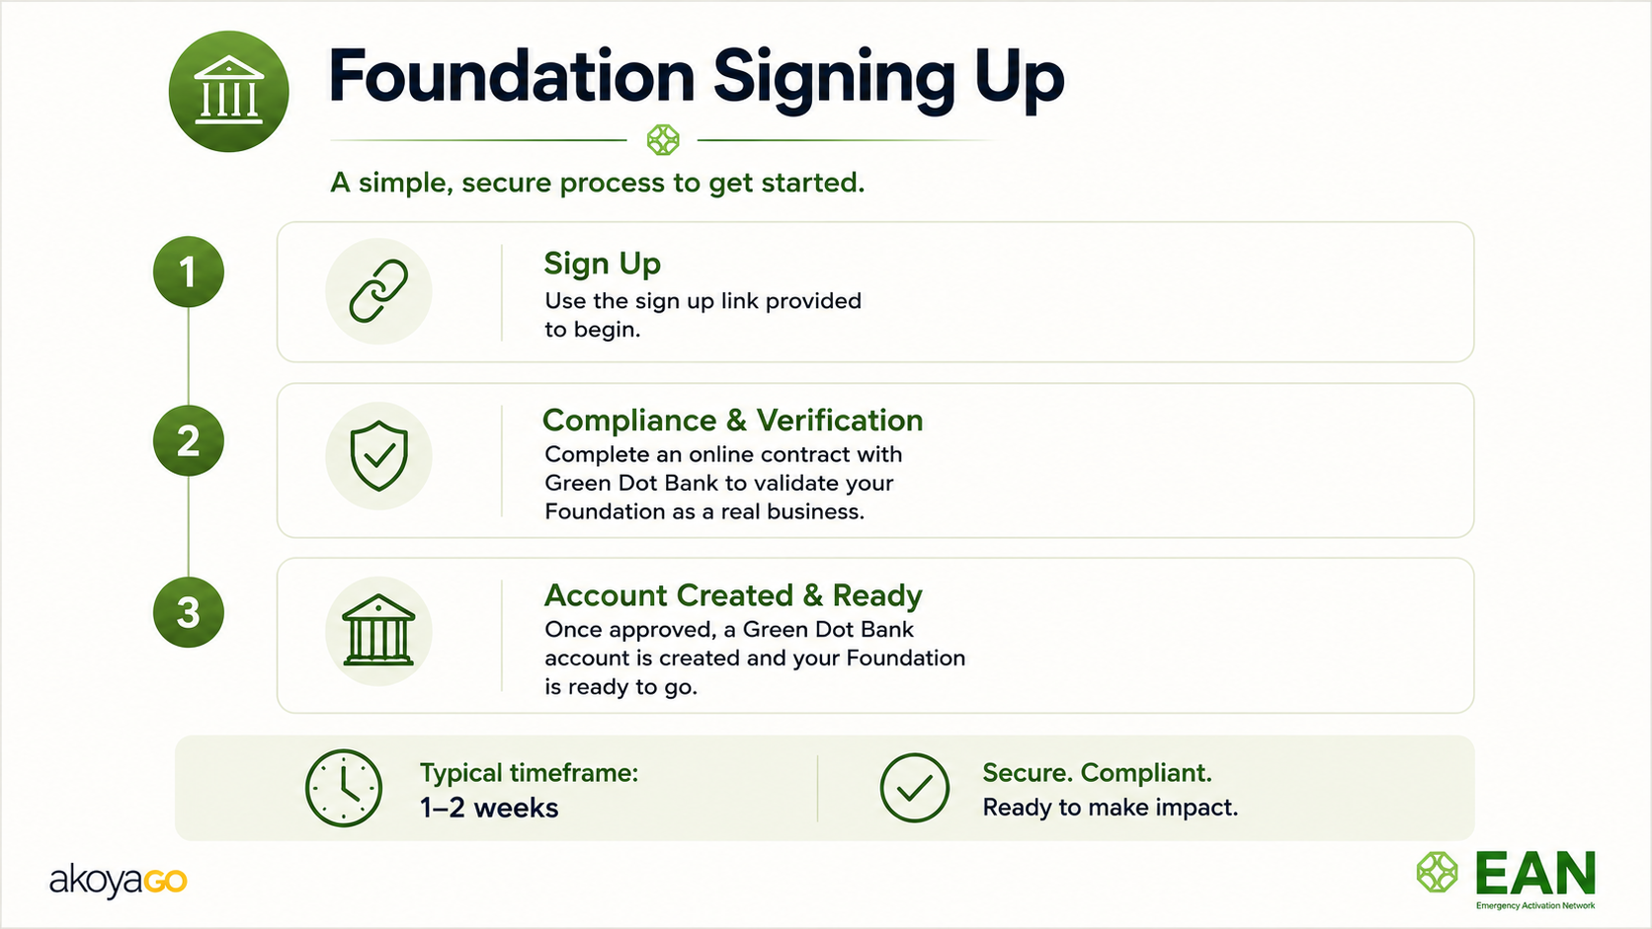

Slide 25
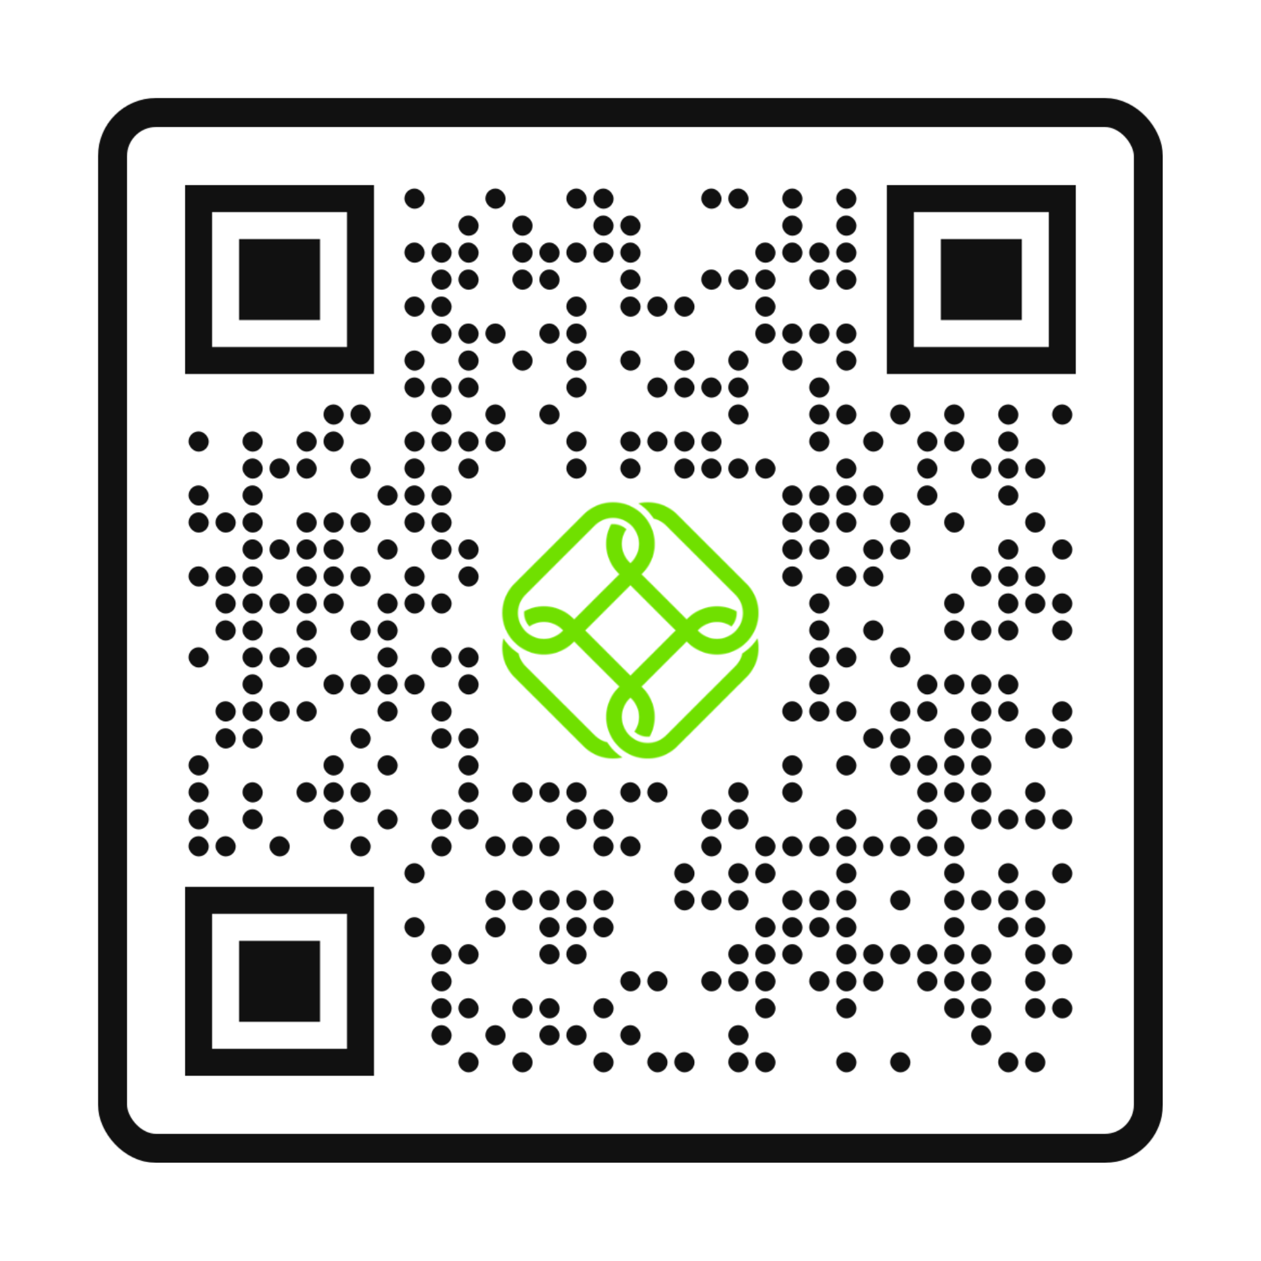
JOIN THE NETWORK
Ready to get linked? Connect with us!
01
Connect with me: john@akoyago.com 612-750-4798 cell
02
Join the network
Sign up, follow us on socials, and register for the webinar by scanning the QR Code.

