Slide 1

MOVE GENEROSITY FORWARD: MAXIMIZING GIVING
DAY DONATIONS IN YOUR
COMMUNITY
akoyaGO Webinar
featuring GivingTuesday

Slide 2

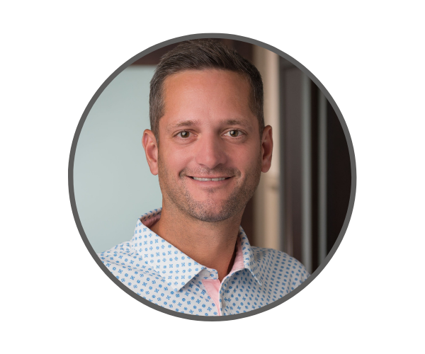
Mike Scoville
Director of Partnerships & Growth
701.320.8561
mike@akoyaGO.com
Mike Scoville
Director of Growth and Partnerships
701.320.8561
mike@akoyaGO.com

Slide 3

Maximizing Giving Day Donations in Your Community
Leading your community to more generosity with a Giving Moments

Slide 4
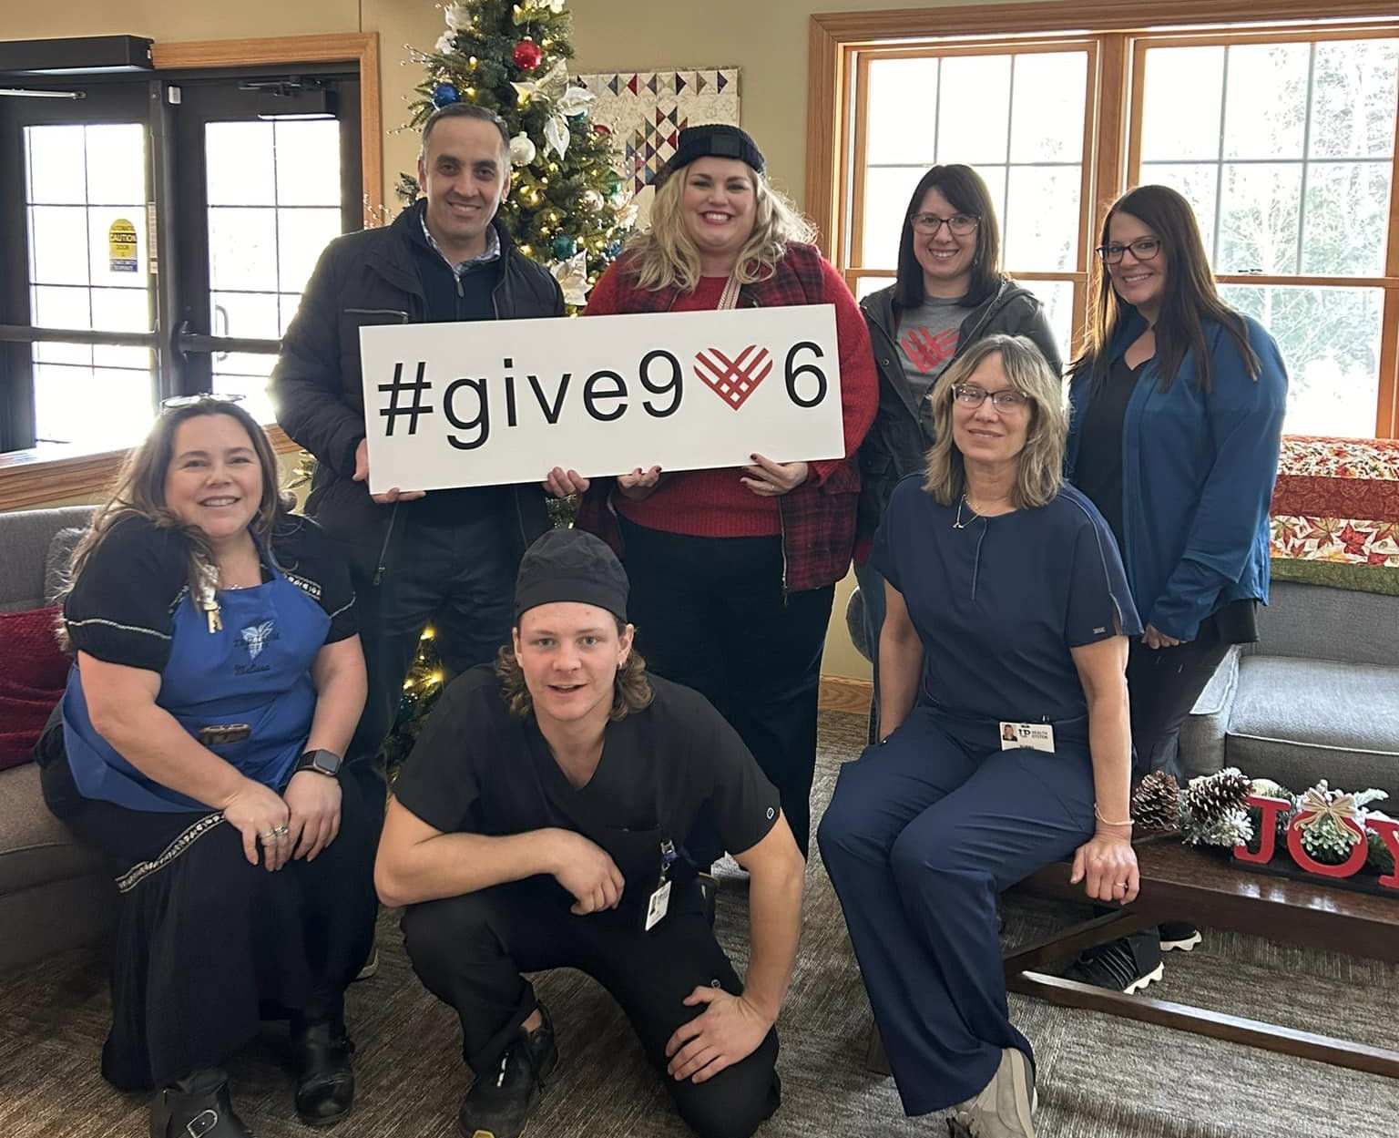
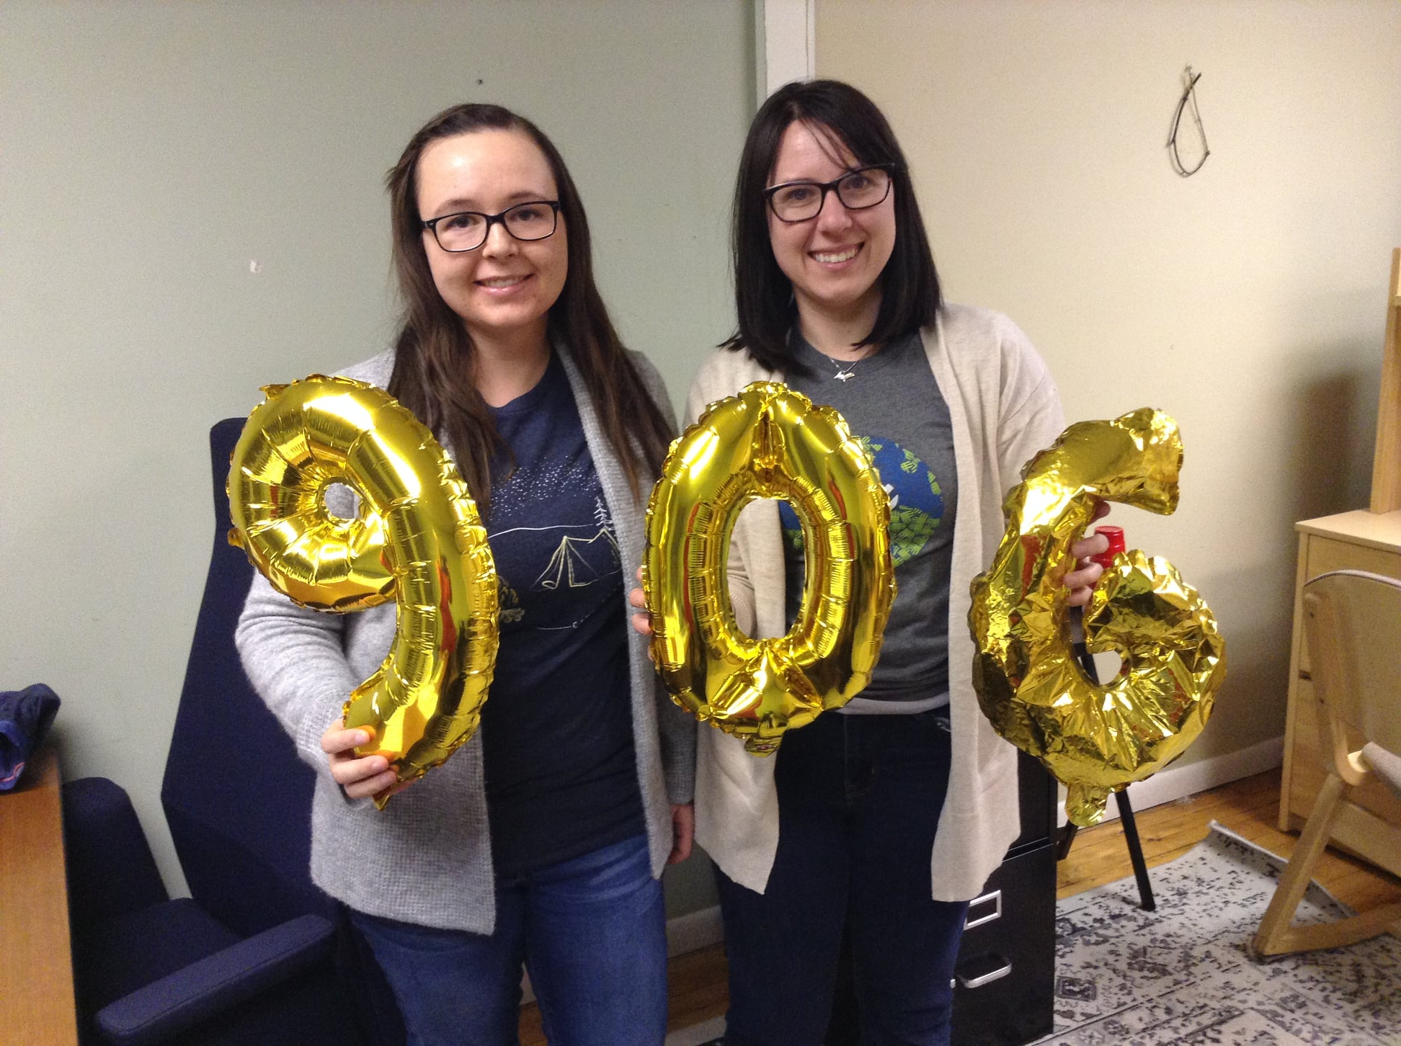
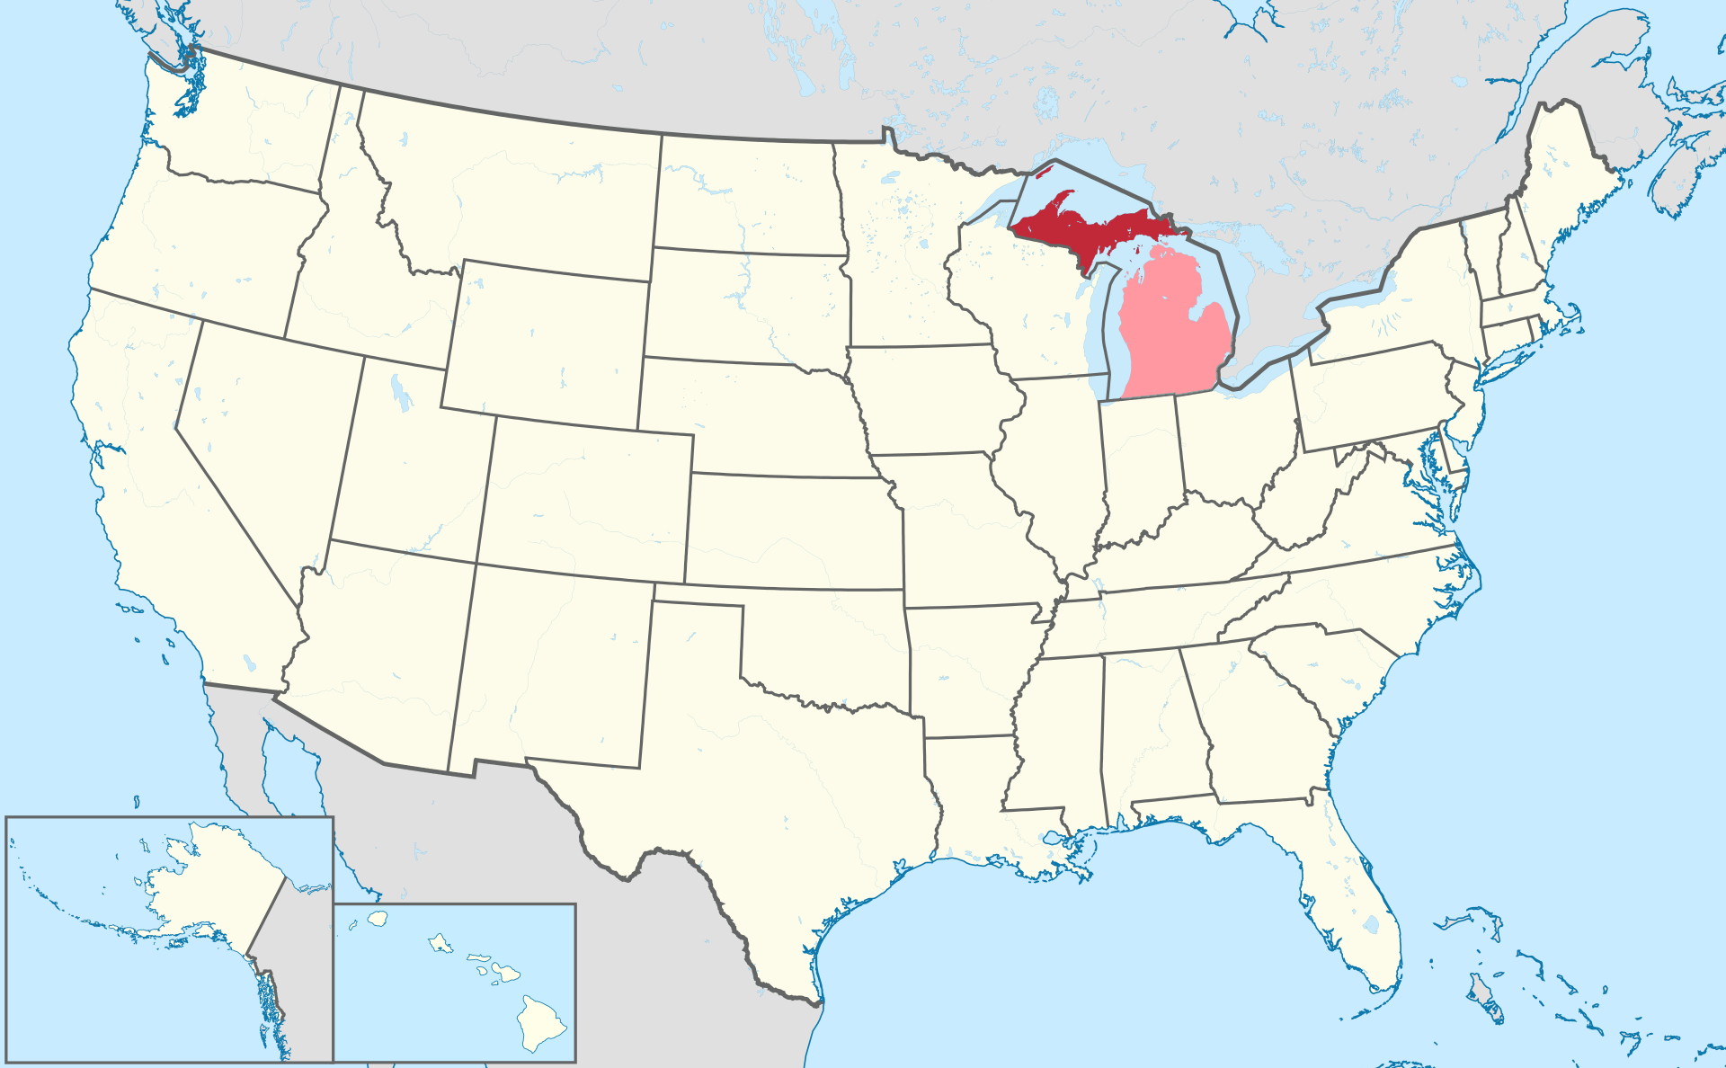
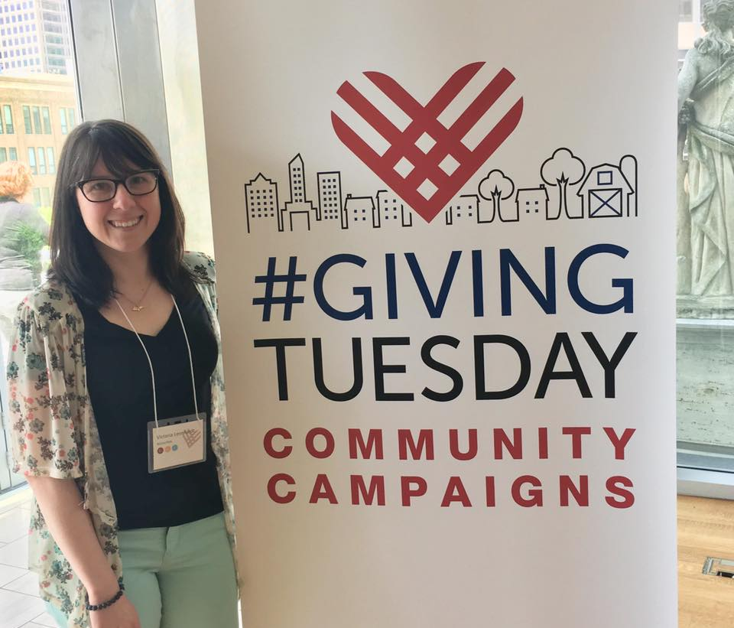
Hi! I’m Victoria!
I am so happy to be here with you today!
I’m a Community Foundation Board of Trustees Member! I’ve been a nonprofit capacity builder, grant manager, start-up coach, board chair, volunteer, community fundraiser, generosity promoter, and GivingTuesday campaign leader.
Notes:
I’m Victoria and I’m on the GivingTuesday US & Canada Hub team where I work with adults and youth in the US that organize GivingTuesday projects that impact beyond their own organization. I’m from a small town in the Upper Peninsula of Michigan. I joined the GivingTuesday team after years of running a GivingTuesday movement for Michigan’s Upper Peninsula - known as Give906. Shoutout to my fellow attendees from the 906 that are here today! Like many of you, I wear a few hats - I’m also the board chair of a very small children’s bereavement organization and the volunteer coordinator for a local film festival. I’m so happy to be here with all of you today!

Slide 5
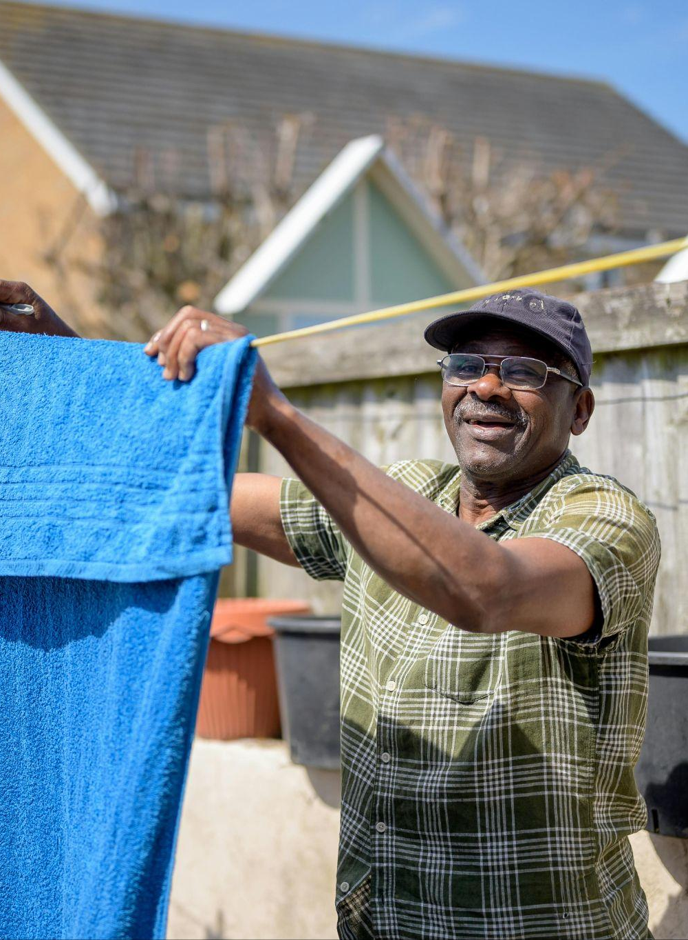

Radical Generosity
\ 'ra-di-kəl \ \ dzenǝ'uasəti \
noun
1: Generosity expressed as mutuality, reciprocity, solidarity; a value based in our shared humanity
2: The belief that people deserve not just to barely survive, but to thrive

Slide 6
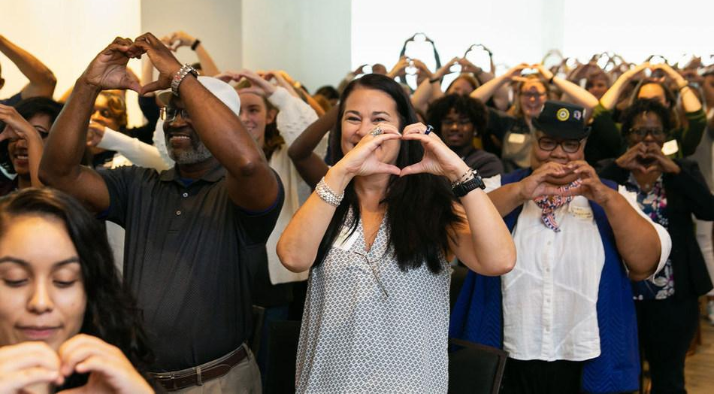
GivingTuesday exists to build the world we imagine to be possible.

Slide 7
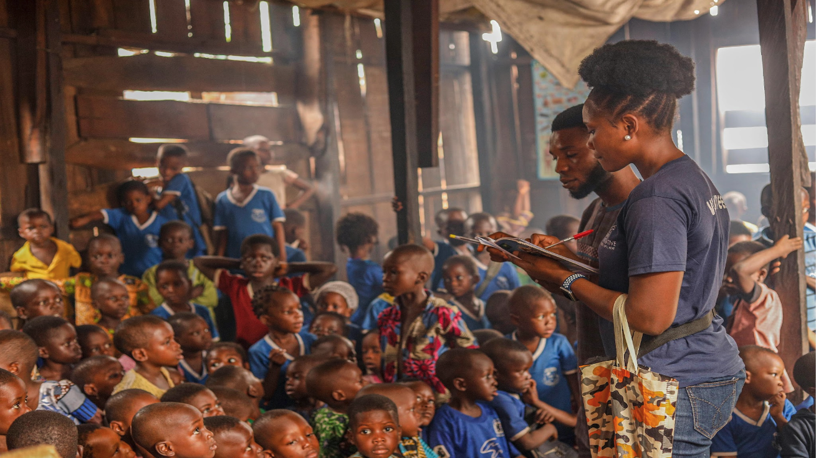
Anyone, anywhere can give.

Slide 8

  GivingTuesday 2025 Results
  38.1M
adults in the U.S. participated, a 6% increase from 2024
U.S. Participation on December 2, 2025

Slide 9
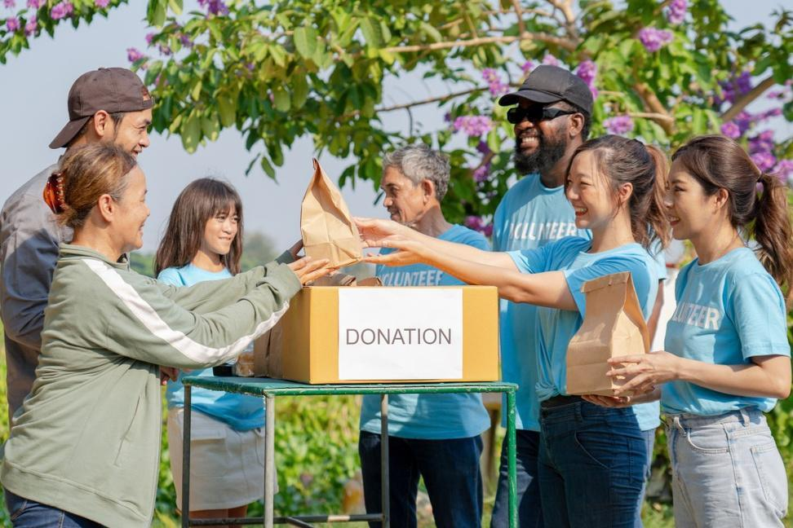
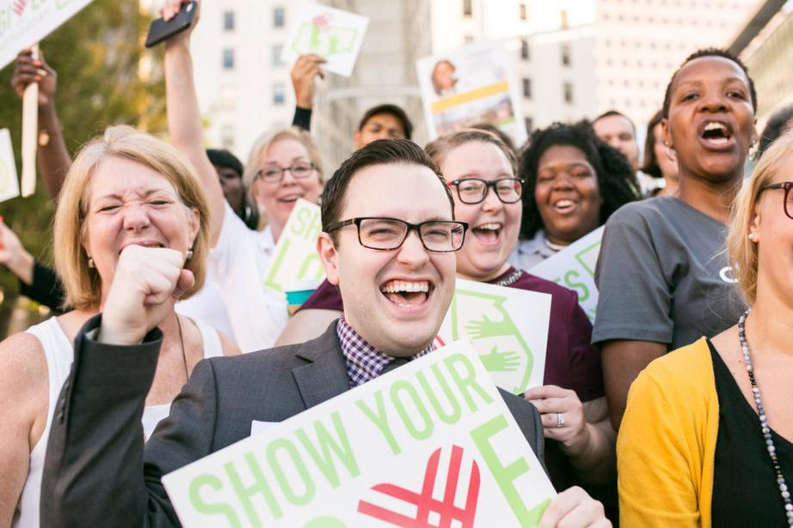
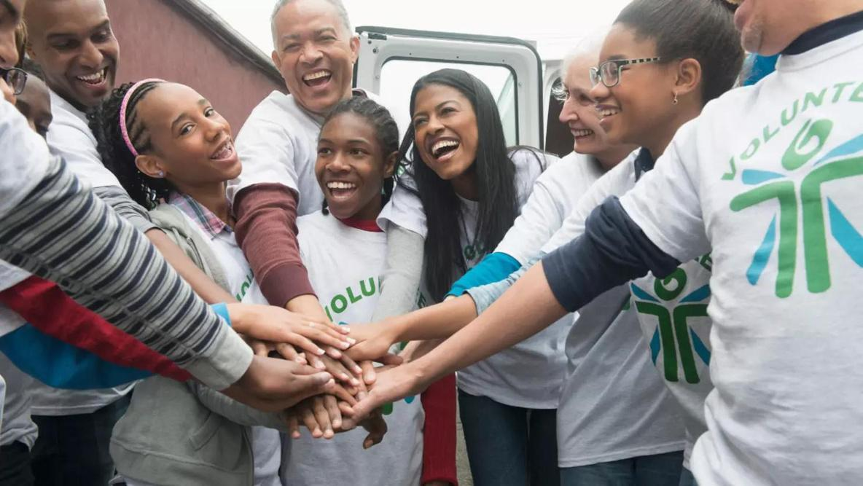
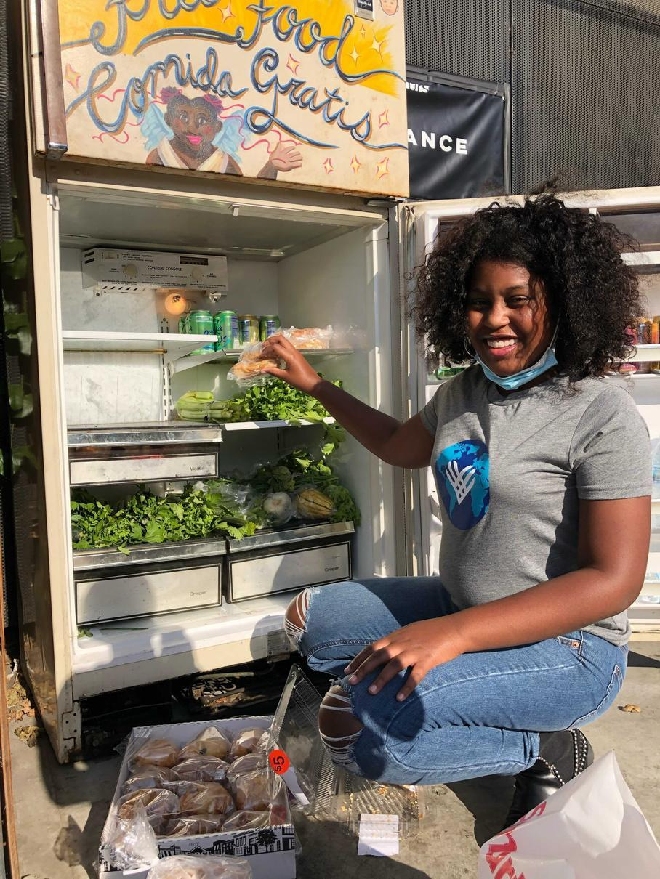
  19.1M
  20.9M
  11.1M
  13.4M
  donated
  gave voice
  volunteered
  gave goods
  (+3%)
  (+26%)
  (+20%)
  (+4%)
U.S. Participation on December 2, 2025

Slide 10
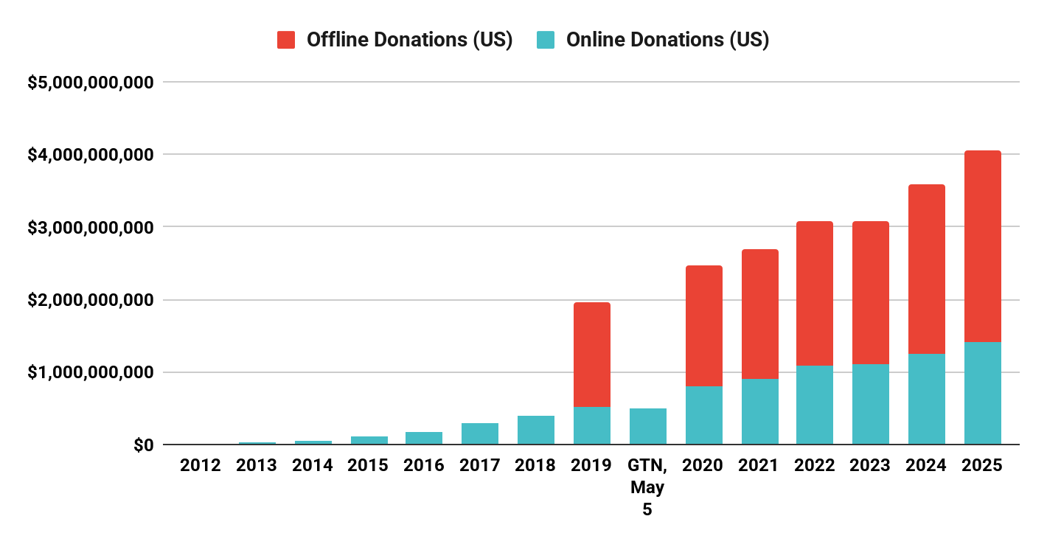

$4 BILLION RAISED ON DEC 2 IN THE U.S. ALONE

Slide 11
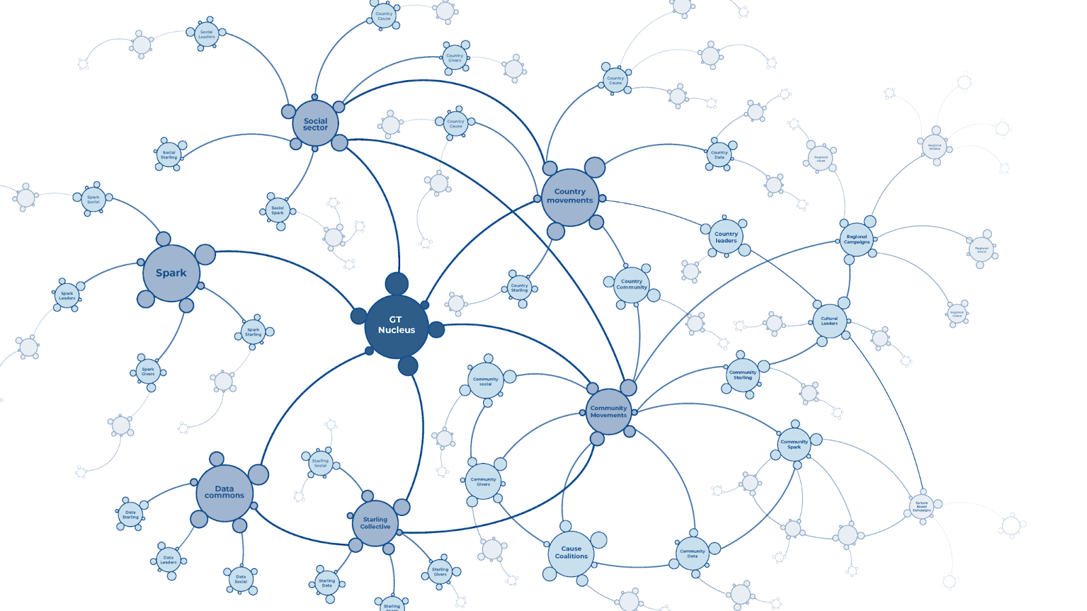
Community Campaigns are:
a generosity activation that brings together people, a network or organizations that share a defined commonality like location, profession, cause or culture in order to increase generous behaviors.
Community Leaders are:
a “hand-raiser” - an individual, group or organization spearheading a community generosity activation in partnership with others for the benefit of their community by using the values and guiding principles of GivingTuesday.
Notes:
Ground on a few terms we use to delineate actions and actors. And again this is just how they have grown for us so far.
Today We will talk though how you can create a generosity moment in your community. The what, why and and the how. Much of this will come through the lens of the GivingTuesday movement, but you can take these lessons and align them with your own community generosity event. So before we jump into the magic of community giving moments, I wanted to share some definitions with you that I’ll be using throughout the conversation. These are terms we use in the GivingTuesday Distributed Leadership Model
A campaign leader is an organizing group that creates and leads a generosity campaign for a geographic location (city, town, region, state), for a particular cause or culture or a community built around a common interest. These campaigns mobilize partners, nonprofits, individuals and entire communities in acts of generosity--whether that’s volunteering, performing acts of kindness, or giving goods, money, voice or skills. Coalition campaigns, specifically, are organizations working together toward a shared mission to achieve far more than organizations working alone.

Slide 12
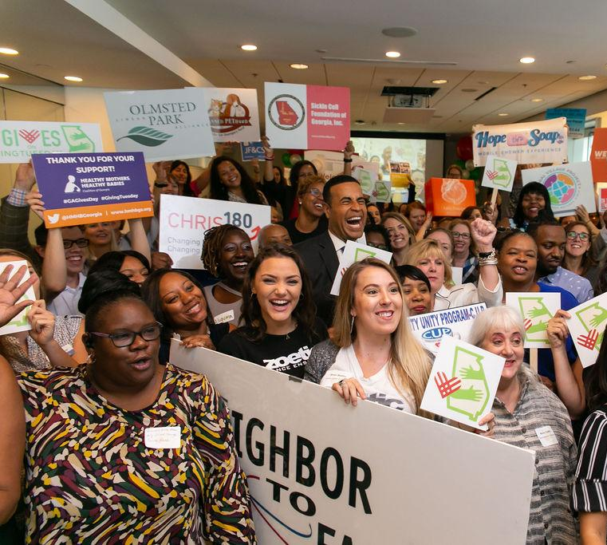

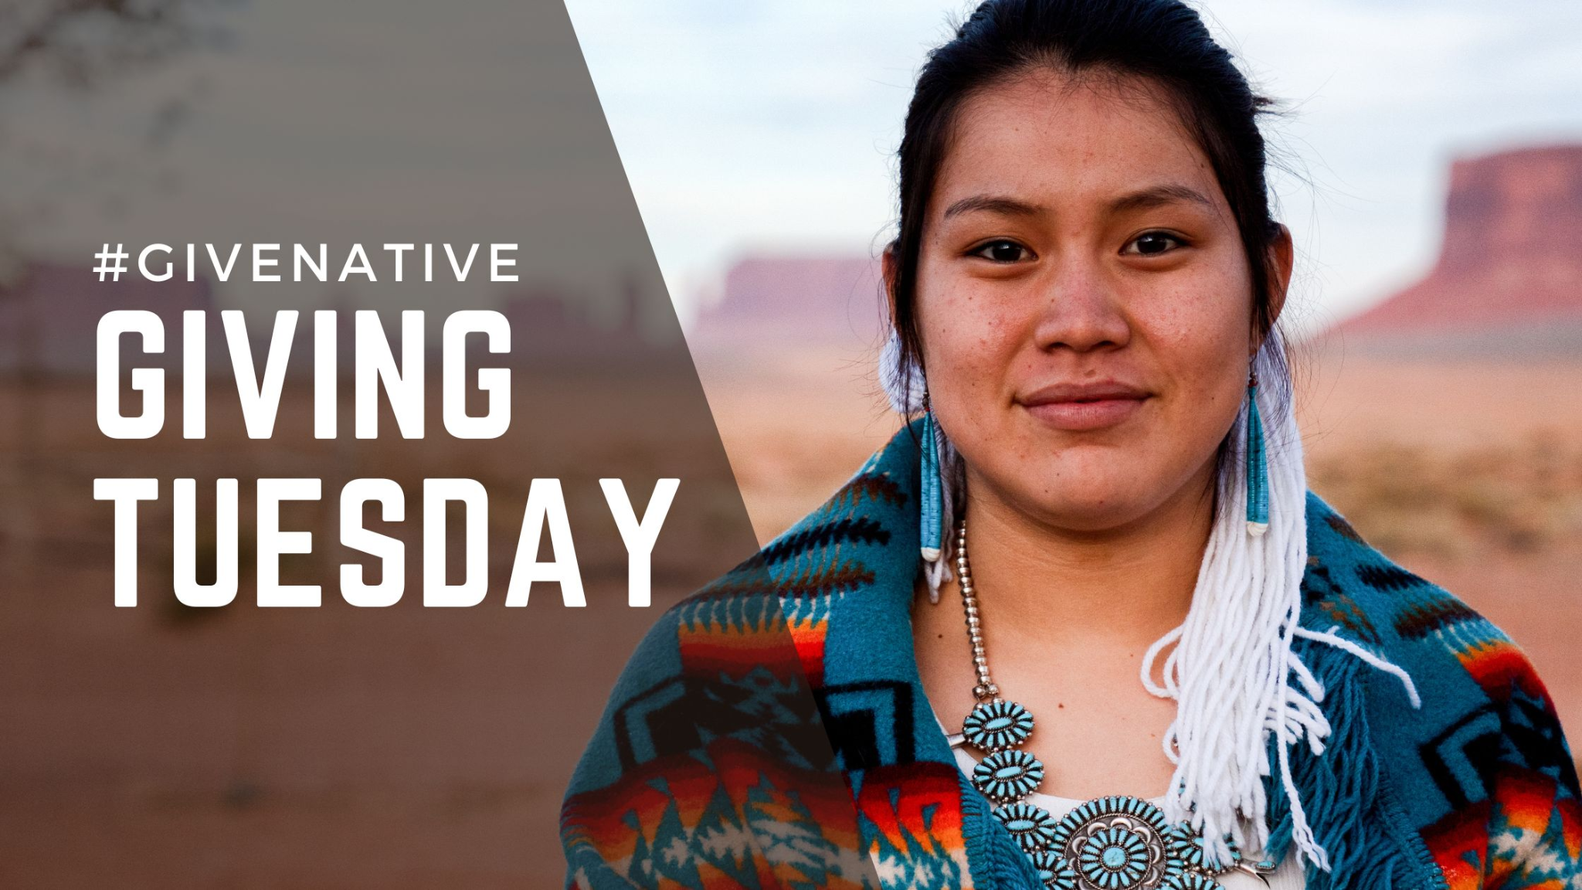
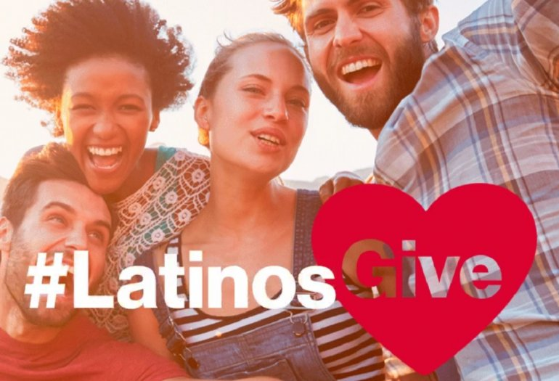
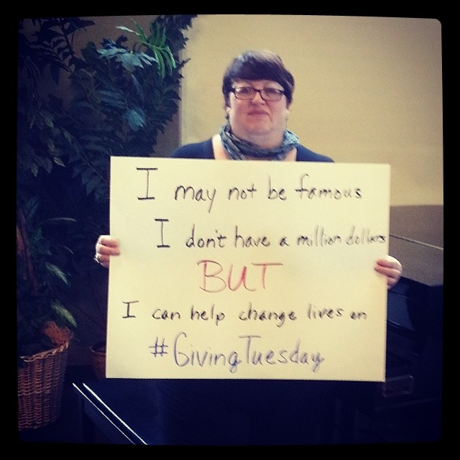
...AS GEOGRAPHIC AREAS
...AS CAUSES
...AS A CULTURE + IDENTITY
...AS NETWORK OF GROUPS
...AS NETWORKS OF INDIVIDUALS
Leaders organize…

Slide 13
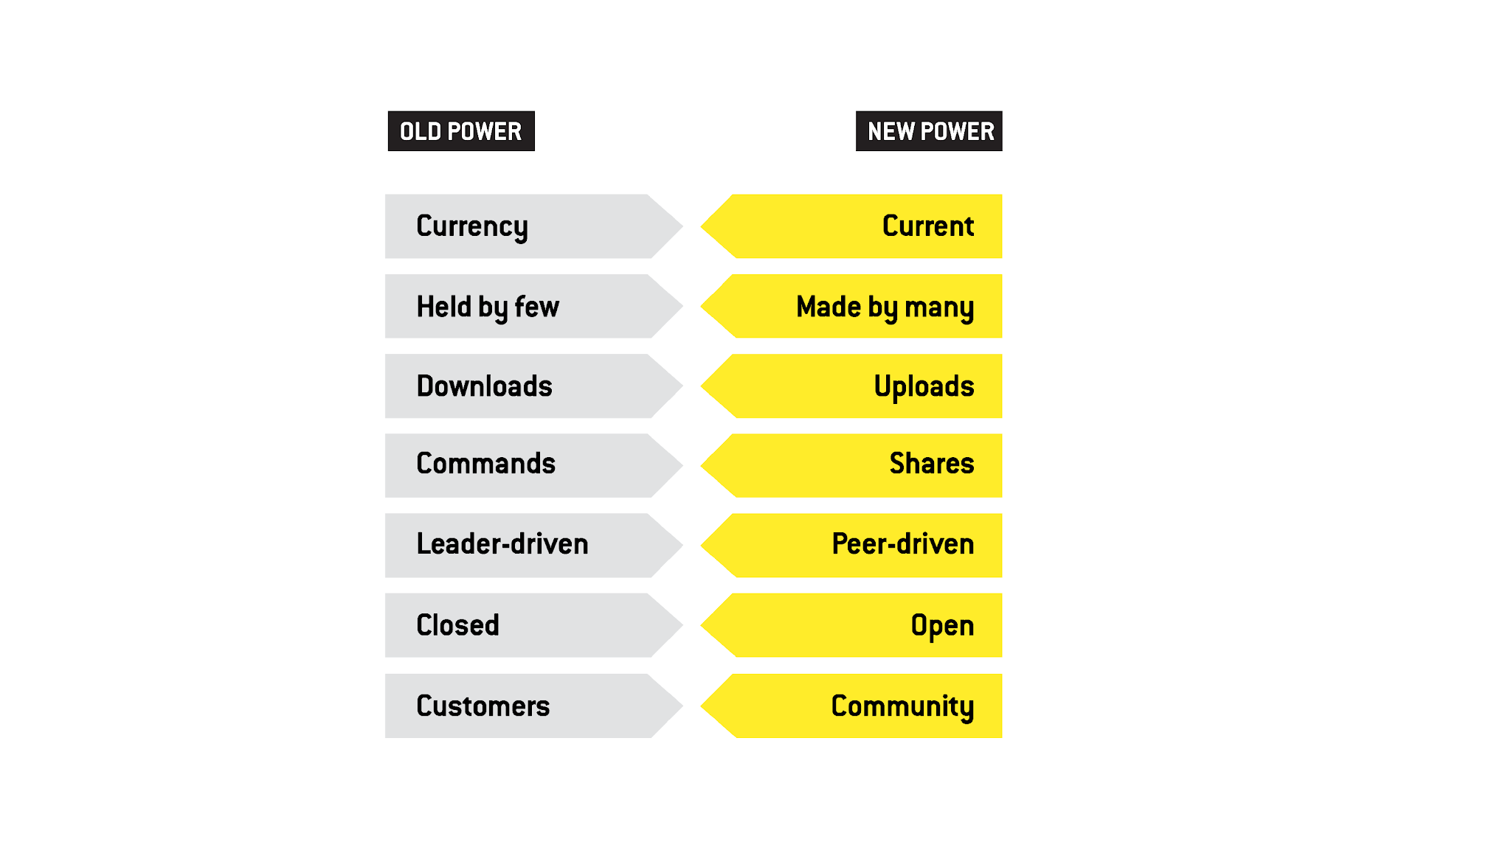
Notes:
This means we must bring in all voices and create space for all voices and build a bigger tent of opportunity.
This was developed Henry Timms – With New Power. And our co-founder who developed this as he was building GT. From HT and his book New Power.
How can we invite new voices in, empower others to lead and follow? We will need to think differently about our power dynamic + be open to new ideas, actions and communities that don’t look/act/feel like we do. How can you use this moment of uncertainty to invite people to participate in the ways that matter to them? Meeting people where they are. People are hungry to connect, give and share -- but this may look different.

Slide 14
Why Collective?
84%
52%
  of those aware report GivingTuesday inspired them to be more giving.
said they donate on GivingTuesday to be a part of a bigger group of people doing good.
Notes:
The collectivity of these days that bring people together to make an impact are very motivating to the Everyday Giver. Our awareness survey shows that 84% of people aware of GivingTuesday sat that they were inspired to be more giving. And 52% said they donate on GivingTuesday to be part of a bigger group of people doing good.

Slide 15
Community
Campaigns
85%
Today, 400+ community leaders across the US organize GivingTuesday Community Campaigns – campaigns where a group of people or organizations work together to rally a geographical community under the banner of generosity.
For more than a decade, Community Campaigns have proven effective at harnessing people’s generosity and enhancing civic life.
More donors engaged in collective giving per capita
90%
More funds raised per capita
in communities with campaigns compared to those without one

Slide 16
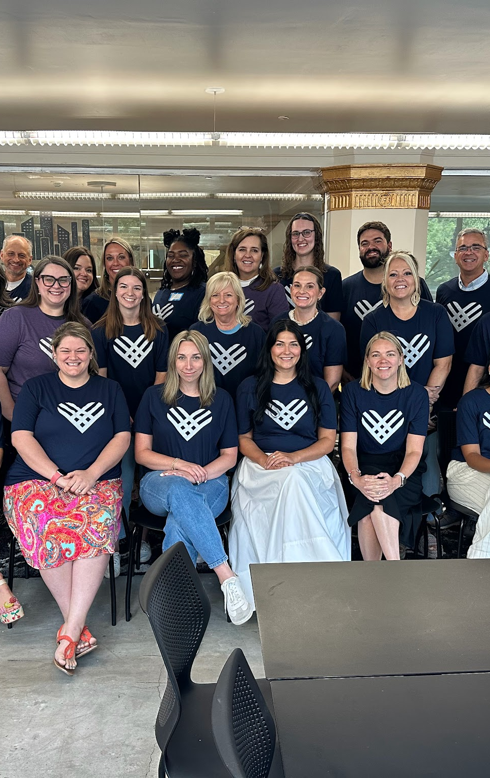
Community Campaign Accelerator for Community Foundations
Southeast Accelerator in Alabama, Kentucky, Louisiana, Mississippi, Tennessee
Kansas Accelerator

Slide 17
Why Giving Days?

Slide 18
About FEP
Understanding giving at scale:
The Fundraising Effectiveness Project (FEP) analyzes sector-wide giving trends
Tracks year-over-year performance in dollars raised, donor participation, and retention
Built on a dataset spanning billions in donations across millions of donors and tens of thousands of nonprofits

Slide 19
About GivingPulse
Weekly survey of generosity and giving attitudes in the U.S.
Administered online
Cross sectional
25k+ responses since 2023
Raw public data for open use

Slide 20
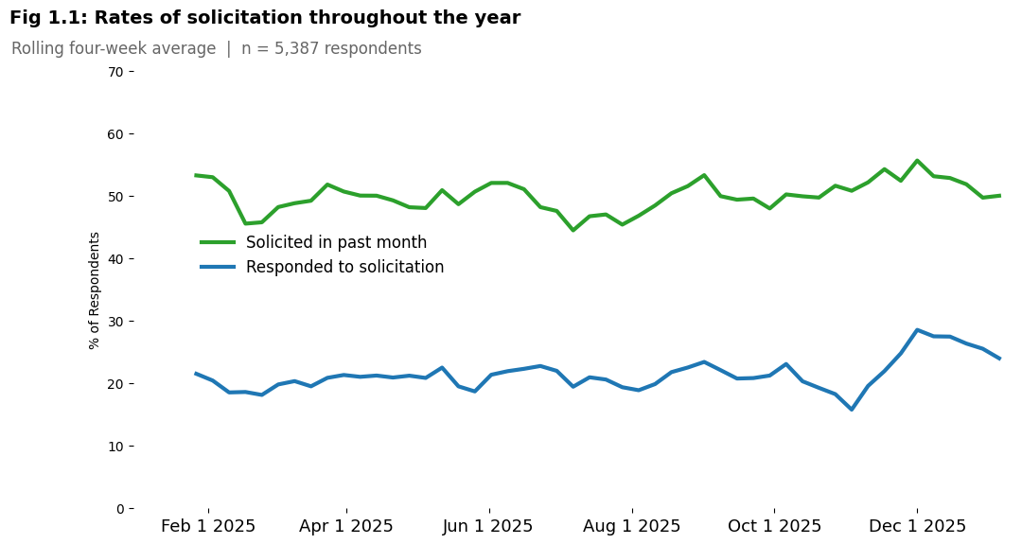
When do people say they give?

Slide 21
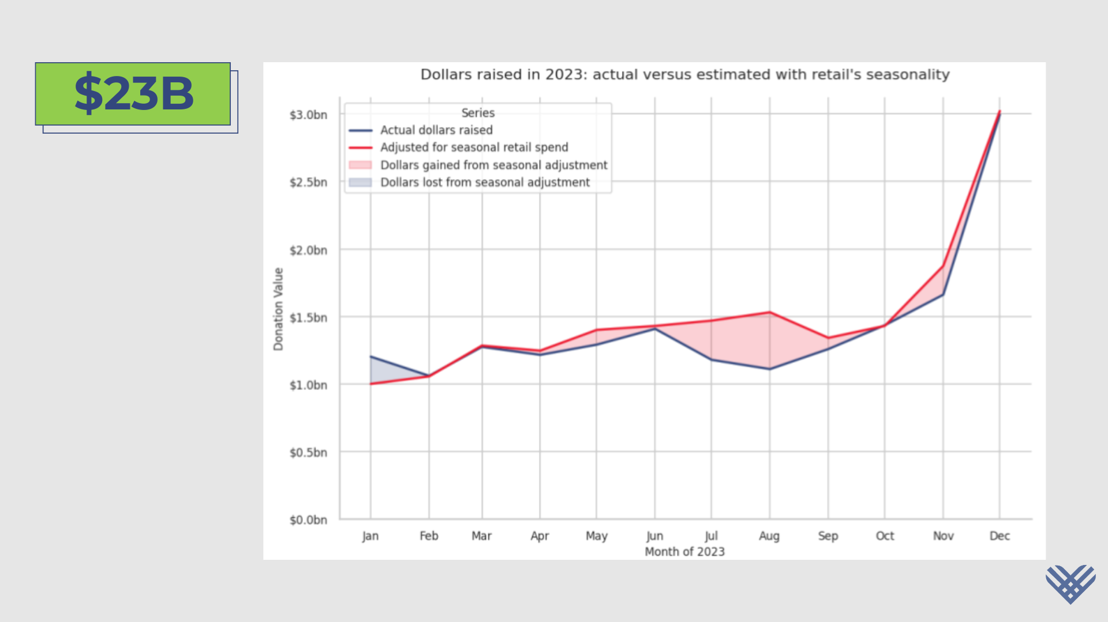
Estimated opportunity

Slide 22
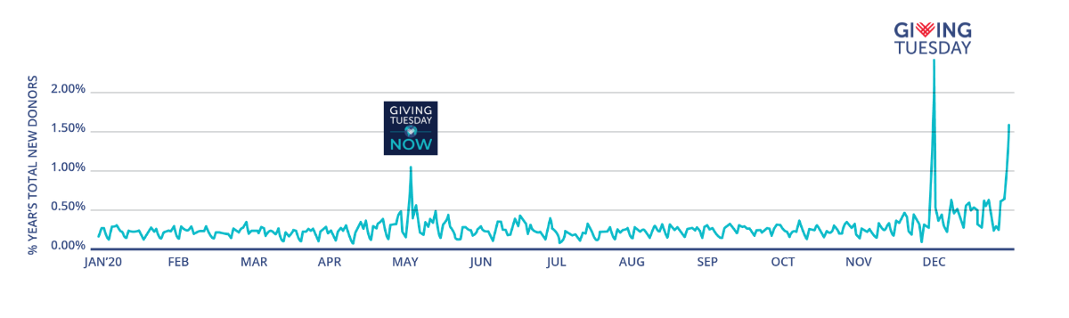
What we saw in 2020
The last time GivingTuesday had two moments of generosity was during the pandemic.

Slide 23
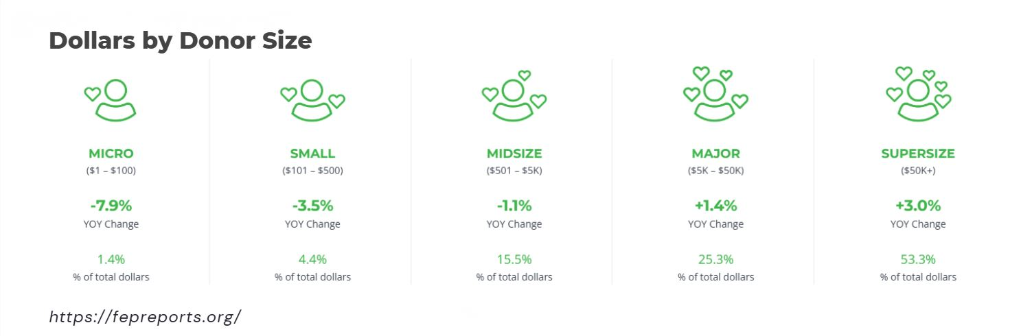
Donor breakdown by donor size

Slide 24
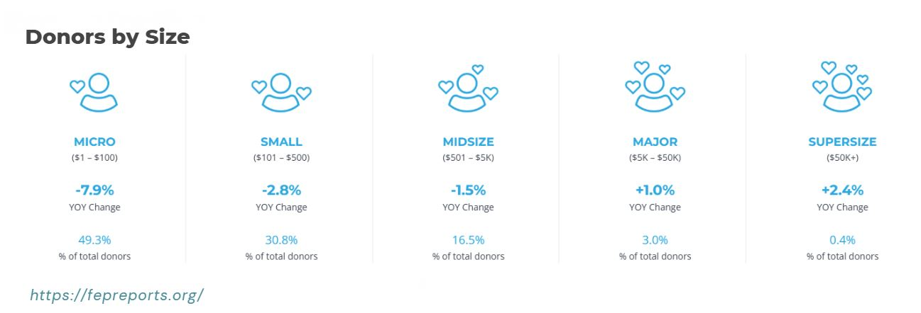
Donor breakdown by donor size

Slide 25
How To Get Started

Slide 26
Steps to building a Giving Moment
1
2
3
4
5
Organize core lead & vision
Identify partners
Align on goals
Design your campaign
Launch and promote
Leading organization(s) raises hand and defines campaign vision. What will success look like?
____
Planning ideas, templates, attend convening meetings, introduction to network of leaders
Identify all partners in ecosystem who might help develop, participate and/or amplify campaign
____
Identify any natural partners in the GT ecosystem, templates to engage audiences
Identify main goals of campaign and calls to action for partners and givers. These will define strategies.
____
Planning support when necessary, sharing best practices
Develop narrative, assets, unifying hashtag, shared “platform”; comm plan, outreach and train partners
________
Share templates and examples, co-present at trainings
Engage campaign ambassadors, partners and execute comms strategy
________
Utilize GT social channels inclusion in press outreach, share campaign w/ all GT leader network

Slide 27
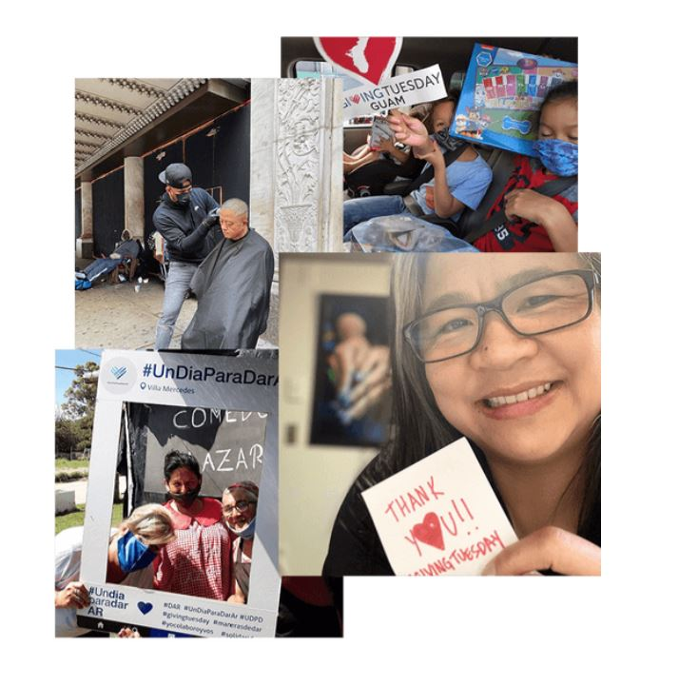
The Outcomes
Leading a GT Community-wide Campaign has helped Community Foundations:
Link their mission to a massive, trusted conversation about philanthropy and bring the wider community to the community foundation;
Increase local nonprofits’ access to unrestricted funds;
Build local nonprofits’ campaign capacities as well as foundation’s county affiliates;
Alleviate year-end solicitation capacity challenges;
Engage more people in the community in giving back, including those new to giving, families and young people;
Further build trust and relationships amongst local people, nonprofits, businesses, and their foundations.

Slide 28
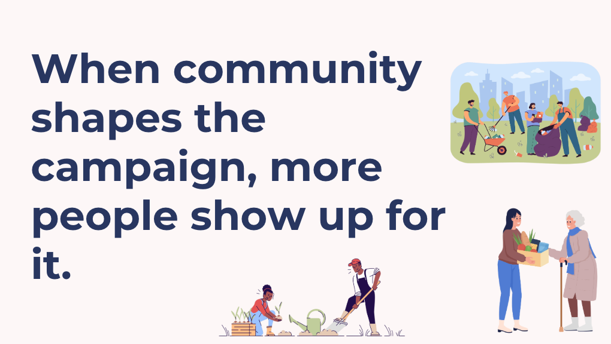
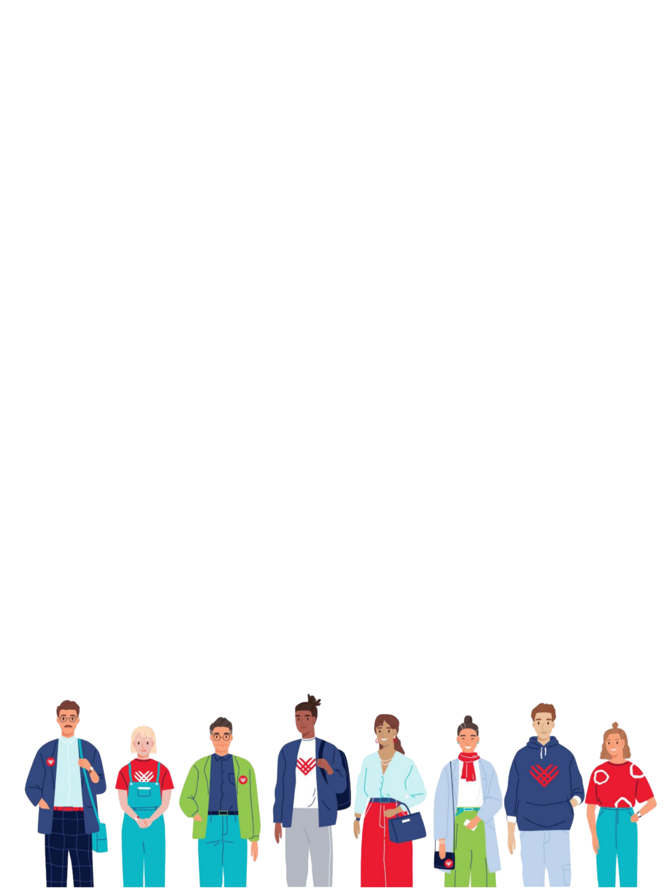
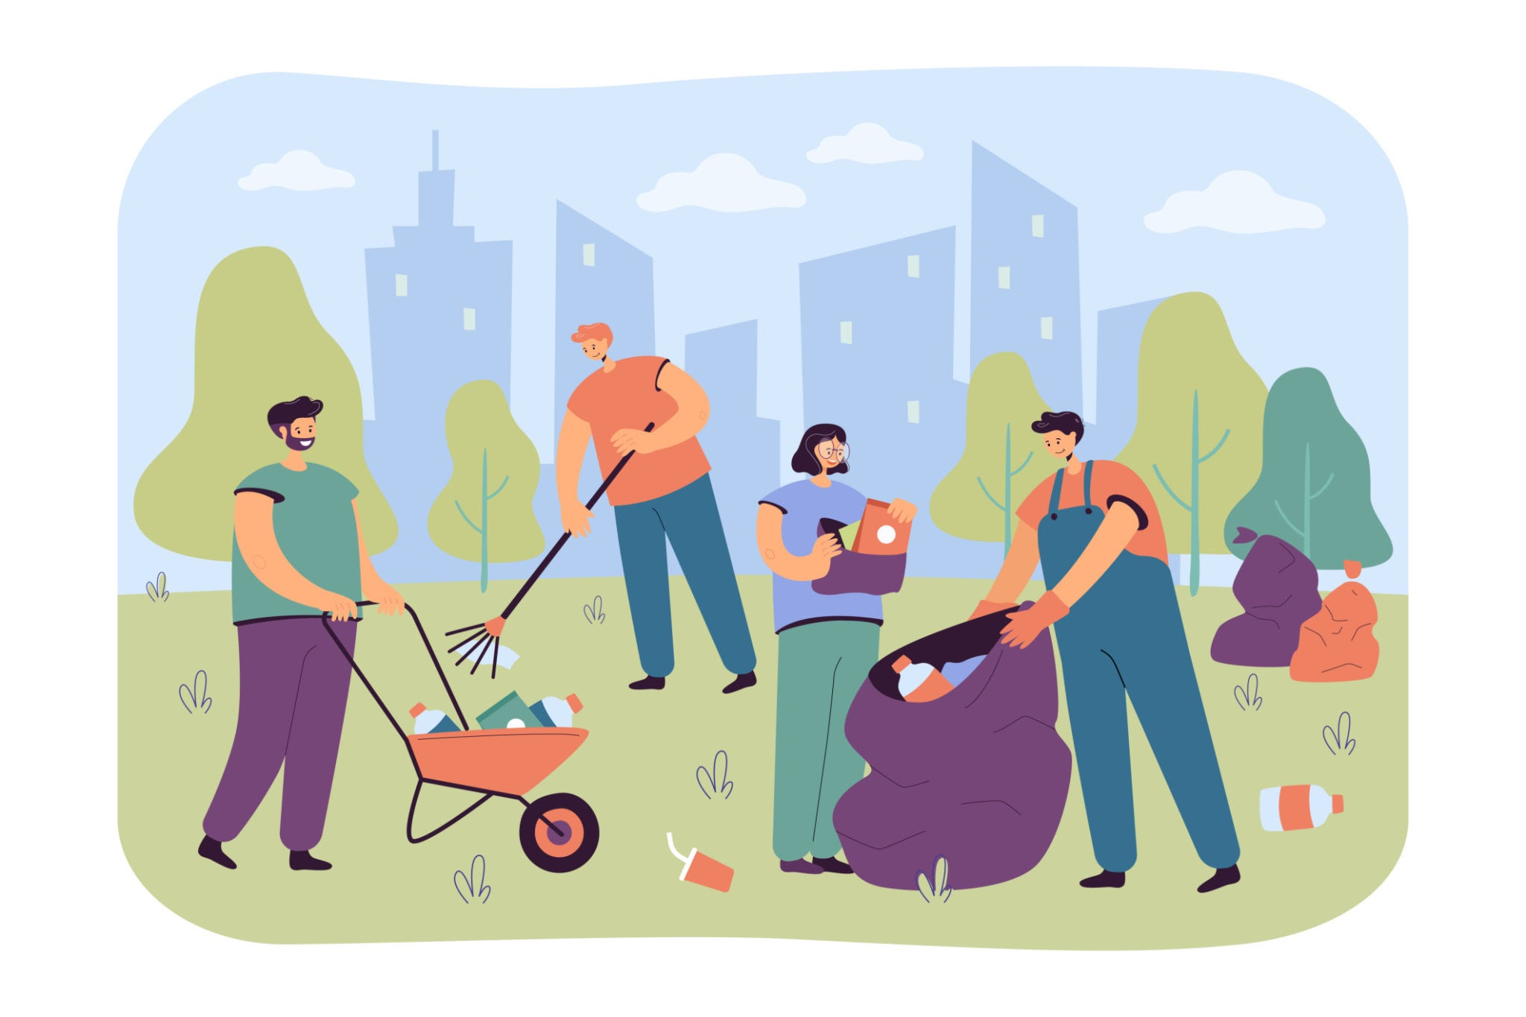
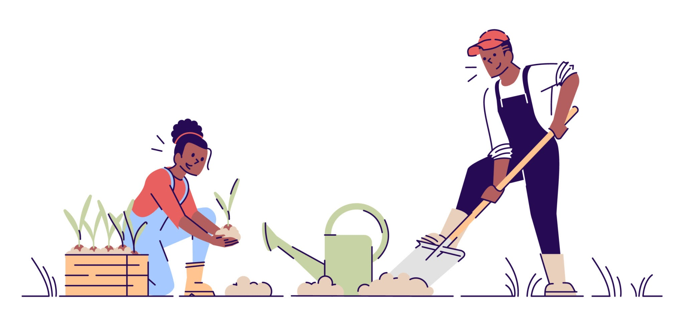
When community shapes the campaign, more people show up for it.
Notes:
Here's the simple truth: people support what they help build.
That's not just a feel-good statement. It's strategic. Campaigns that people feel ownership over are campaigns people tell their networks about, show up to, and come back to the following year.

Slide 29
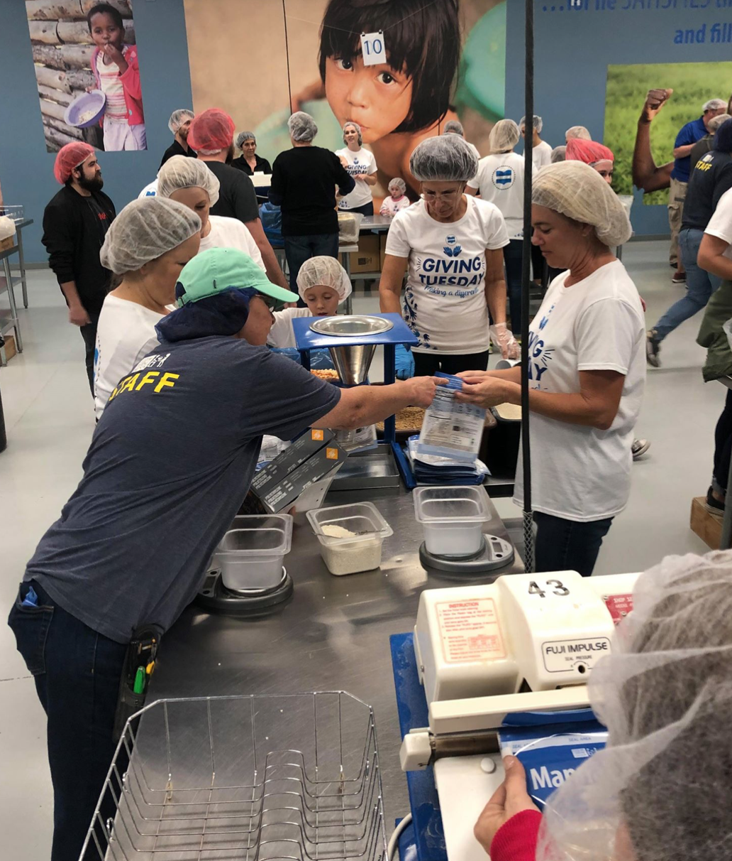
All the ways to do this!
Additional ways Community Foundations leverage a Giving Day
Community-wide awareness day
Grant award celebrations
Storytelling campaigns
Community Volunteer Day
Training for County Affiliate leaders and nonprofit orgs
Match Day for nonprofit fundholders
Giving Guides for the community
Giving Day for all organizations (non- grantees included)
Youth engagement activities - ie. YAC initiative
Giving Circles special engagement or creation

Slide 30
Let’s Chat

Slide 31
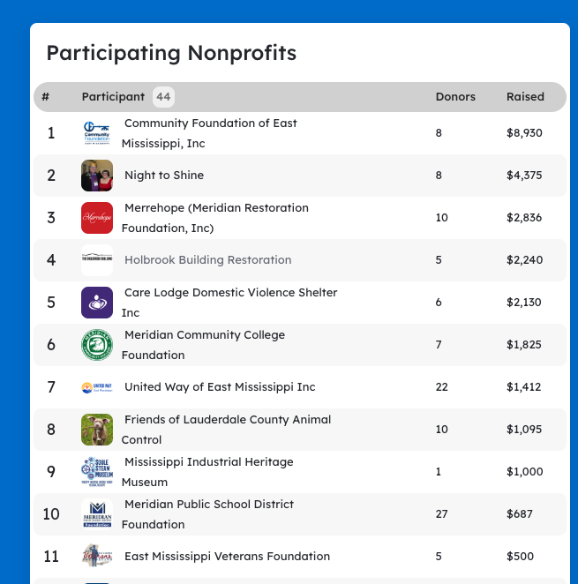

What it can look like: Getting the $$ Straight to Nonprofits
Giving Day EMS
Hosted a webpage with 30+ nonprofits listed that donors could choose from
CF of East MS still fundraised for the foundation, but spread the wealth and got money directly to nonprofits right away
Think about: Who’s invited? Who has visibility? Who benefits?
Notes:
Link to webpage: https://www.givingdayems.org/

Slide 32
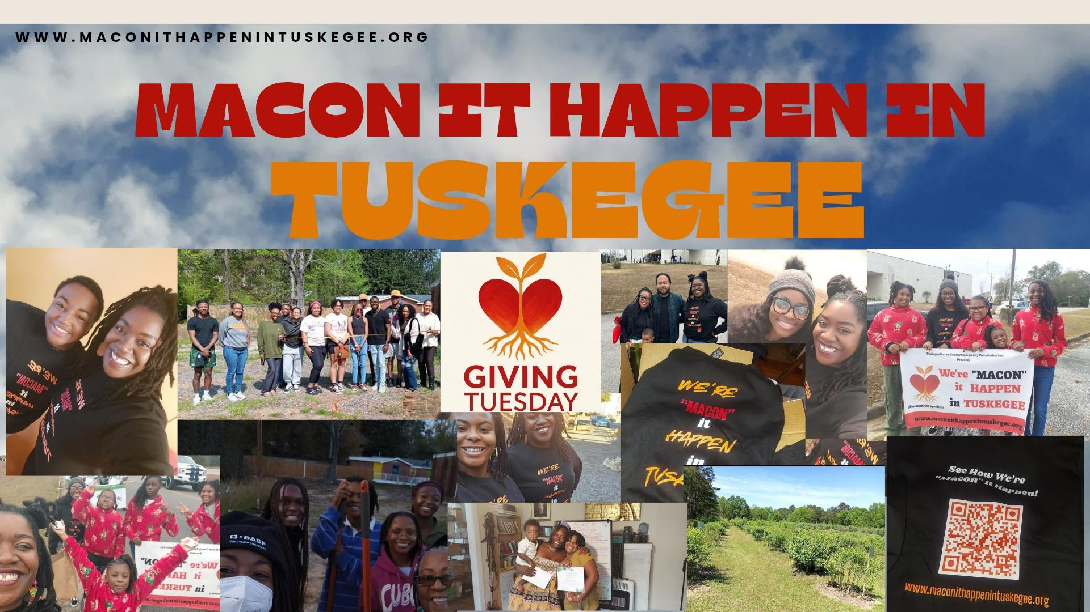
What it can look like: Inviting Everyone to the Party
Macon It Happen in Tuskegee
Invited participation from local nonprofits, the business community, local government, young people, and more
Utilized already existing events like Small Business Saturday and the Christmas Parade to spread awareness
Notes:
Link to webpage: https://www.maconithappenintuskegee.org/

Slide 33
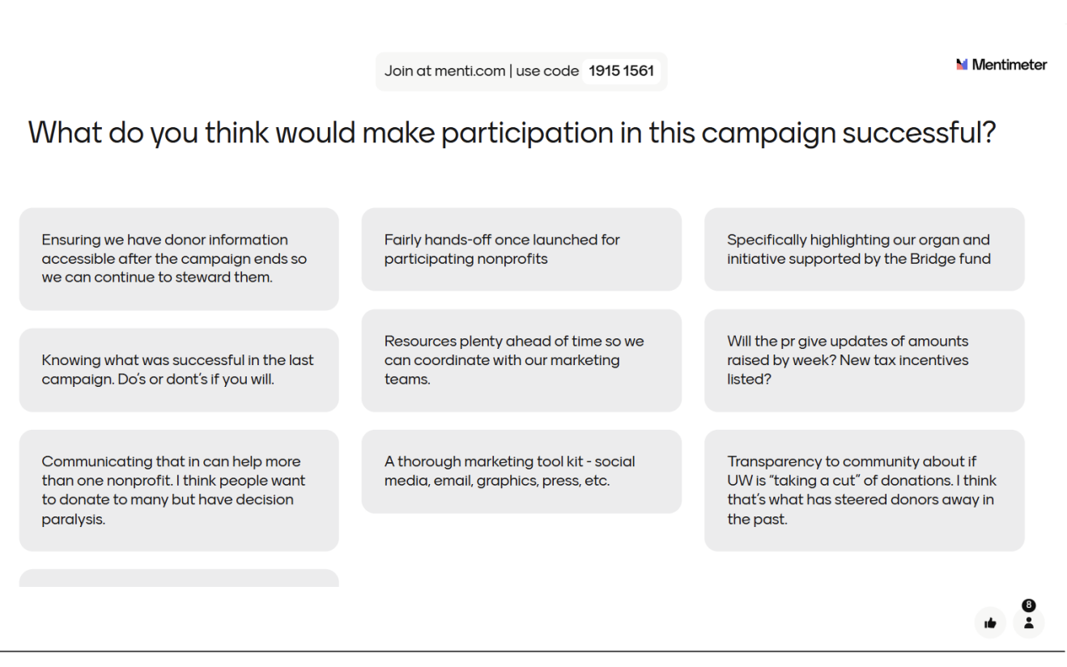
What it can look like: Asking Nonprofits to Shape the Campaign
CHA Gives
Held a nonprofit listening session ahead of launching the campaign
Shaped campaign decisions based on feedback
Notes:
Link to webpage: https://www.chattanoogagives.org/

Slide 34
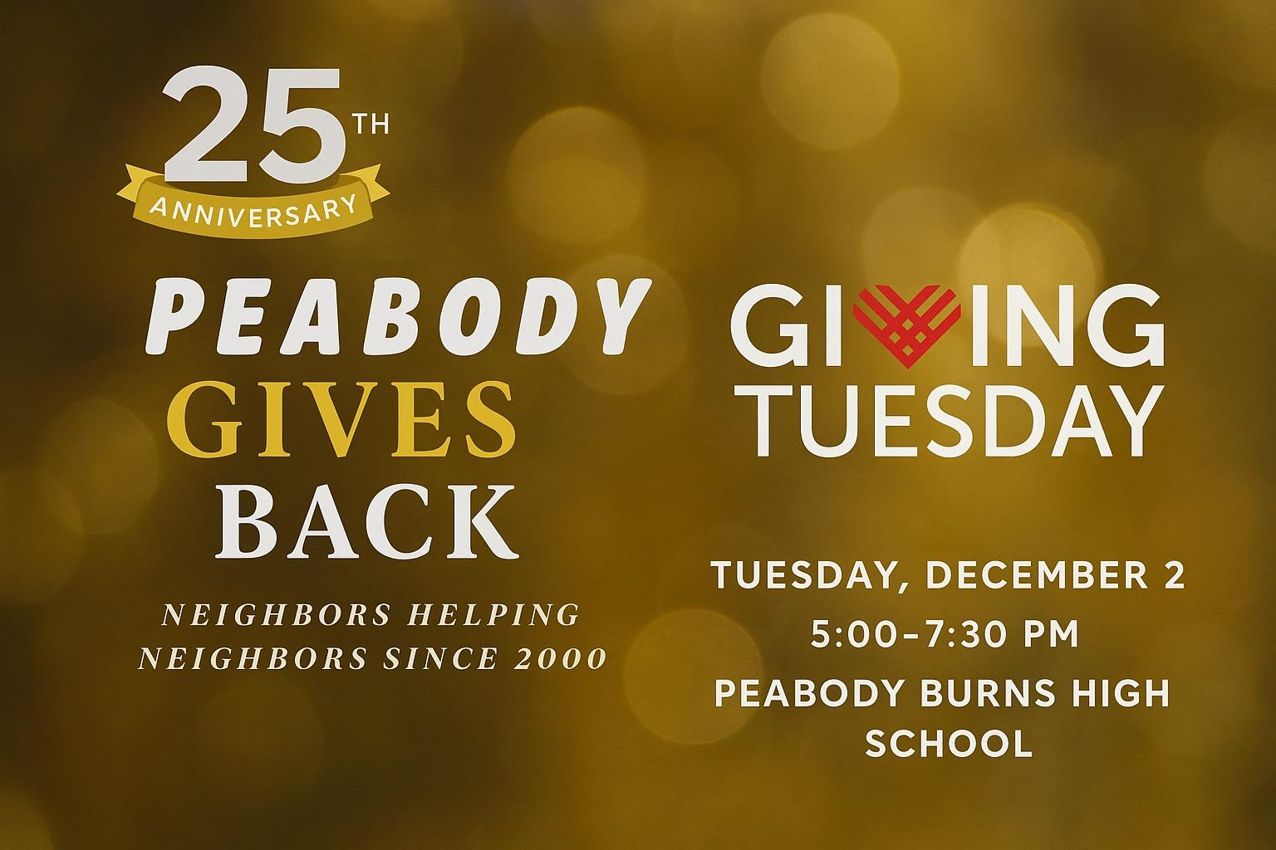
What it can look like: Cultivating Community Spaces
Peabody Community Foundation
Community supper at a local high school
Local nonprofit fair - the community learns about local charities
Angel tree and food pantry
Student art fair + silent auction
Notes:
Peabody Community Foundation partners with a local high school to host a #GivingTuesday event. Community members are invited into the school to learn more about local charities and enjoy a soup supper provided by school clubs. Community members are encouraged to bring items for the local angel tree and food pantry.

Slide 35
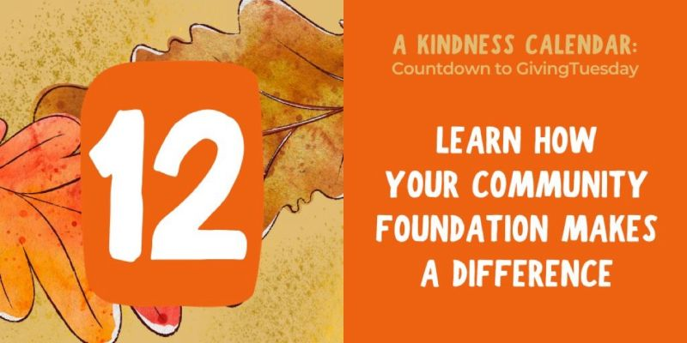

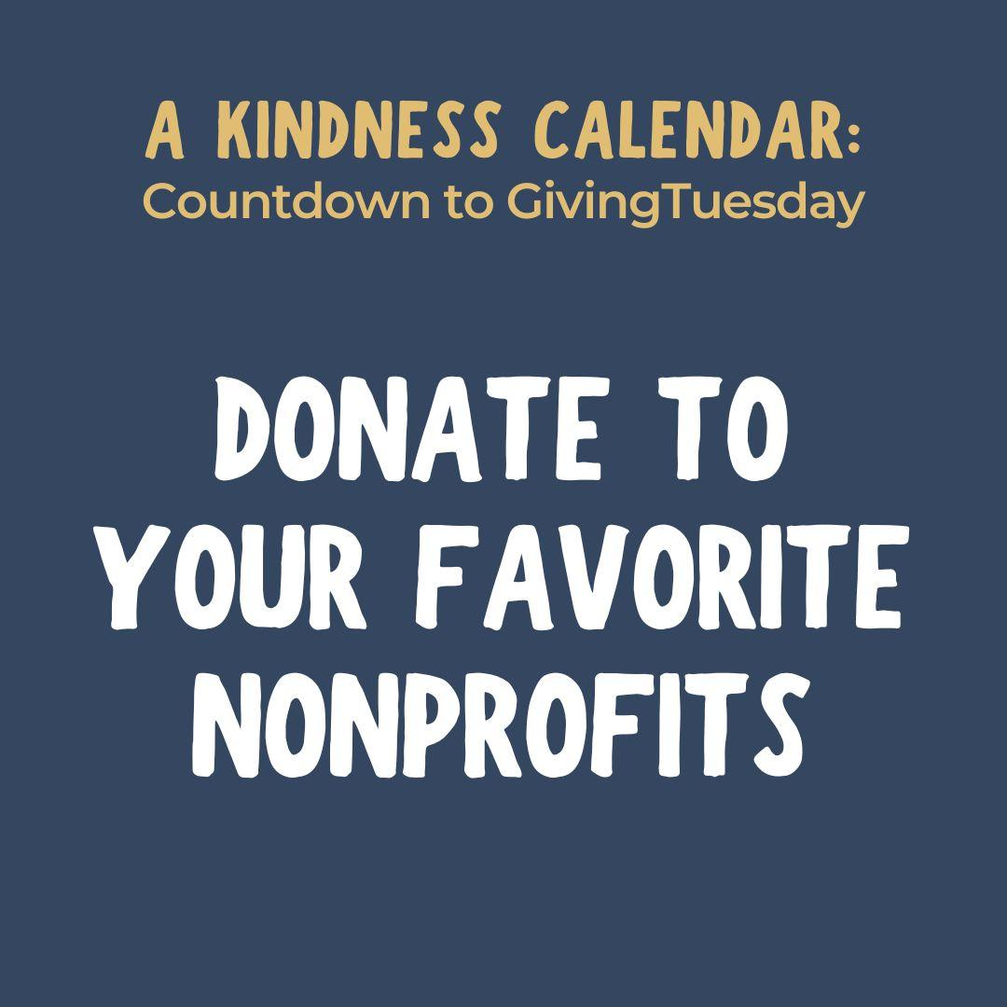
What it can look like: Encouraging ALL Kinds of Giving
Community Foundation of Middle Tennessee
Sends out a “Kindness Calendar” counting down to GivingTuesday with ways individuals can be generous
Holds workshops for nonprofits leading up to GivingTuesday
Encourages donors to give “shout outs” to their favorite nonprofits and community organizations on their website
Notes:
Throughout the month of November, Community Foundation of Middle Tennessee and GivingMatters.com are embarking on an innovative 28-day journey in anticipation of GivingTuesday. A Kindness Calendar: Countdown to GivingTuesday is designed to illuminate the multitude of ways individuals can contribute to our community. Each day at 10:00 am, A Kindness Calendar highlights a distinct avenue for giving, underscoring not just financial contributions but also the priceless gifts of time, talent, and testimony.
https://www.cfmt.org/season-of-giving/

Slide 36
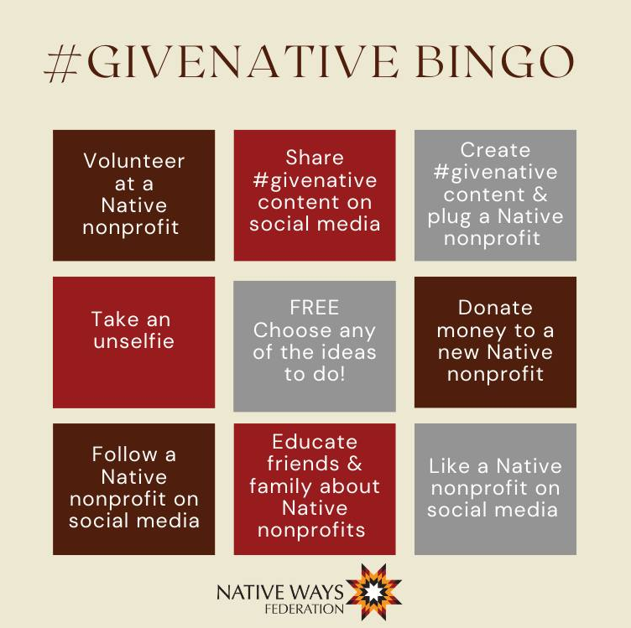
What it can look like: Gamify Participation
Native Ways Federation
Open sourced Bingo Card
Native-led nonprofits share with their networks
Submit for small prizes
Completed virtually, but can be repurposed for in-person too!

Slide 37
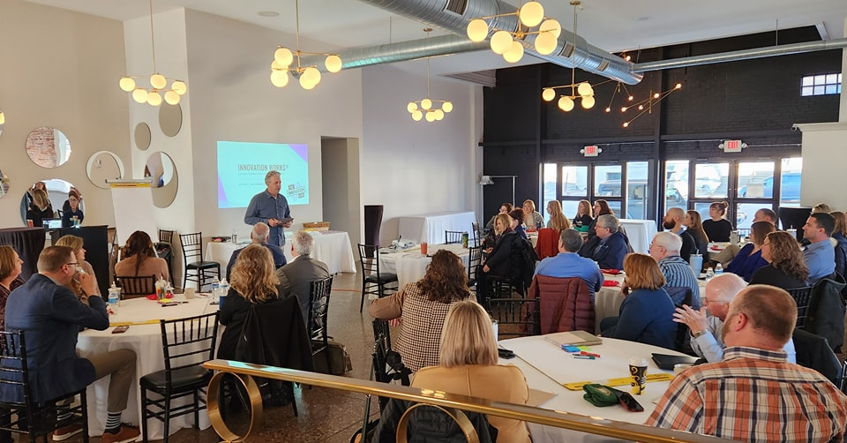
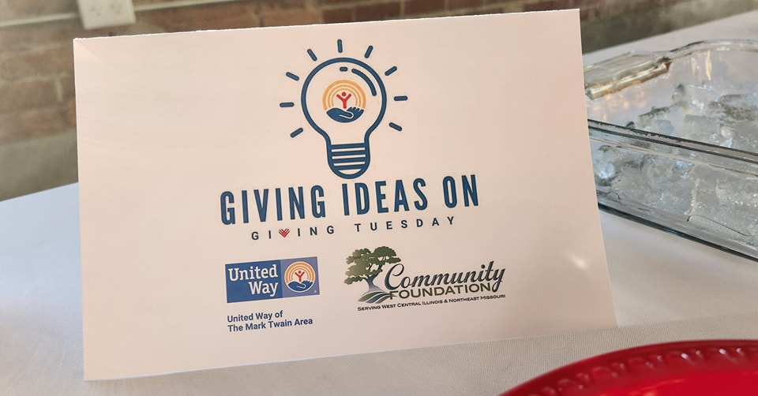
What it can look like: Engage Corporate Community
Community Foundation of West Central IL and Northwestern MO + United Way of the Mark Twain Area
Brought together corporate partners and nonprofits
Consulting on anything but fundraising
After consulting session, made charcuterie board
Auctioned off boards at community open house

Slide 38
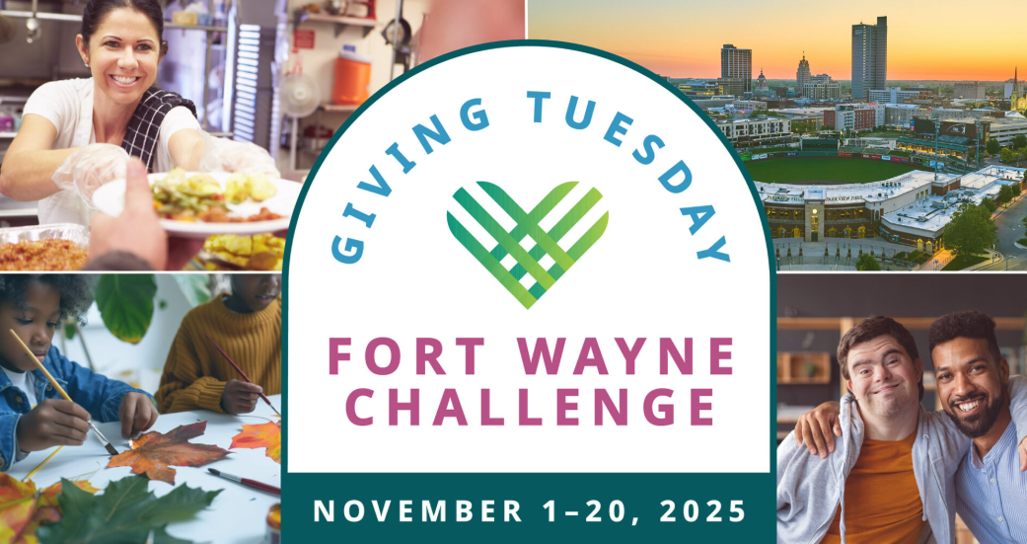
What it can look like: Training & Strengthening Nonprofit Endowments
GivingTuesday Fort Wayne
Invites over 100 nonprofits with endowment funds to participate
Every gift receives a 20% match from the Community Foundation
Provide nonprofits with year round training, a toolkit, a social media guidelines packet, sample emails, and logos and graphics
Go into Community on GivingTuesday to present checks
Think about: Whose skills are strengthened? Who benefits?
Notes:
Fort Wayne Community Foundation invites over 100 nonprofits with endowment funds at the Foundation to grow their long-term support by raising money for their endowments. Every gift to an eligible endowment fund receives a 20% match from the Community Foundation. They support get their nonprofits involved with a toolkit, a social media guidelines packet, sample email for nonprofits to use with their donors, and logos and graphics.

Slide 39
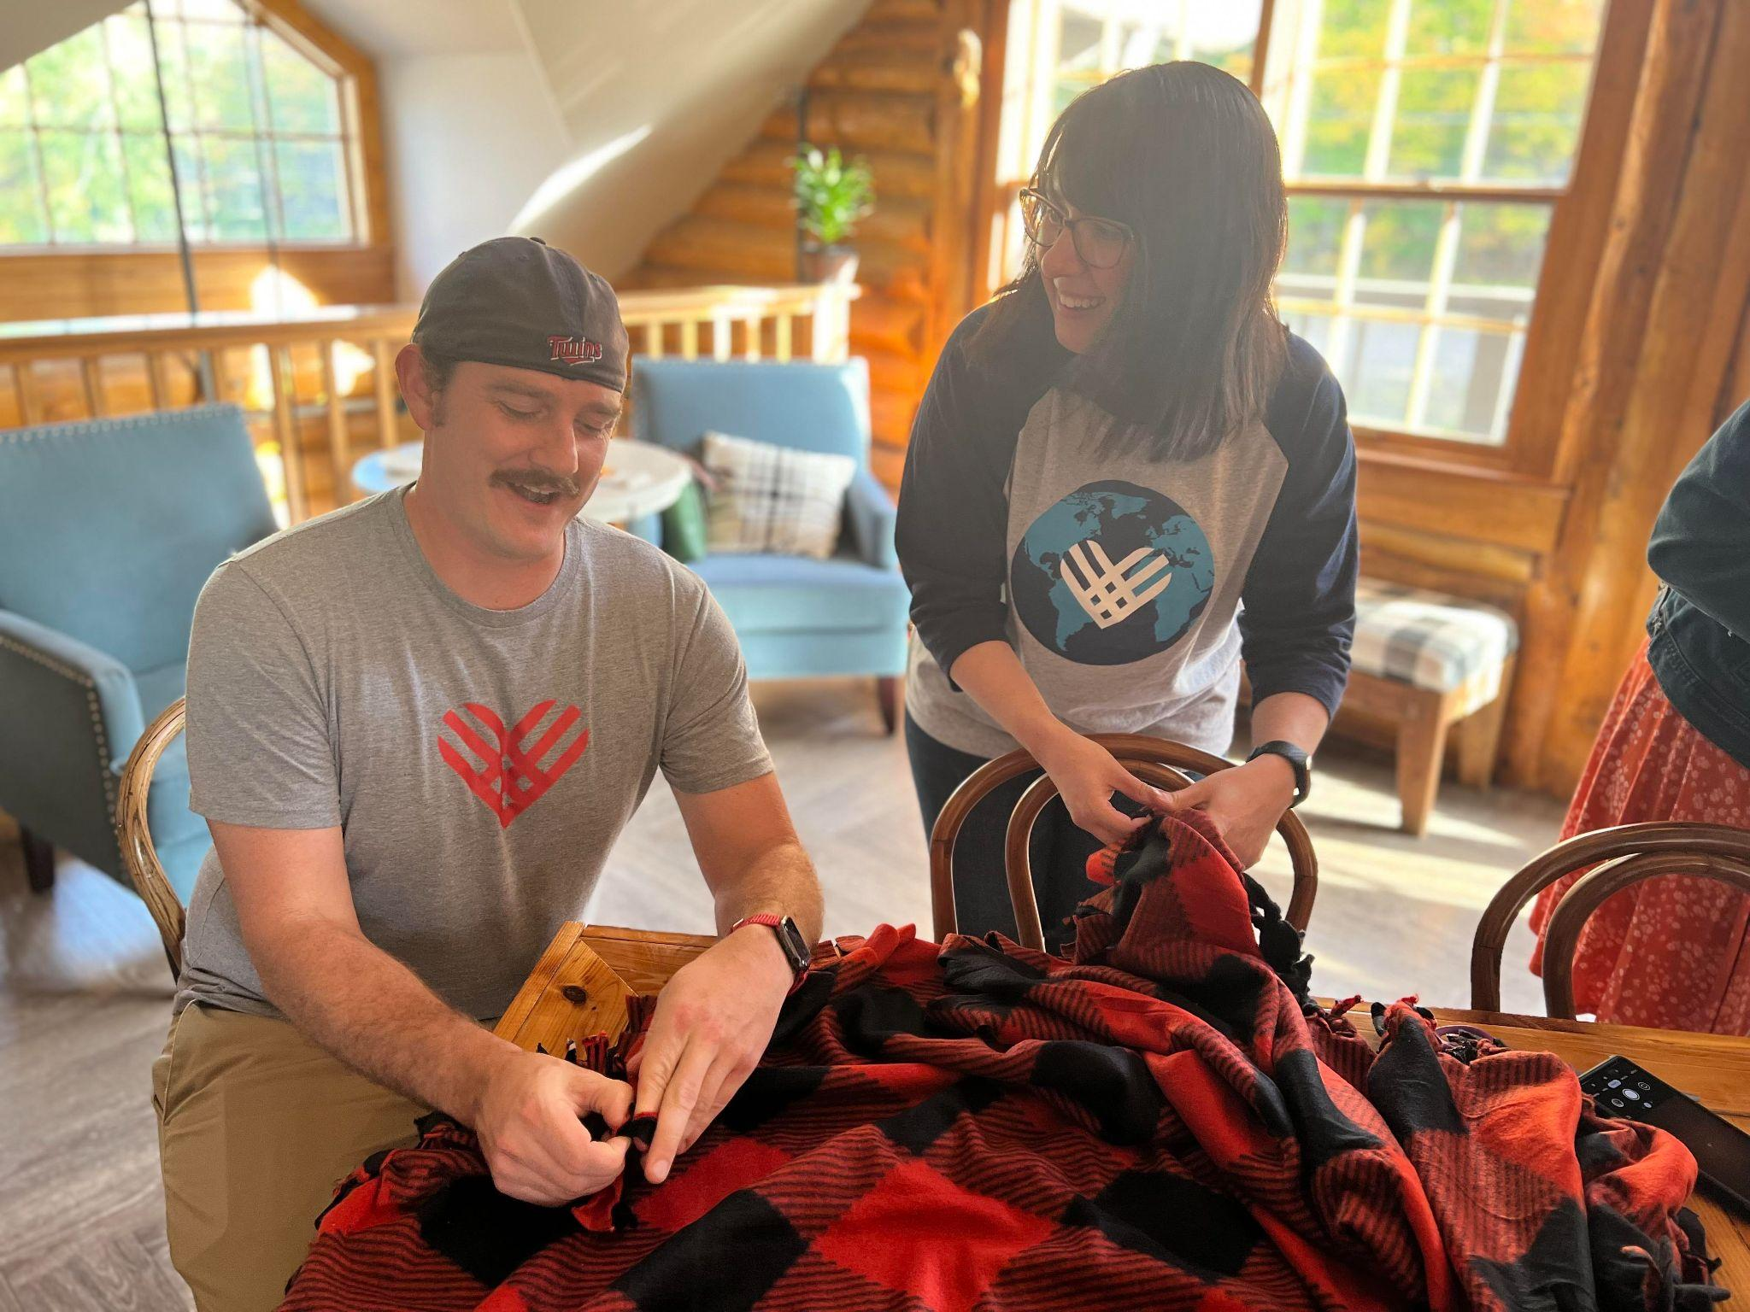
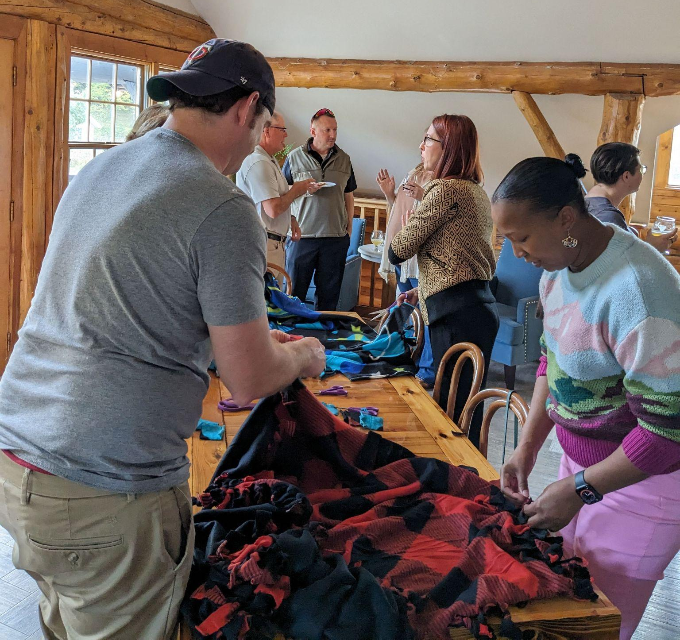
What it can look like: A Generosity Station
Give906
Table where people can give back in a casual setting
Hosted during a reception
Everyone has an opportunity to participate
Distributed via regional nonprofit conference the next day

Slide 40


Practice with us!
Stay in contact! victoria@givingtuesday.org
TogetherTuesday GivingTuesday
June 23, 2026 December 1, 2026
Notes:
Well, we have two days to practice if you’d like to try something new, TogetherTuesday, our new mid-season initiative, is coming this June 23. And GivingTuesday is this December 1. If you don’t have a local giving day, participating in these national efforts can be a great alternative. And if you’re interested in staring something locally, talk to me after! We have networking and programming specify to Community Leaders organzing collective action.

Slide 41
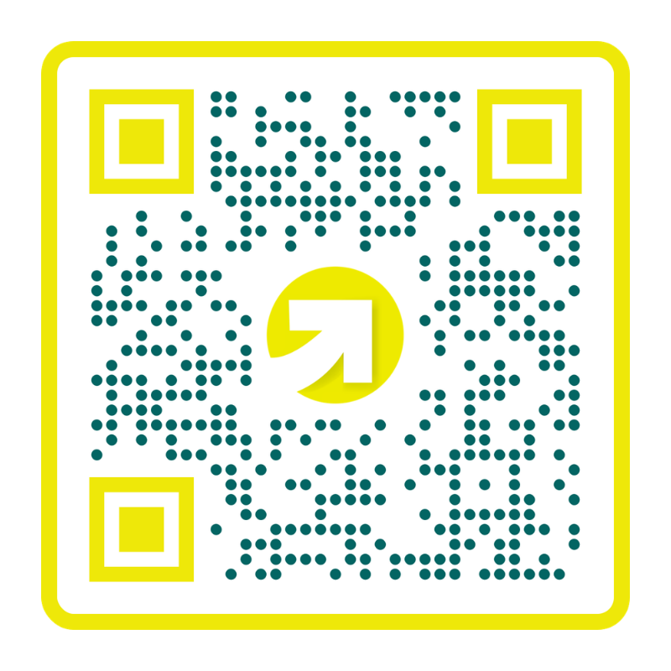
Learn More & Connect with Us!
Mike Scoville
Director of Partnerships & Growth
701.320.8561
mike@akoyaGO.com

