Slide 1

EQUIPPING YOUR BOARD FOR BETTER DECISIONS:
KEY FINANCIAL INFORMATION FOR FOUNDATION BOARDS
akoyaGO Webinar
featuring Your Part-Time Controller

Slide 2


Mike Scoville
Director of Growth and Partnerships
701.320.8561
mike@akoyaGO.com
Mike Scoville
Director of Growth and Partnerships
701.320.8561
mike@akoyaGO.com

Slide 3

YPTC Presenter
Rachel DeMatteo
Director, New York
Notes:
I’m the director for YPTC’s NY office. I am also our foundation’s specialization leader. I’ve been with YPTC for 12 years now and been doing accounting for nonprofits and grantmakers in one form or another for over 20 years.

Slide 4
WHO WE ARE
EXPERIENCED PROFESSIONALS
SPECIALIZED SOLUTIONS
We create flexible financial management plans and accounting solutions based on clients’ unique needs
We have over three decades of experience building stronger nonprofits
AWARD-WINNING FIRM
A TRUSTED PARTNER
We are recognized as a “Best Place to Work” and a “Top 100 Firm”
We serve clients nationwide through our regional offices and remote services
© 2026 Your Part-Time Controller, LLC
Notes:
Before we get into today’s session, I’d love to introduce Your Part-Time Controller (YPTC for short) and what we do.
YPTC is a professional services firm that specializes in nonprofit financial management with more than 30 years of nonprofit expertise.
Our services include accounting, financial reporting, data visualization, and implementing best practices to name just a few.
We support over 2K nonprofit clients nationwide, of which nearly 200 are foundations – that includes community foundations, private family and independent foundations, university foundations, intermediaries, etc, etc

Slide 5
LEARNING OBJECTIVES
PURPOSE
1.
Assess and strengthen board members’ financial literacy through targeted onboarding and education.
In this session, we will examine best practices for board education and onboarding, clarify financial reporting, and empower your board to make informed decisions. Through real-world case studies, we’ll also illustrate ways to effectively convey a financial message to engage your board.
2.
Clarify the board’s role in financial oversight, including annual review of internal controls, key policies, and relevant KPIs.
3.
Communicate the financial story using clear, engaging presentation methods to support informed board decisions.
5
Notes:
Our goal today is to share essential financial knowledge and practical strategies that help strengthen board members’ understanding and confidence in financial decision-making.
To get there, we’ll look at how to assess your board’s current level of financial literacy and how effective onboarding can build a strong foundation.
We’ll then talk about how to identify the financial story you want your board to understand—what information truly matters and how to frame it in a clear, useful way.
And finally, we’ll walk through several case studies that illustrate different approaches to presenting financial information and engaging your board more effectively.
Now, with those learning objectives in mind, let’s take a look at how today’s session will be structured.

Slide 6



Agenda
OUR THREE FOCUS AREAS
BOARD FINANCIAL LITERACY AND OVERSIGHT
Assessing and strengthening financial knowledge through onboarding and education.
FINANCIAL STORYTELLING
Identifying key financial messages
CASE STUDIES
Effectively communicating financial information to engage your Board
© 2026 Your Part-Time Controller, LLC
Notes:
To meet the learning objectives we just discussed, we’ll organize our time around three focus areas. We’ll start with board financial literacy and oversight, move into financial storytelling, and then bring it all together with practical case studies you can apply in your own organizations.
And I’ll ask for some responses in the chat along the way to keep things lively.

Slide 7

Board Representation Matters
BUILDING INCLUSIVE LEADERSHIP
Diversity goes beyond demographics; includes skills, lived experience, and perspectives
Community representation is critical for trust and impact
Strong boards = strategic mix of expertise, accountability, and equity
Note: Not everyone will have a financial background!
Notes:
Before we dig too deep into assessing financial knowledge, let’s take a quick step back and look at the bigger picture of board leadership.
Foundation boards are essential to the structure and function of how foundations run.
According to Center for Effective Philanthropy (2022), Foundations that have boards with more racial diversity tended to adopt MORE practices to support grantees, like changing their grant application and selection processes, as well as focusing more funding on underserved communities.
Board diversity goes beyond demographics and includes diversity of skills, lived experience and perspectives.
Diversity of experience benefits the organization with well round leadership, unique perspectives, and support for the whole organization., which means [CLICK] not everyone will or should have a financial background to join a foundation board.

Slide 8
Board responsibilities
THREE AREAS OF FIDUCIARY RESPONSIBILITY
No matter an entity’s size, board members / trustees are responsible for strategic decisions and governance
DUTY OF CARE
Actively participate, stay informed, and make prudent decisions in the best interest of the organization.
DUTY OF LOYALTY
Prioritize an organization’s interests above personal or professional gains, avoiding conflicts of interest.
DUTY OF OBEDIENCE
Ensure the organization complies with laws, adheres to its mission, and follows its governing documents.
© 2026 Your Part-Time Controller, LLC
Notes:
But, just because someone doesn’t have a financial background on your board, doesn’t mean they don’t have fiduciary responsibilities to understand the financial information and provide oversight. Fiduciary responsibilities are foundational to board service. We are not going to spend a lot of time on this topic today as we’ve covered this in other presentations at YPTC such as Tides of Transparency. You can find a recording of that webinar on our website’s resources.
To summarize a baseline of fiduciary responsibilities, this slide shows a basic overview of the three areas. Duty of Care (Actively participating in board meetings and governance), Duty of Loyalty (Prioritizing the organization’s interest above personal/professional gains) and Duty of Obedience (Ensuring organization complies with laws, and furthers their mission)
The Board is not usually involved in the day-to-day activities of the organization and typically shouldn’t get bogged down with details of the management (what copier vendor should the organization use), it is responsible for the strategic decisions and governance of the organization. The board typically is in charge of approving new policies, approving the budget, adding or removing board members, hiring and firing key officers, engaging the auditors, and authorizing significant financial transactions or new program initiatives.
How can a Foundation identify what skills/qualities to look for when recruiting new board members?
--------------------------------
Additional info:
Board members have 3 fundamental areas of legal and fiduciary responsibility:
Duty of Care - requires that a board member actively participate in governance and oversight of an organization’s activities.
Duty of Loyalty - requires that a board member act in the best interest of the organization at all times, avoiding conflicts of interest and personal gain.
Duty of Obedience - requires that a board member work to ensure the organization complies with applicable laws and regulations, acts in accordance with its own policies, and carries out its mission appropriately.

Slide 9
What to look for in a new board member
SELECTING STELLAR MEMBERS
Establish a reusable checklist to streamline across your organization.
Mission alignment: passion for the organization’s purpose
Community representation: reflects the population served
Financial literacy or willingness to learn: comfort with oversight responsibilities
Diverse skills: legal, finance, fundraising, program expertise
Equity & inclusion commitment: advocates for fair practices
Time & engagement: ability to attend meetings and participate actively
Ethical standards: integrity and transparency
Connector capacity: networks that expand organizational reach
BoardSource tip: balance governance, fundraising, and advocacy roles
Notes:
Here is a checklist that you can use during your search.
While skillset and experience is important, foundations should also think beyond resumes.
Start with mission alignment: does this person care deeply about your cause?
Representation matters: does your board reflect the community you serve?
Financial literacy is important, but willingness to learn can be just as valuable. (this will be a big focus of today’s discussion)
Look for diverse skills, commitment to equity, and the ability to engage consistently.
Ethical standards and connector capacity — meaning their ability to open doors — are also key.
BoardSource, a great resource for all nonprofits, including foundations, also emphasizes balancing governance, fundraising, and advocacy roles for a well-rounded board.

Slide 10
POLL QUESTION 1
How many people on your board have a finance background?
0
1
2
3+
N/A
Notes:
intro question –
Thinking about the foundation you are representing today. - How many of your board members have a finance background?
Depending on the size of your board, you may or may not have a lot of financial expertise available, so we hope to give you ideas to help with that today.

Slide 11
BOARD FINANCIAL LITERACY AND OVERSIGHT
Assessing and strengthening financial knowledge through onboarding and education
Notes:
As you can see, most nonprofits only have a small amount of financial experience on their Board. So that leads us to today’s first objective – assessing AND strengthening the Board’s financial management knowledge.

Slide 12
WHERE TO START
STRENGTHEN BOARD ORIENTATION
ASSESS BOARD KNOWLEDGE
PROVIDE TARGETED EDUCATION
REVIEW CONTROLS & POLICIES
Use self-assessment tools and group or private conversations
Tailor training sessions and offer practical resources (i.e. cheat sheets)
Formalize onboarding and provide easy access to materials
Discuss internal controls annually and encourage board engagement
Notes:
Where do we start? This is an example of a framework you could use:
CLICK
We recommend starting by assessing your Board’s current financial knowledge.
How do you do this…well, you’ll need to get them involved. We don’t want to just make assumptions.
You could use a tool like a self-assessment to gauge your Board’s current knowledge and comfort level (I’ll show you an example of one in a moment)
OR, you could simply talk to your Board to see where their current comfort level is. You can do this in a meeting, but if no questions come up and everyone says they’re comfortable, it may be helpful to follow up privately. Some members may hesitate to admit gaps in front of the group, and that’s completely normal—as I just mentioned, everyone brings different experiences to the table. Our goal is to create an inclusive environment where Board members feel safe asking questions and seeking training.
CLICK
Second, after you know where you are starting from, you can provide an educational session to your board, whether that’s from someone on your own finance team, a respected finance director from another foundation, or an accounting firm that specializes in working with foundations, like YPTC. That educational session can be tailored to your Board based on their current knowledge and needs determined in the assessment step. In addition to or in place of the training session, you may consider integrating learning into regular board meetings and using interactive activities, or providing a cheat sheet that defines key elements of your financial statements. I’ll show you an example of a cheat sheet in a moment.
CLICK
Third, don’t think of the educational session as a one-and-done thing. How will you make sure that any new Board members will also receive the training in the future? Do you currently have a Board orientation that this could be added to? Is there an outside training that you could recommend to new Board members? Or should you conduct Board financial training on an annual basis? We’ll talk briefly about board orientation shortly.
CLICK
Finally, the Board’s financial responsibilities are not only about reading financial statements. Board members also need to protect the assets of the organization as part of their fiduciary responsibilities. In order to do this, they should have an understanding of the controls that are in place.
Now, let’s go into a little more detail with examples for each of these.

Slide 13
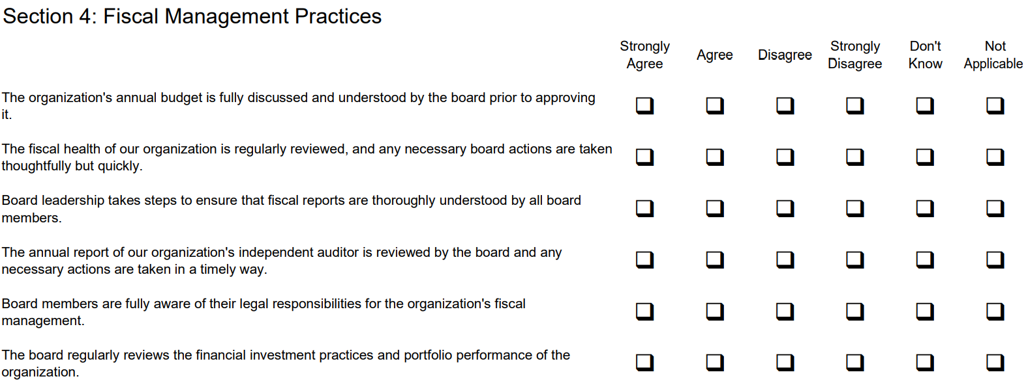
self-Assessment Tool Example
ASSESS CURRENT
FINANCIAL KNOWLEDGE
Source: New Hampshire Center for Nonprofits Board Self Assessment Questionnaire;
https://www.nhnonprofits.org/sites/default/files/attachments/2022-08/SampleQuestionnaire2022.pdf
Notes:
First, the assessment: The goal is to determine where your Board coming from, in terms of their financial knowledge.
If you are a checklist person like me, and you’d like to use a tool to assess your Board’s current financial knowledge, here is one example we quickly found with a basic internet search. If you’d like to look at the full assessment tool, there’s a link on our resource slide, but I highly recommend doing your own research to find a tool that works best for you - there are many others out there to choose from or customize. Using something like this will give you a starting point for what to focus on first when building up your board’s financial literacy.
For example, if you get a lot of answers in the “Don’t Know” column, that’s a great jumping off point for training opportunities.
[NOTE: Self-Assessment Questionnaire linked on the Resources slide at the end of the deck, which you can download from the Related Content widget!]
Link to resource; https://www.nhnonprofits.org/sites/default/files/attachments/2022-08/SampleQuestionnaire2022.pdf

Slide 14
Training topics
PROVIDE EDUCATION SESSION OR CHEAT SHEET
BOARD FINANCIAL RESPONSIBILITIES
ACCOUNTING & REPORTING 101
Clarify fiduciary duties
Focus on financial oversight, not day-to-day management
Define key terms in simple language
Explain cash vs. accrual accounting
Walk through the purpose of each financial statement
MONTHLY PROCESSES
POTENTIAL RED FLAGS
Describe steps that ensure accuracy
Outline the month‑end close process
Discuss patterns that may signal issues
Help board members understand which questions to ask when something looks off
Notes:
Once you’ve determined what areas you’d like to focus on based on the assessment results, you can begin providing training sessions, whether you conduct these yourself or bring in a 3rd party. You may want to add some of this to your Board meeting agenda (perhaps in small chunks) or set up a separate meeting for training. And try to keep it engaging so everyone gets the most out of it!
Based on your assessment, you should be able to tailor the training for your Board but here are some common topics that might be helpful based on trainings that we’ve provided to some of our clients’ Boards.
[CLICK] Board financial responsibilities: What are the board’s responsibilities? What are their duties related to finance?
[CLICK] Accounting and reporting 101: This could include topics like:
Cash vs accrual accounting – what are the differences and how are your financials presented?
This might include discussing how multi-year pledges are reflected in the financials? If you receive this type of funding, you probably know, this is one of the most confusing things about nonprofit accounting.
How about defining key terms: Accountants typically throw around terms like assets, liabilities, net assets, receivables, payables, but a non-accountant might not be so comfortable with these terms, so that could be another useful training topic.
You may also focus on the purpose of each financial statement that’s being presented. What does it show? How is each statement related to the others in the reporting package? And what should Board members be looking for?
[CLICK] How about walking the Board through the steps that are taken monthly to ensure financial statement accuracy (like reconciliations)? We accountants often call this the month-end close. You can proactively share this information with your board. This is something that they might be wondering about but might not know HOW to ask.
[CLICK] Finally, what are the red flags your Board should look out for? I think this is an area that makes Board members very nervous – They may be wondering, “Will I miss a potential red flag?”… so help them out with some examples of what to look for.
If you’d like to learn more about Board responsibilities, accounting and reporting 101 for Boards, and potential red flags, please checkout YPTC’s past webinars for great content on all these topics. "Financial Reports Challenge" from Jan 2025
"Spotting Financial Risks in Nonprofits" from Feb 2025
"Tides of Transparency" from August 2024
Are great ones to start with

Slide 15
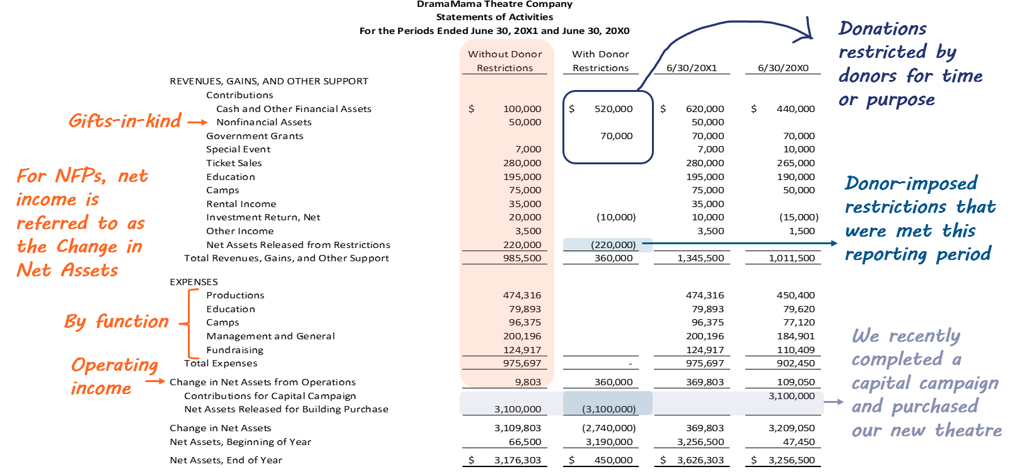
CHEAT SHEET Example
Notes:
So, what about the cheat sheet that I mentioned?
Training sessions are perhaps the most obvious way to educate your Board on financials. But, another way is to provide them with annotated financial statements creating cheat sheets to help explain key terms. You can use the cheat sheets to supplement your training sessions.
This is an example of one such cheat sheet – and this is a theater company, not a foundation, but you get the idea. Here we are highlighting common areas where we often experience confusion or lots of questions from Boards. The orange text and orange highlight are calling out the information related to current operations and net income by helping to define Change in Net Assets and operating income. The dark blue circle is helping explain donations with restrictions, the lighter blue text and highlight is explaining releases from restrictions, and the grey highlight and text is helping to explain what’s going on with the capital campaign.
As you can imagine, a tool like this can help your Board feel more comfortable with the statements. It can proactively answer some basic questions that might go unasked – Like what is meant by the “change in net assets?” Once some of these basic questions are out of the way, your Board can ask better questions, like what do we need to do to keep contributions coming in now that our capital campaign is complete?
Once your cheat sheet is developed, you could consider adding it to your Board Orientation materials so board members can refer back to it during meetings until they get more familiar with your financial statements.
[just a note to presenter - This is a snip of the original, to make changes to this slide, use the hidden slide at the end of this presentation.]

Slide 16
Board orientation checklist EXAMPLE
Mission, history, values
Organizing documents
Board member expectations
Bios, board listings, and committee listings
CONTINUE THROUGH BOARD ORIENTATION
Key policies
Recent financial reports and donor list/key funders
Calendar of meetings for the year ahead
Adapted from: National Council of Nonprofits, https://www.councilofnonprofits.org/
Notes:
Speaking of Board orientations. This is an example of things to include in your board orientation from the National Council of Nonprofits. I’ve consolidated some things for this presentation, but the full checklist is linked on the resource slide.
There’s a lot listed here, but I want to focus on a few things:
1. Setting Board member expectations – The board orientation materials is a great place to document those expectations. You may list your give/get fundraising requirement here if you have one, as well as expectations about promoting the organization and attendance at Board meetings and even at other events that the org holds (fundraisers, etc.). Having Board member job descriptions is a great way to help set expectation clearly, and to help board members understand that their role really is a job to be taken seriously.
2. I’ll also highlight the point about recent financial reports. This is where you could add the cheat sheets and other financial management training materials we’ve been discussing to help members better understand the reports.
Many organizations used to have physical binders for Board orientation, but in today’s more remote and tech savvy environment, you might consider making it a PowerPoint deck or use an online board management platform to help organize and share information.

Slide 17
BOARD TECH ESSENTIALS
TECH TOOLS FOR EFFECTIVE GOVERNANCE
Leverage tools to streamline processes, boost collaboration, and drive more effective governance.
Meeting scheduling: integrated calendar and RSVP tracking
Secure document access: board packets, bylaws, and policies in one place
Minutes & voting: digital tools for recording and approvals
Cost transparency: clear pricing and budget alignment
Mobile-friendly access: easy use on tablets and phones
Compliance features: audit trails and secure storage
Collaboration tools: discussion boards and task tracking
Examples: BoardEffect, Boardable, OnBoard
Notes:
Anyone using a board management platform?
When considering an online board management platform to help you organize and communicate with your board, you want to find software that can provide a workspace for board members, chief executives, and other professionals in charge, to stay organized, make timely decisions, and plan progress in a cohesive manner.
Technology can make or break board engagement. Essentials include scheduling tools with RSVP tracking, secure document access for board packets and policies, and digital voting and minutes.
Cost transparency is critical—leaders want to know the investment upfront. These platforms range in price but typically have an initial implementation cost and an ongoing fee.
Mobile-friendly platforms ensure accessibility for busy board members.
Compliance features like audit trails protect your organization, and collaboration tools keep committees on track.
There are numerous platforms out there, like BoardEffect, Boardable, and OnBoard. Do your research to find the one that best meets your organization’s needs.

Slide 18
Internal controls
Document controls in a policies & procedures manual
Review and update annually
PROVIDE REVIEW OF P&P MANUALS AND INTERNAL CONTROLS
Provide to Board for approval annually
Notes:
And lastly in our section about educating your Board, as a part of their fiduciary responsibilities, the Board is responsible for safeguarding the assets of the organization and providing proper financial oversight. So, help them to understand how the organization’s assets are protected. Tell them about your internal controls. Hopefully those are already documented in your P&P manual AND the manual is up-to-date and reviewed/updated at least annually.
Have the Board review your P&P annually. And I know what you are thinking… seriously, my board does not want to read the 50+ page P&P manual every year!
I hear you! But, don’t think of it as reading a manual and then providing a rubber stamp of approval vote. This could be an opportunity for the finance team to attend a Board meeting to discuss what has changed since the prior year. (side note, you could use AI to help identify the changes from one year to the next more easily!)
Going one step further, you can use this as an opportunity to provide space on an annual basis to make Board members comfortable asking about internal controls. Let them consider and talk about “what could go wrong?” and help them understand what controls the organization has in place to prevent or detect those things.

Slide 19
POLL QUESTION 2
How are you educating Board members on fiscal responsibilities and understanding key financial information?
New board member orientation
Financial training
Cheat sheets
Reviewing policies & procedures
Some or all of the above
None of the above
N/A
Notes:
I’m curious about our audience - How are you educating your Board members on fiscal responsibilities and understanding key financial information?
*Doing New Board member orientation
*Financial training for your Board
*Providing cheat sheets
*Reviewing your P&P
*Some of or all of the above
*None of the above

Slide 20
FINANCIAL STORYTELLING
Identifying key financial messages
Notes:
We’ve talked about educating the Board. Next, we are going to dive into how to tell the story. Through education and experience, board members will become more comfortable with interpreting financial statements. However, it is our role as finance professionals to meet Board members where they are. We have to ensure we communicate the most important financial information that is useful for the board to understand the financial picture and make effective decisions.
Sometimes accountants close the books, create the reports, and then feel like their job is done. Most often it’s due to a lack of time at the end of the month, we are rushing to get all the numbers in the system, reconciled and the reports completed, then the analysis, interpretation, and story telling portion can get forgotten. In order to empower the organizations management, leadership, and board to effectively run the organization, it is imperative that the finance team analyzes the numbers, pulls out the key information and then delivers the financial story to the Board along with the reports.
And especially in the age of AI and automation, finance teams roles need to focus on streamlining the bookkeeping and reporting, so that you can spend more time analyzing and interpreting the story behind the numbers.

Slide 21
Storytelling
What is the STORY behind the numbers?
Test results
Mechanic
Financials
Accountant
Doctor
Car engine
To a non-accountant, the story may not be readily accessible or apparent
Notes:
Accountants specialize in reading the numbers, like a doctor can read and interpret a medical test result or a mechanic can understand what’s going on under the hood of a car. I know that I do not know what is wrong with my car when the engine light goes on. I need a mechanic to run a diagnostic, interpret the code, and then tell me what needs to be done. Likewise, when your doctor reads you a test result, they don’t just read the lab report word for word, they give you interpretation. They tell you what you need to know – what’s important. What is actionable.
This is exactly what the Board and the organizations management need from the finance department.
To a non-accountant the story in the financials may be difficult or impossible to interpret.
It’s the finance team’s job to tell the organization’s story in such a way that the user, whatever their background, will get it. Think about how a newpaper reporter tells a story. They use headlines, pictures, and graphs. They pull the reader in, grab their attention, and get their message across.

Slide 22
How to Tell the Story
What info is important to our audience?
What can we measure?
How do we draw attention to what’s important?
How can we evaluate performance?
Notes:
So how does the finance team do that?
We start with determining what we can measure. That might be data in the accounting system or another system (grants management system for example). It might mean looking back a few more years than we normally do to look at long-term data trends.
We also should be asking – How do we best evaluate performance? What’s our target? Are we comparing against a budget or a past year? Are we comparing our cash balance to a target number or do we have other programmatic targets? This is a great conversation to have with the board during annual budgeting season or even during a 5 year strategic planning session. What are the goals of the organization and what financial measures can be tracked along the way to evaluate how the organization is progressing toward its goals.
Then, What’s important to the audience (in our case, the Board) and what are we (the Finance Director/team) trying to make sure the board sees?
And, lastly, How do we draw attention to the right questions and start a conversation with the Board? I’ll say this a few times during the session. The goal of the board meeting should be to ensure the board members know the issues at hand quickly, so they can have productive conversation and discussion about action items and next steps.
Based on all of this, you might be thinking, well that would mean I have to prepare a different package for each board meeting if I have a different story I’m trying to tell one month vs. the next. And YOU’RE RIGHT! You might not be preparing the exact same package at every board meeting. Parts of it might vary depending on what story you want OR need to tell. Far too often, the finance team gets stuck in a rut using the same package to present the financial information. But the information doesn’t stay the same, so a static package doesn’t draw your attention to anything specific. Don’t get me wrong, we’re not saying consistency is a bad thing, it just shouldn’t be the ONLY thing the board sees each meeting.

Slide 23
CATER TO YOUR AUDIENCE
DIFFERENT STAKEHOLDERS, DIFFERENT EXPECTATIONS
DEPARTMENT HEADS
EXECUTIVE DIRECTOR
FINANCE COMMITTEE
BOARD MEMBERS
Use financial data to inform day-to-day management and strategic decisions, so need detailed info
Relies on clear financial messaging to communicate strategy with staff, board, and external stakeholders
Seeks in-depth analysis and technical details for oversight and compliance
Benefits from summarized,
big-picture financial presentations with context and narrative explanation
Notes:
I am going to take a quick detour to talk about catering reporting to your audience. As I said a few minutes ago, financial packages are not one-size-fits-all for every organization, not for every time period and they are likely not one-size-fits-all for everyone within the organization.
Today, we are focused on presenting to the Board, but your finance team might be presenting to each of these stakeholders and they may choose a different presentation style when presenting to each of these audiences. More detail WILL be required when you are presenting financial information to Click department heads, Click the ED, or Click even the Finance Committee.
But what should be considered when choosing a presentation style for your BOARD? Click Click
Think Summarized
Big Picture focused
Include context and narrative explanations

Slide 24
Choose Your Presentation method
Financial statement memo
Condensed financial statement
Static visualization
Dynamic visualization
Keep it simple
Highlight only key lines
Direct the reader
Executive‑summary style
Clear narrative
No jargon
Visual, not text‑heavy
Highlight key insights
Use explanatory headlines
Interactive
Real‑time or refreshable data
Drill‑down capability
Notes:
Again, our goal is that the Board is spending less time trying to figure out the message and more time discussing the key issues found in the financials. We want an engaged board who knows that valuable discussions happen at the board meetings, so they shouldn’t miss a meeting. So let’s serve up their data in a way that makes that message quickly apparent.
Here are some ideas and we will look at examples soon.
Condensed financial statements. Summarize the categories you present to the Board to what’s important. Keep it simple. Less is more! Consider using things like highlights, boldface and underlines to direct the reader but don’t go overboard with color.
One page memo. Anticipate questions and address them proactively. For example, if one department has revenue that is significantly below budget, let the Board know why that happened. Start with your headline or elevator pitch. Make it clear…don’t use a lot of jargon. Write in a way that a non-accountant will understand.
3) Static visualization is another method you could use. AKA a graph. Again, keep it simple so the message speaks for itself. But add a little narrative or a headline to focus the readers’ attention.
4) Dynamic Visualization are useful when your audience would appreciate interactivity. This can also be a way to combine data from various softwares like the accounting system, a donor database, and a grants management system into one interactive dashboard. (Assuming you don’t already have an integrated system!)

Slide 25
KPIS for boards
MEASURING WHAT MATTERS
Clear metrics inform decision-making.
KEY PERFORMANCE INDICATOR (KPI) | WHAT IT MEASURES
Liquidity Ratio
Financial stability
Operating Reserve
Months cash on hand
Program Efficiency
% of expenses spent on mission delivery
Revenue Diversity
Dependency on single funding source
Fundraising ROI
Cost per dollar raised
Board Engagement
Attendance and participation metrics
Scenario Planning Metrics
Stress-test for shifts in revenue & expense
Notes:
Whatever method you choose for your audience, the financial information should still be clearly conveyed. A way to do this is through KPIs (or Key Performance Indicators). Boards need clear metrics to make informed decisions. Let’s cover a few of what these could be. Some of these might resonate more with our community foundation folks than the private foundations, but I’ll have more KPIs on the next slide that are more foundation focused.
Liquidity ratio and operating reserves show financial stability.
Program efficiency tells you how much is going toward mission delivery.
Revenue diversity reduces risk, while fundraising ROI measures cost-effectiveness.
Don’t overlook board engagement, attendance and participation matter.
Finally, scenario planning metrics help boards prepare for unexpected changes. For more on scenario planning, check out our webinar “Scenario Planning for Nonprofits” on our Website Resources
These KPIs provide a dashboard for governance and strategic oversight.

Slide 26
KPIS FOR BOARDS
FOUNDATION-SPECIFIC KPIS
Liquidity | Investments | Grant Commitments | Programmatic | Impact
Cash available for near-term payments | Return vs policy benchmark | Grants committed vs paid | Grants awarded by strategy and/or geography | Impact data from grantees by strategy area
Percentage of assets in illiquid investments | Investment asset mix vs policy statement | Grants payable commitments by year | Average time from grant approval to payment | Repeat grantee rate vs desired mix
Investment liquidity buckets vs upcoming commitments | Spending rate vs long-term return | Conditional grants payable by year | Average grant size and number of grants | Co-funding ratio (if tracked)
Notes:
Here are some foundation specific KPIs to consider. Now, we don't want to use every single one. That could be an overwhelming amount of information. You could choose what resonates with your foundation and helps to tell your story.
For example, if you are interested in invested more into your community – you may look at spending rate vs long-term return to analyze if you've been perhaps very conservative in setting your spending rate. You may also be interested in seeing grants awards by strategy area.
Another foundation that makes a lot of multi-year gifts and conditional gifts may be more focused on seeing those commitments by year and also keeping an eye on Investments by their liquidity – for example, what will be available next year and the following year and how much have we already commited for those years.

Slide 27
POLL QUESTION 3
Does your board regularly review mission-specific KPIs?
Yes, every meeting
Occasionally
Rarely
Not yet, but interested
N/A
Notes:
That leads us to our next poll questions.
Does your board regularly review mission-specific KPIs?

Slide 28
CASE STUDIES
Effectively communicating financial information to engage your Board
Notes:
So we threw a lot of theory at you, but what might this actually look like? Let’s go through some case studies –
So imagine some real life board members that you know. The ones that don’t have a finance background. We are going to walk through some of their pain points, see what they were receiving before, and how we used some of the concepts we just went over to make the information easier for them to understand and act upon.

Slide 29
Case Study #1
“At every Board meeting, I’m given several spreadsheets with lots of small numbers. I keep my head down and nod along, but I really don’t know what I should be looking at. In the end, I trust that my finance team knows what they are doing, and I don’t ask any questions.”
– Board Member
Notes:
Board member – My first issue is that at every board meeting, I’m given several spreadsheets with lots of TINY numbers. I keep my head down and nod along, but I really don’t know what I should be focusing on. In the end, I just trust that the finance team knows what they are doing, and I don’t ask any questions.
Certainly we want to prevent someone feeling like they don’t know what is going on and aren’t asking questions.
So let’s see what they are talking about (next slide)

Slide 30
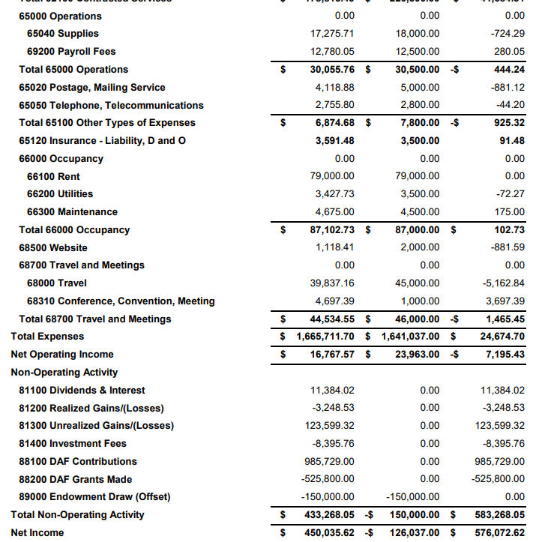
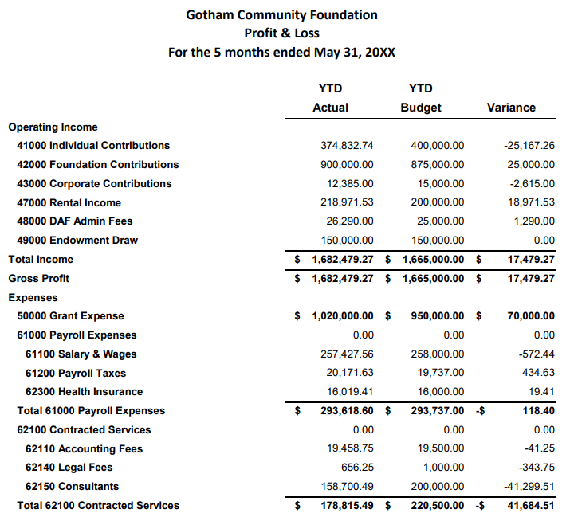
Old Presentation
Notes:
Here, we can see what they mean! A bunch of tiny numbers! You really need to get your glasses out for this one. For most readers, they can hardly see the numbers much less understand what they’re SUPPOSED to FOCUS on.
And as an accountant myself, I can see that this is basically straight out of the accounting system, QuickBooks in this case. Every GL account is included and every number is shown to the penny. It’s hard to see the forest through the trees. And I can tell the finance team really wanted this to fit on one page and it’s ended up so small that we can barely make out the numbers.
When we present to the Board, we want to “Keep it Simple,” “Direct the Reader” and “Add Explanation.” This does none of those.
Let me show you a condensed version of this information.

Slide 31
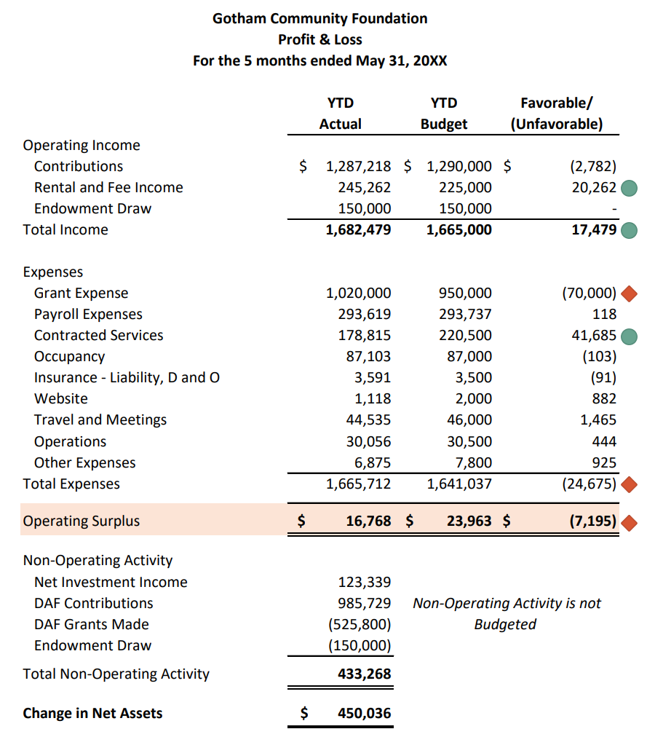
New Presentation
Variances >$5,000
Favorable
Unfavorable
Notes:
Here is the exact same information, and this presentation isn’t groundbreaking. It only took a few minutes to take the other data and simplify it. One obvious difference is grouping the accounts into summary categories and removing the account numbers and the pennies which are just “noise” for Board members.
Also note that we changed the heading on the variance column to favorable and unfavorable. I’ve learned that many Board members and really even “financial people” have trouble honing in on what variances are good and bad, so changing our labeling can save them some time in trying to figure that out.
We’ve also added conditional formatting in Excel to show an icon next to variances over $5,000, either positive or negative. Now, it should be easier to see that rental and fee income is coming in better than budget (green circle), which is pushing the total Income to be better as well. On the Expenses, Grant expense is spending higher than budget (red diamond shape), but here is also positive news in the savings from Contracted Services (green circle). All in all, expenses are still higher than budget and the operating surplus is worse but by a smaller amount.
We’ve also directed the reader by isolated the non-operating activity like investment income and DAF activity to the bottom.
This presentation helps to “keep it simple” and “direct the reader” but it still doesn’t tell the whole story… it doesn’t “add explanation.” This format should be an improvement over the previous one because it helps a Board member to know what questions to ask…”WHY” is a certain item up or down.
Just a note to be careful when using red and green….do you know if any of your Board members are color blind? If they are, red and green could look the same to them. In this case, we’ve made the shape slightly different for the favorable and unfavorable variances. We could also include a key to define these icons as well. [CLICK]
Next slide--

Slide 32
Case Study #2
“I am not a numbers person. I tend to zone out when someone asks me to focus on so much detail. I wish someone could just tell me what I need to know. And please no jargon.”
– Board Member
Notes:
Back to our board member – picture them in your head saying - I’m NOT a numbers person. I tend to zone out when someone asks me to focus on so much detail. I wish someone could just tell me what I need to know. And can you NOT use any of that crazy accounting jargon??

Slide 33
OLD Presentation
Variances >$5,000
Favorable
Unfavorable
Notes:
So we hear them – and I agree. They should have the information that they need “served up” in a way that it easy for them to engage.
So, let’s look at the same revised report we were just discussing.
While this report answers the “what is happening” question, it doesn’t address the “why is it happening” question.
Finance teams can get ahead of board and management questions by providing a memo and interpretation along with the financial package. We’ve created one for us to look at together.

Slide 34
New Presentation
EXECUTIVE SUMMARY
Five months into the year, our operating surplus of $17K fell slightly short of plan due to intentionally higher grantmaking, while non-operating activity like strong investment returns and DAF activity led to a solid increase in net assets.
FINANCIAL HIGHLIGHTS
Grant expense exceeded budget by $70K as we approved additional grants earlier than planned to respond to heightened demand from local organizations. This was partially offset by $42K in savings on contractors, by delaying several planned engagements until the summer.
Interest has surged for our coworking space, resulting in rental income exceeding budget by $19K. We expect this to continue through the year.
FINANCE UPDATE
We have applied for a $20K grant to help defray costs of upgrading to a new donor management platform. We will find out in July whether our application was accepted.
Notes:
By adding a memo, using an Executive Summary and Financial Highlights, we can interpret the major events and reasons for variances ahead of the Board meeting. This way the meeting can move from a Q&A session to a valuable discussion on action items.
READ HIGHLIGHTS
Additionally. This is a great place to add status updates about things that don’t even show up on the financials. Here there is an update about a new funding opportunity. The revenue isn’t shown on the financials yet, but the Board may be interested to hear the status.
We know this board member is not a numbers person, and likely many on the board are not. So providing a memo like this, using as much plain language as possible should help to answer “WHY”

Slide 35
Case Study #3
“The Board is made up of people from our community, and that’s very intentional. We’re here because we understand what’s happening on the ground and who the foundation is meant to serve. When we’re handed pages of spreadsheets, I fear the message is getting lost, and we are unintentionally leaving some board members out of the discussion.”
– Board Member
Notes:
Now, the last examples were from a community foundation. Now, let’s imagine this board member, also serves on the board of an independent private foundation. They are concerned that their board is intentionally recruiting board members who represent the community they serve. When they are handed pages of spreadsheets there’s a real worry that the message is getting lost and is even unintentionally leaving some board members out of the discussion. Let me show you another example.

Slide 36
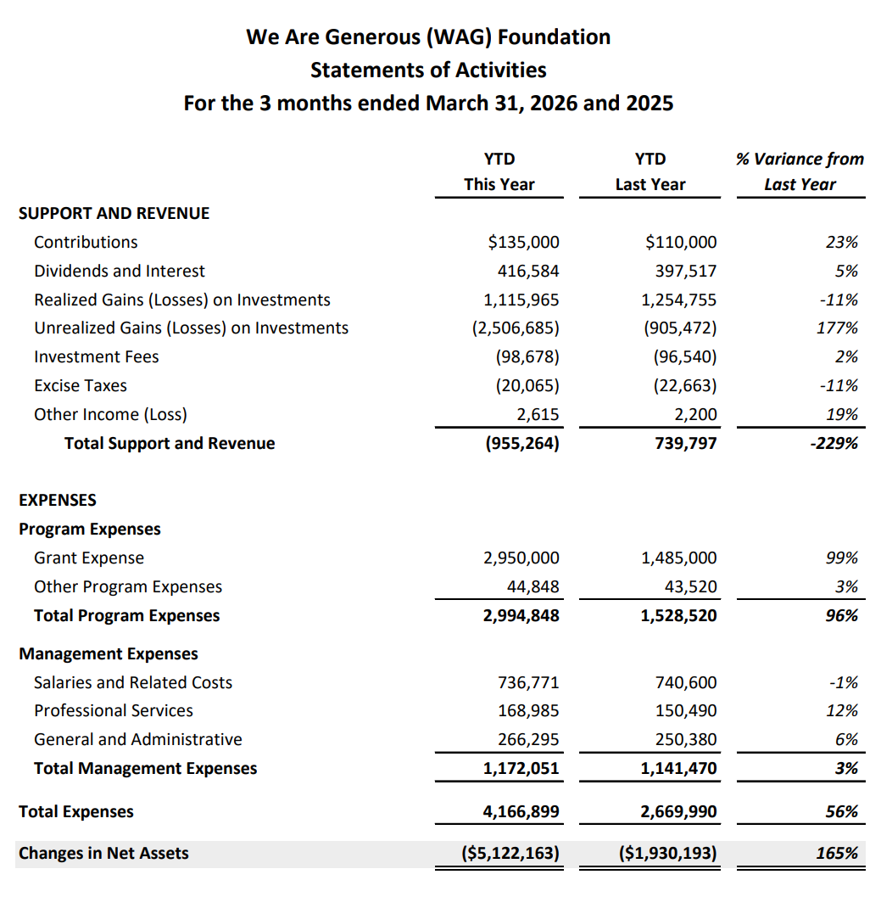
Old Presentation
Notes:
Now this presentation looks very simple but it’s not doing a good job at directing the reader. And this percentage method is really misleading. If you look at the largest variance, it’s the unrealized loss. And that might grab a board members attention and really monopolize the conversation. And yes, it’s important to keep an eye on investment performance but often that’s a smaller group of people, like an investment committee, and it’s not uncommon to have large swings in market value over short periods. By focusing on that, which LOOKS like a big alarming number, you can miss some of the other, let’s say more “controllable” activity. I also think it’s confusing when a foundation includes their investment income in the “top section” of their revenue. I would recommend isolating that below the line like in our previous example.
What I see is the REAL story here is that overall expenses are up $1.5M from last year and that’s mainly because grant exps are $1.5M higher than last year. That’s where I have a lot of questions.
We could add another memo, but instead, let me show you a presentation that I think will help visually illustrate one of our biggest points…
Let’s look at this data another way.

Slide 37
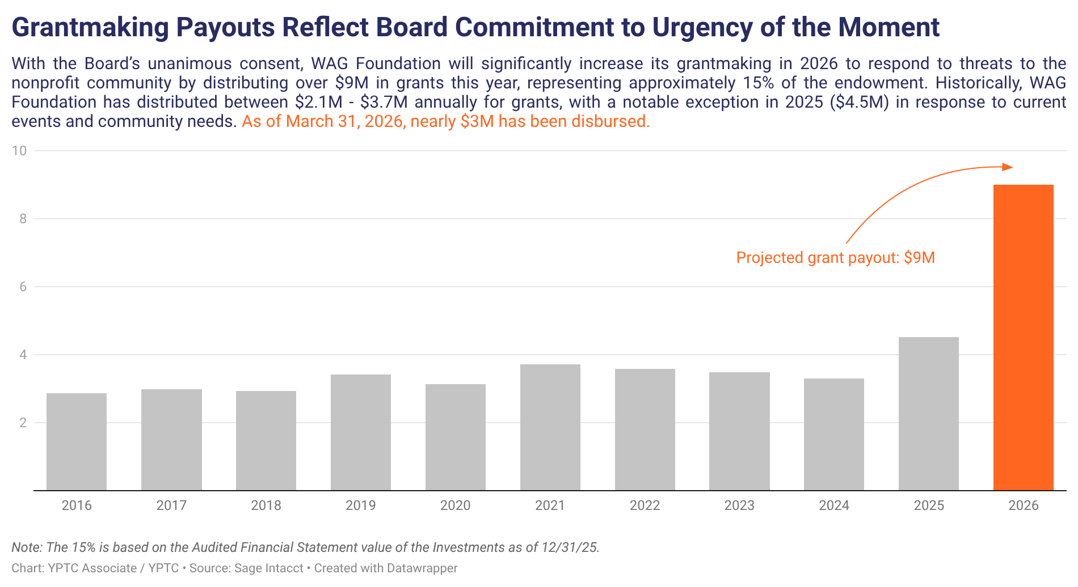
New Presentation
Notes:
Here, we’ve stripped out the detail and are just focusing on grant expenses, and in this case, it was really helpful to have a long time horizon to really SEE the picture. Now, we aren’t hiding information from the board. We should still present financial reports in the board packet.
But having a graphic like this, makes it more clear that grantmaking is significanly above budget, and that was intentional. And, we expect that to continue this year.
This brief narrative tells you that story… READ … So our grantmaking is already really high this year, and that will continue, but we, as a foundation, made the choice to spend down some of our accumulated surpluses from past years.
Using a graphic like this really helps draw the readers’ attention to what’s most important. Now, this might raise some other questions, like ‘do we have enough cash for this plan’
And this is created using a tool called Datawrapper

Slide 38
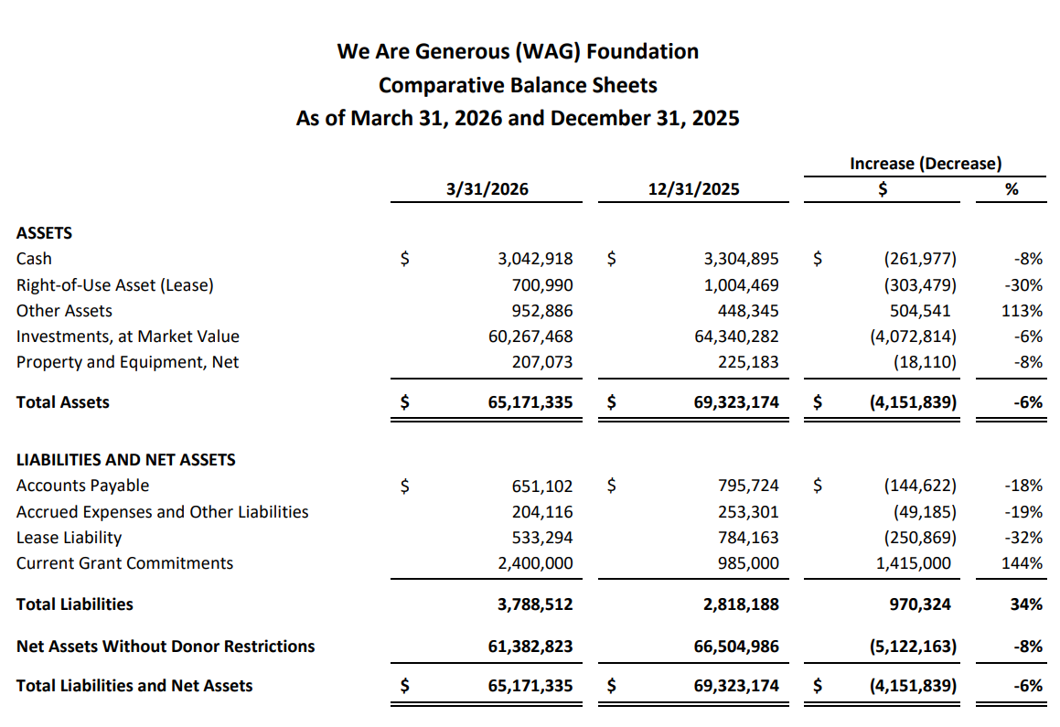
Old Presentation
Notes:
So let’s look at a balance sheet. We can see that cash is down and we have $60M in investments (those happen to be down). The board might vaguely know how the portfolio is invested. But do we have enough cash or access to cash for this ambitious grantmaking plan?
This is an example of a standard balance sheet/statement of financial position that you might see at a foundation. It’s condensed, so that makes it easier to read, at least you can focus in on the increases and decreases of the balances, but what’s the story here? What should the Board be focused on? There’s no added explanation.
Also, tying this into our last slide, how are we going to make another $6M in grants with $3M cash. Again, we can do this all in a narrative, but let’s SHOW them how it’s possible…

Slide 39
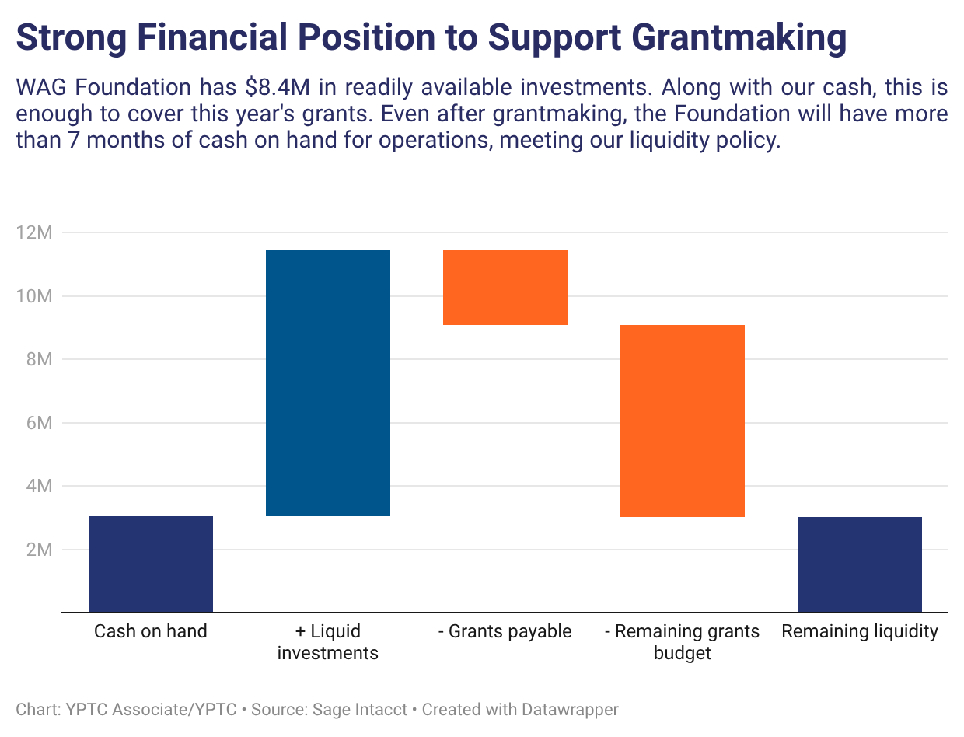
New Presentation
Notes:
Now, here is a story to SHOW how the foundation will cover the cost.
Notice the narrative at the top that explains exactly what is happening. [READ whole thing above.]
This graph visually provides the information to answer a question that we anticipated. With that made clear, the board might have other questions – perhaps about our liquidity policy? How much is our goal for cash on hand? Is that still sufficient? What kind of practices should we consider for next year? Providing clear information can get an important strategic discussion started. A discussion that might not happen if the board only saw the balance sheet?

Slide 40
Choose Your presentation method Carefully
Communicate your message clearly
Use tools that are within your reach
Call the experts if needed
Notes:
That brings me to me final points about choosing a presentation method. The ultimate goal is to communicate your message clearly.
We’ve just seen some great examples using different tools. Some of these statements can be made in Excel. Others require more complex software like Data Wrapper, PowerBI or other graphic software. Learning PowerBI and similar software is a challenge in itself, so know when to call in the experts if you need that additional oomph to your presentation.

Slide 41
POLL QUESTION 4
What methodology would support your organization the most in conveying the financial message?
Removing the “noise”
Adding a memo with executive highlights
Using graphics and data visualization
All of the above
Notes:
We hope you had as much fun as I did discussing the different ways to present financial information to Boards. To help wrap up our discussion, we have one final poll question for you:
What methodology would support your organization the most in conveying the financial message?
Removing the “noise”, like simplifying the reports at a summary level
Adding a memo with executive highlights
Using graphics and data visualization
All of the above

Slide 42
Key Takeaways
BOARD FINANCIAL LITERACY & OVERSIGHT
Assess current financial knowledge and provide tools like cheat sheets and a board manual
Offer ongoing financial education, starting with orientation
Share key financial policies and procedures
FINANCIAL STORYTELLING
Communicate the financial message clearly
Use tools that align with your capacity
Engage experts when additional support is needed
CASE STUDIES
Apply the presentation method that best fits your board
Tailor complexity to board literacy levels
Reinforce the core financial narrative
Notes:
Let’s wrap up with a few key takeaways.
First, board financial literacy and oversight: make sure your board has the tools and education they need — starting with assessing their financial knowledge and giving them clear resources and ongoing training.
Second, financial storytelling: focus on communicating a clear message, use tools that fit your team’s capacity, and don’t hesitate to bring in support when needed.
And lastly, case studies: choose the presentation method that best fits your board, tailor the complexity to their comfort level, and always reinforce the core financial narrative you want them to walk away with.

Slide 43
Resources
Board responsibilities:
  https://boardsource.org/resources/board-responsibilities-structures-faqs/
Board Self-Assessment Questionnaire:
  https://www.nhnonprofits.org/sites/default/files/attachments/2022-08/SampleQuestionnaire2022.pdf
Financial statement cheat sheet:
  https://blog.boardsource.org/blog/making-financial-statements-less-scary
Financial management resources for Boards:
  https://www.councilofnonprofits.org/tools-resources/financial-management
Board orientation checklist:
  https://www.councilofnonprofits.org/tools-resources/board-orientation
Sample dynamic visualizations:
  https://www.yptc.com/data-visualization/
Notes:
Here are links to some of the great resources we mentioned today!

Slide 44
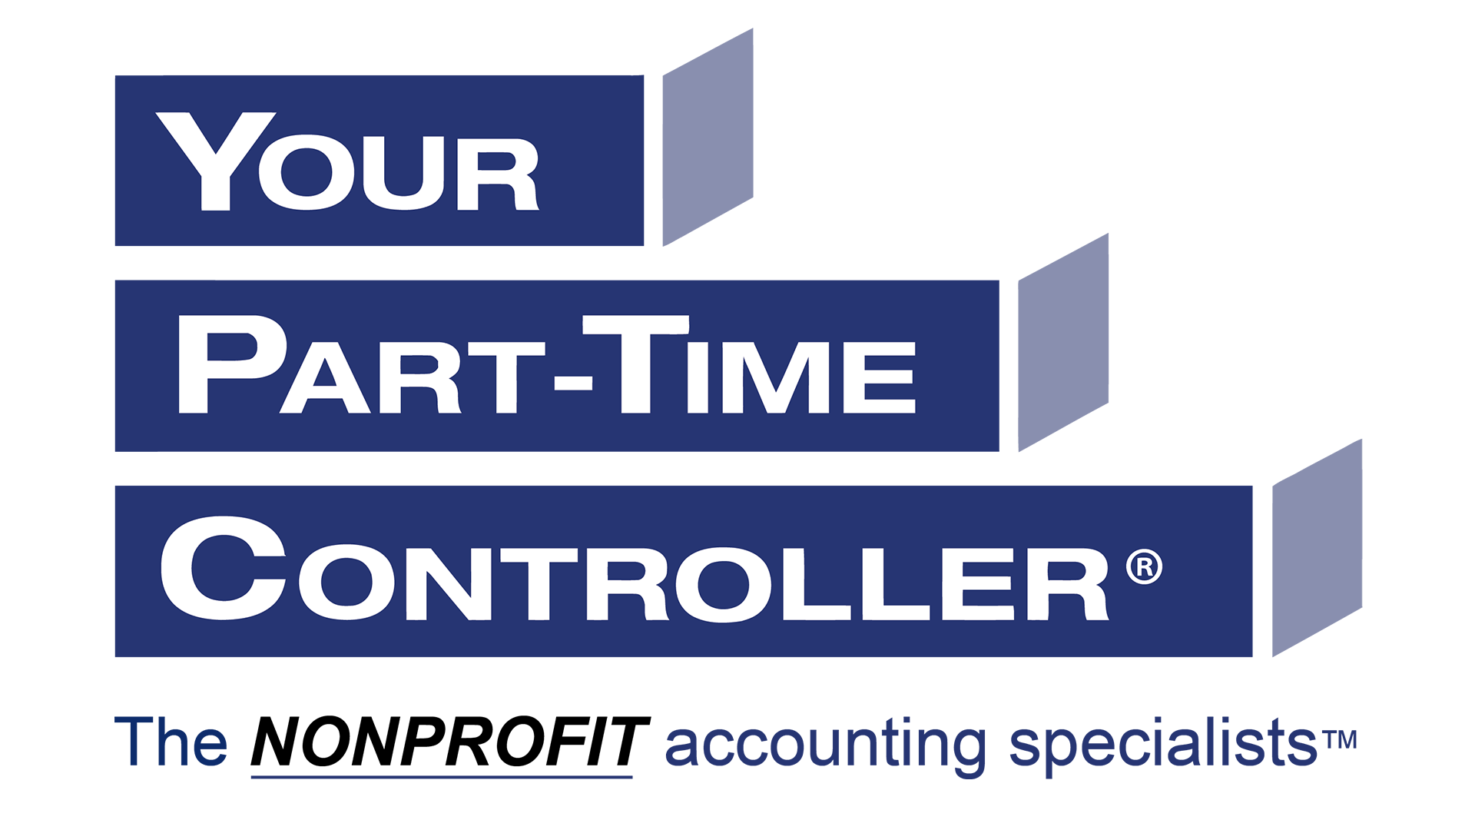
contact us
hello@yptc.com
844.358.4023
www.yptc.com
Notes:
If you’d like to speak with YPTC about how we can help your nonprofit, here’s how to reach us.
Thank you so much for joining us for this webinar.

Slide 45

Let’s Connect on Linkedin!
Rachel DeMatteo
LinkedIn QR Code
Director, New York

Slide 46

Learn More & Connect with Us!
Mike Scoville
Director of Growth and Partnerships
701.320.8561
mike@akoyaGO.com

Slide 47

Key Financial Information for foundation Boards
For: akoyaGO | April 29, 2026
Notes:
This version: 4/27/26 (Foundation specific)
Welcome, and thank you for joining us for today’s webinar: Equipping Your Board for Better Decisions: Key Financial Information for Foundation Boards.
We’d also like to extend a special thank‑you to akoyaGO for inviting us to lead this session.

