Slide 1

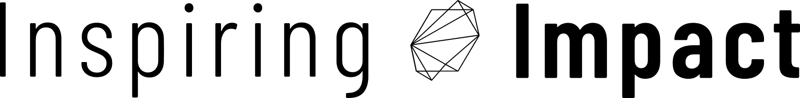
THE POWER OF BUILDING UNRESTRICTED ENDOWMENTS:
UNLOCKING YOUR FOUNDATION'S GREATEST OPPORTUNITY
Webinar by
featuring

Slide 2

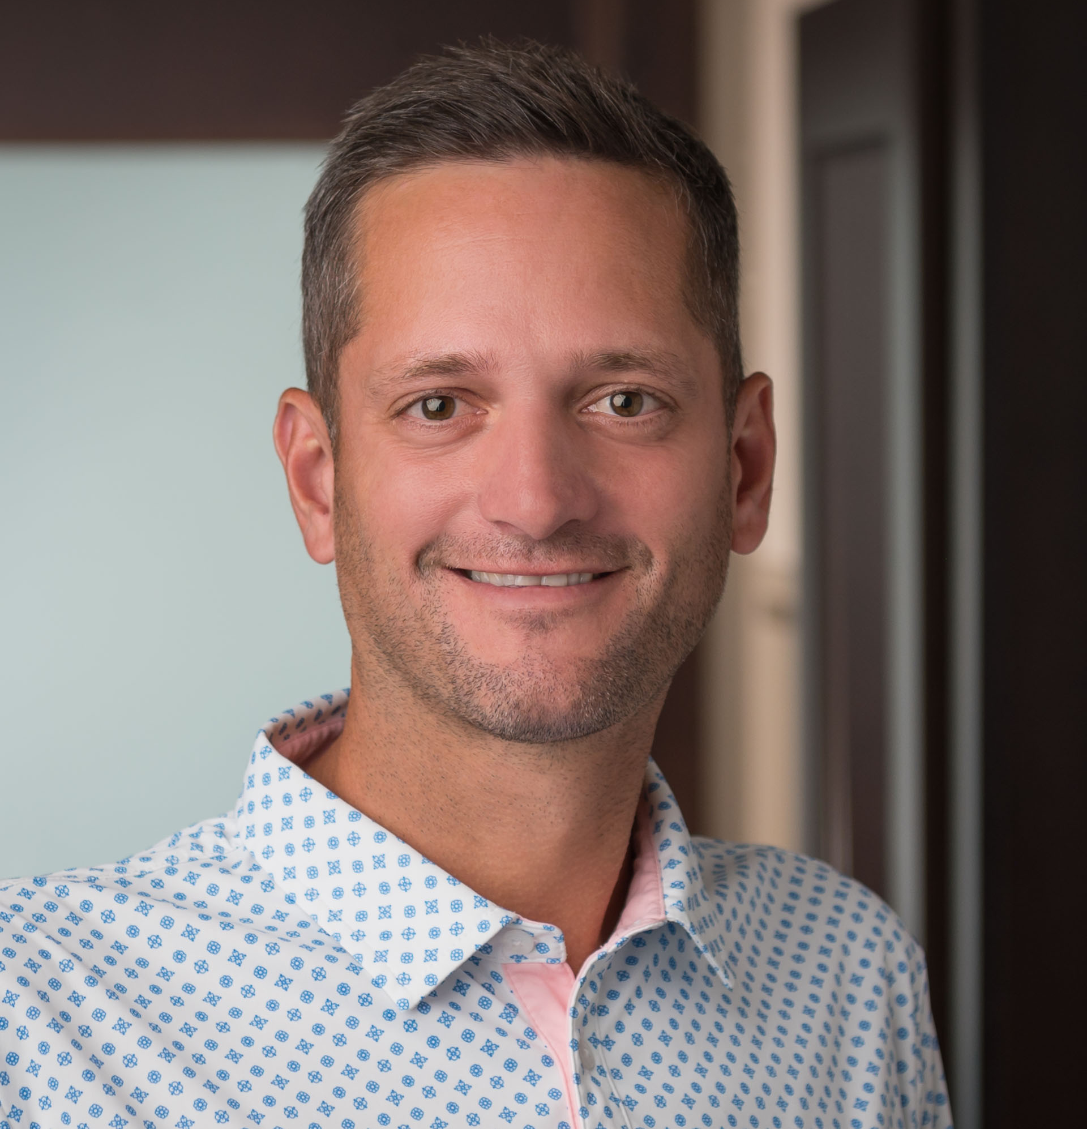
Mike Scoville
Director of Partnerships & Growth

Slide 3
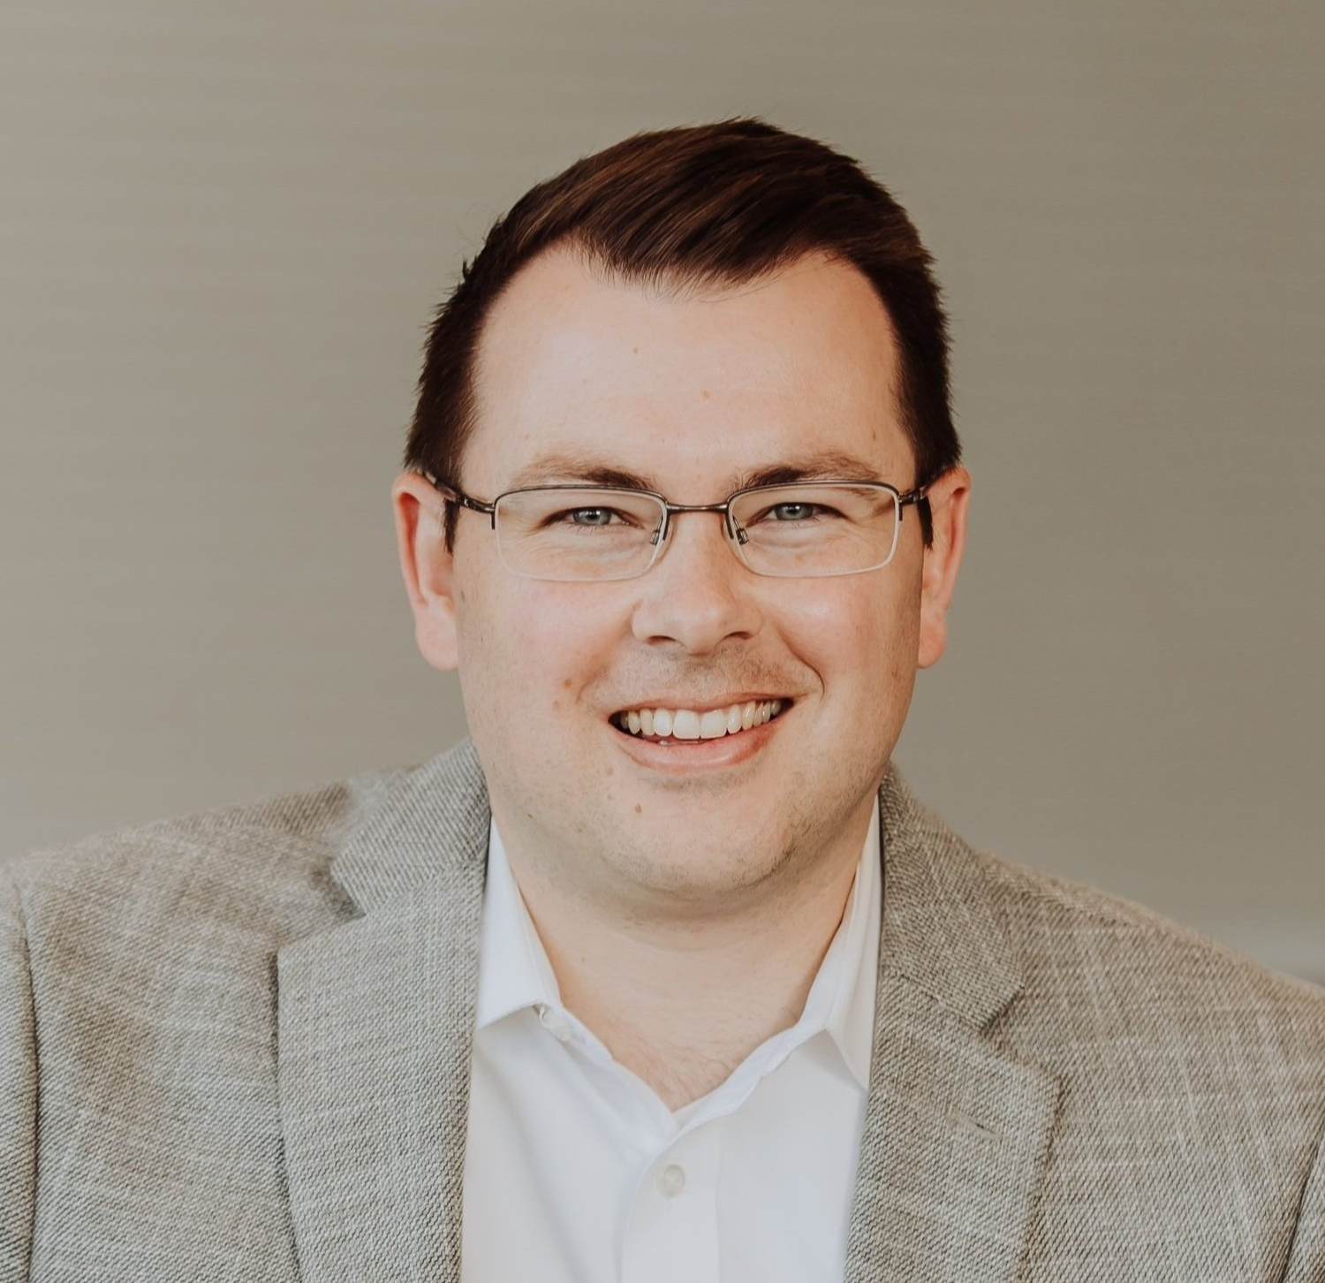
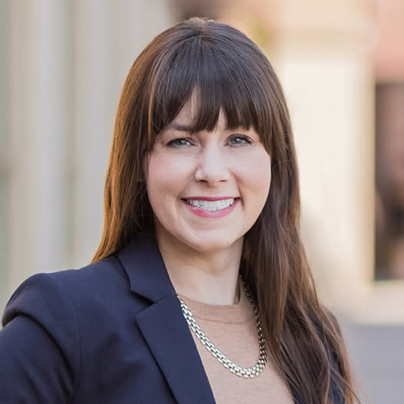
Mike Goorhouse
Founder
Elizabeth Kidd
Consultant

Slide 4
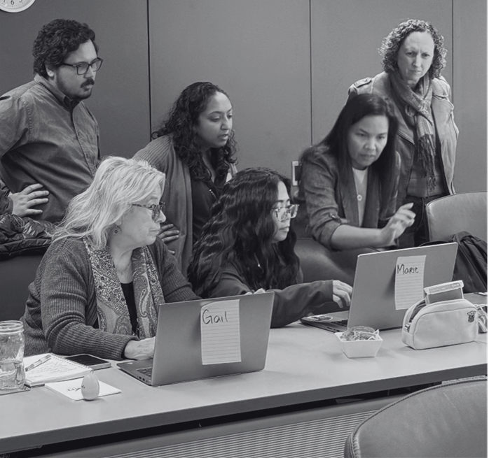
Community Foundation Framework
Community Endowment (Foundation Directed Grantmaking)
We build and manage our community’s permanent philanthropic endowment to ensure that there will always be resources available to respond to needs and opportunities as they arise
Donor Service (Donor Directed Grantmaking)
We provide services to donors to help them achieve their charitable goals
Community Leadership (Non-Grantmaking Activities)
We lead and partner to catalyze transformative community solutions

Slide 5

Community Endowment
Foundation Directed Grantmaking
Talking Points
By giving together, we can do more
We can’t predict the future, but we can prepare for it
You can make a difference today, tomorrow, and forever
If we care about the vitality of all our community beyond our lifetimes, we need to ensure that there are flexible resources available for future generations
There are so many nonprofit organizations in our community that it can be overwhelming to try and figure the best way to give away your money to achieve the greatest impact; our community’s endowment is here to help.
Individually you might not be able to make a $50,000 investment in a new program or initiative but by having an Unrestricted or Field of Impact Fund at the Foundation your resources are combined with others to make these larger grants possible
Fund Types
Unrestricted Funds
Field of Interest Funds

Slide 6
Donor Service
Donor Directed Grantmaking
Talking Points
Helping donor achieve their charitable goals.
Our Philanthropic Services are designed to help you create maximum impact with your charitable gifts.
Our team is here to support your giving so you have confidence your dollars are being used in the most effective way possible.
Fund Types
Donor Advised Funds
Scholarship Funds
Designated Funds
Agency Funds

Slide 7
Community Leadership
Non-Grantmaking Activities
Talking Points
Beyond our grantmaking, the Community Foundation is here to help catalyze, convene and facilitate solutions to community issues that go beyond the scope of one organization.
Incubating new organizations tackling unmet needs
Serving as a backbone for multi-sector collaboratives
Facilitating community-wide planning
Lifting up data and community dashboards

Slide 8
Setting the Stage
for Growing Unrestricted Endowment
Know your numbers
Does this matter enough to your organization to invest the time it takes to do this work well?
Ensure grantmaking strategy is clear and ready to stand the test of increased scrutiny.
Do you believe that giving to unrestricted endowment is a strategic choice for donors? Are you compelling in sharing why you believe that?

Slide 9
Communications Clarity
Gain strong internal clarity on the role of the community’s endowment (unrestricted and field of interest funds) vs donor service funds (donor advised, agency, scholarship and special project funds)
Refine external messaging on the impact of the community’s endowment for a full cycle of communications

Slide 10
Campaign Goal
Today Dollars:
Grow CFHZ’s Community Endowment assets by $5 million during the campaign.
Tomorrow Dollars:
Obtain at least 100 additional bequest commitments to CFHZ’s Community Endowment.

Slide 11
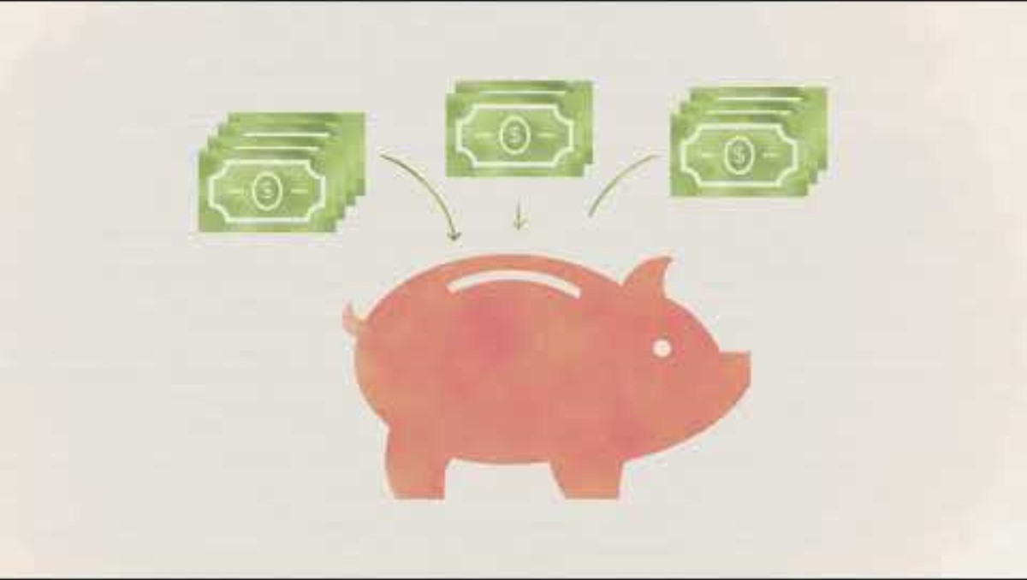
Campaign Video
https://youtu.be/aANO3SS9pQs?si=jfIVhX288Pa4RTzL

Slide 12
Campaign Donation Matching Structure
Today Match:
$1,000,000 matching gift pool provided to match on a 50% basis up to $2,000,000 in donations to CFHZ’s Community Endowment.
Tomorrow Match:
$2,000,000 matching gift pool provided to “match” each commitment of 5% of estate or $50,000 to CFHZ’s Community Endowment with a $20,000 gift to the Community Endowment now.

Slide 13
How to Secure Estate Gift Commitments
The match mattered.
Having an excuse to initiate the conversation, and follow up after the ask, was key.
Face-to-face was our primary strategy.
We did not ask Campaign Committee to ask their peers.
Documentation needed to secure the match – pledge form only. No other “proof”.

Slide 14
Our Best Advice
A campaign is a tool, it's not the only way to grow these kinds of gifts
Campaigns and other targeted efforts can create momentum for unrestricted endowment giving and can solidify new giving patterns that continue beyond the campaign
Invite donors to give to BOTH community endowment and donor service
The planned giving side of these efforts is where the real transformative growth happens... and it's usually slower to be realized

Slide 15
Getting Started
Take a fresh look at your own giving/granting data through the lens of the three part framework...
    Is the split what you expected? Does anything surprise you?
Try out the language of Community Endowment (Foundation Directed) and Donor Service (Donor Directed)
Ask your staff and/or board if they had to choose between a $10 million endowed gift to your Community Endowment (board directed) or a $40 million gift to your Donor Service Funds (donor directed) which would they choose and why?

Slide 16
Q&A

Slide 17
Learn More
Inspiring Impact
Website: inspiring-impact.com
Founder: mgoorhouse@inspiring-impact.com
Consultant: ekidd@inspiring-impact.com
akoyaGO
Website: akoyago.com
Director of Partnerships & Growth: mike@akoyago.com
Marketing Manager: ameliea.dulaney@akoyago.com
Facebook & LinkedIn: akoyaGO

